Slide 1

Notes:
Briefly introduce yourself: Name, current job, chapter you are from, volunteer experience with the Fraternity.
Switch to slide #2

Slide 2
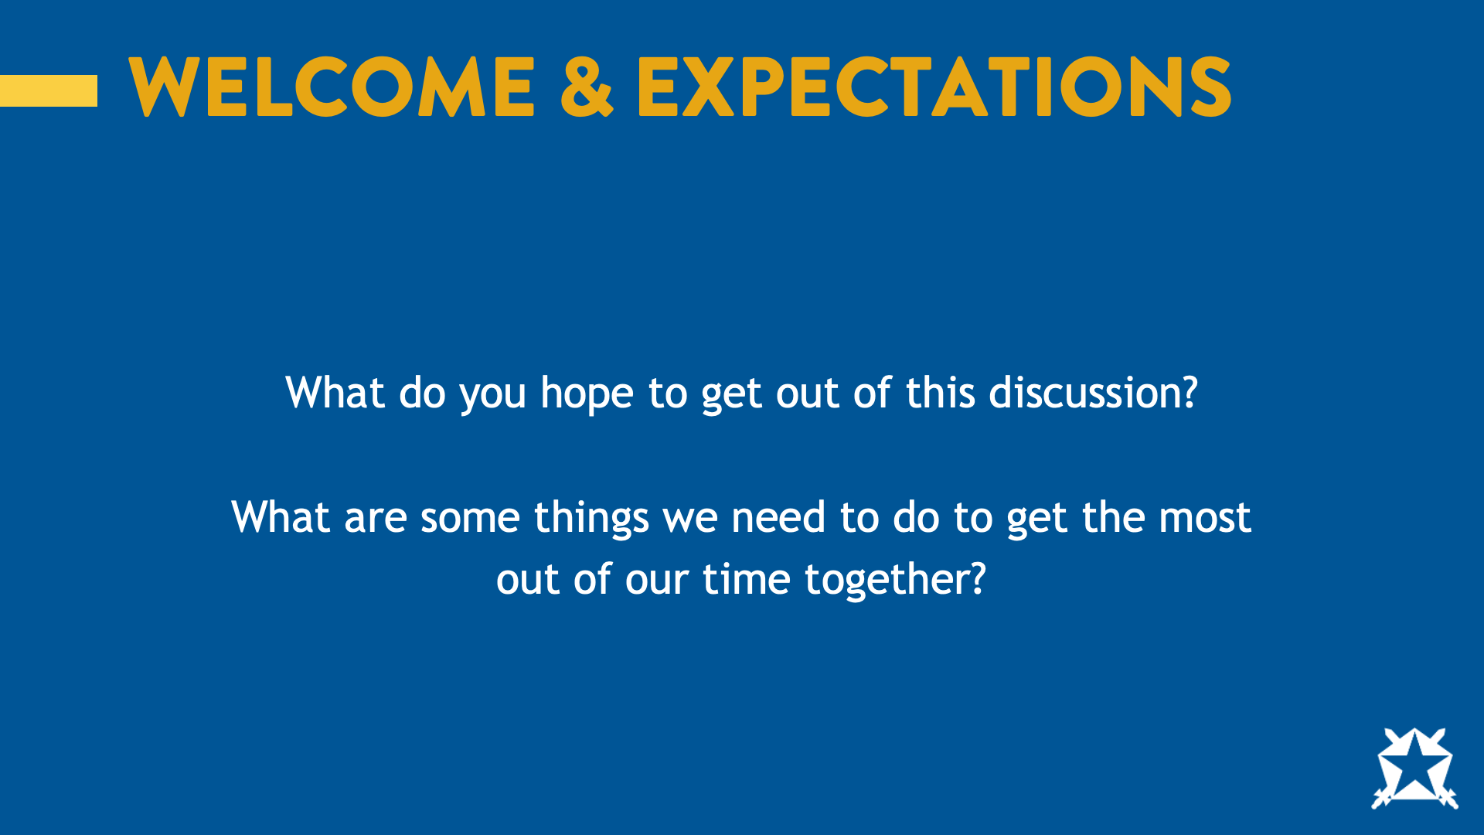
Notes:
Today, we are going to learn about the concept of Ultimate Respect. The goal of this program is that you will not only understand the concept, but that you’ll be prepared to put it into action, not just within the Fraternity but beyond.
Before we start the program, it is important to establish some shared expectations for our time together.
Ask: What do you hope to get out of this discussion?
Ask: What are some things we need to do to get the most out of our time together?
If the group doesn’t mention it, we recommend adding an expectation about active participation. This program is only effective if all participants are willing to engage. As a facilitator, you can insert your expectations for what community you would like to create while presenting. You can always revisit these expectations throughout the program if needed.
Great! Now that we’ve established some expectations, let’s move forward.
Switch to slide #3

Slide 3
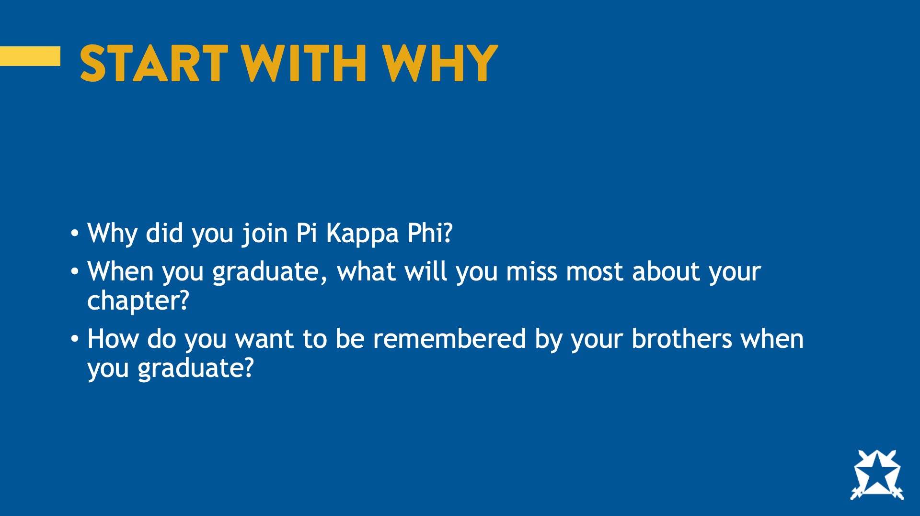
Notes:
To help get participation started, we recommend turning this into an activity. Ask the participants to stand up and find someone to discuss each question with. Ask each question one at a time.
Ask: Why did you join Pi Kappa Phi?
Allow some groups to share.
Ask: When you graduate, what will you miss most about your chapter?
Allow some groups to share.
Ask: How do you want to be remembered by your brothers when you graduate?
Allow some groups to share.
Sum up the responses as you move forward.
Share: Thank you for sharing. There are some common themes in what you shared, and whenever I ask myself these questions, I’m reminded of the Fraternity’s creed.
Switch to slide #4

Slide 4
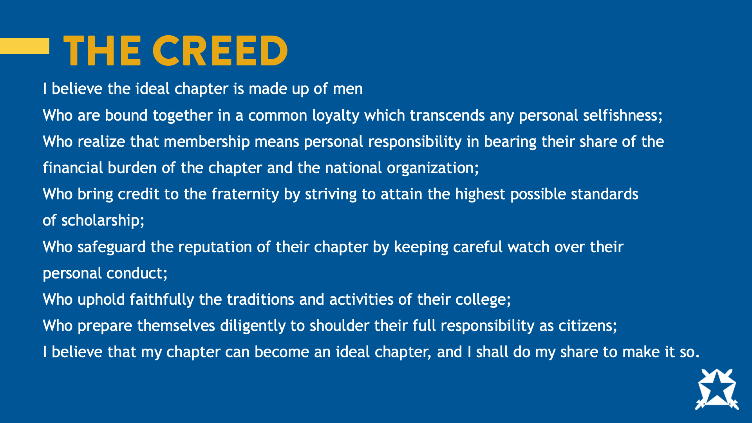
Notes:
Share: I’d like us to read the creed using the popcorn method.
Ask members to popcorn read the creed, each reading a different segment.
I believe that the ideal chapter is made up of men
Who are bound together in a common loyalty which transcends any personal selfishness;
Who realize that membership means personal responsibility in bearing their share of the financial burden of the chapter and the national organization;
Who bring credit to the fraternity by striving to attain the highest possible standards of scholarship;
Who safeguard the reputation of their chapter by keeping careful watch over their personal conduct;
Who uphold faithfully the traditions and activities of their college;
Who prepare themselves diligently to shoulder their full responsibility as citizens.
I believe that my chapter can become an ideal chapter, and I shall do my share to make it so.
Ask: Who can name the Fraternity’s public values?
Allow them to share. Some chapters may struggle to answer this correctly. It is important not to lead with shame here but instead to invite them to learn.
Switch to slide #5

Slide 5

Notes:
Share: The Fraternity’s public values are common loyalty, personal responsibility, achievement, accountability, campus involvement, responsible citizenship and lifelong commitment.
Ask: Why is it important that we know and understand the Fraternity’s values as we continue today’s conversation?
Allow for some responses. The answer should be some version of, "we need to know what standard to hold ourselves to.”
Switch to slide #6

Slide 6

Notes:
Now that we know our values, let’s talk about “beginning with the end in mind.” What do you want to be when you grow up? That question may appear a little trite, but think about it for a moment. Are you — right now — who you want to be, what you dreamed you'd be, doing what you always wanted to do? Be honest. Sometimes people find themselves achieving victories that are empty; successes that have come at the expense of things that were far more valuable to them. If your ladder is not leaning against the right wall, every step you take gets you to the wrong place faster.
Begin with the end in mind is habit two of the seven habits of highly effective people. Begin with the end in mind is based on imagination, the ability to envision in your mind what you cannot at present see with your eyes. It is based on the principle that all things are created twice. There is a mental (first) creation and a physical (second) creation. The physical creation follows the mental, just as a building follows a blueprint. If you don't make a conscious effort to visualize who you are and what you want in life, then you empower other people and circumstances to shape you and your life by default. It's about connecting again with your own uniqueness and then defining the personal, moral and ethical guidelines within which you can most happily express and fulfill yourself. Begin with the end in mind means to begin each day, task or project with a clear vision of your desired direction and destination and then continue by flexing your proactive muscles to make things happen.
Switch to slide #7

Slide 7
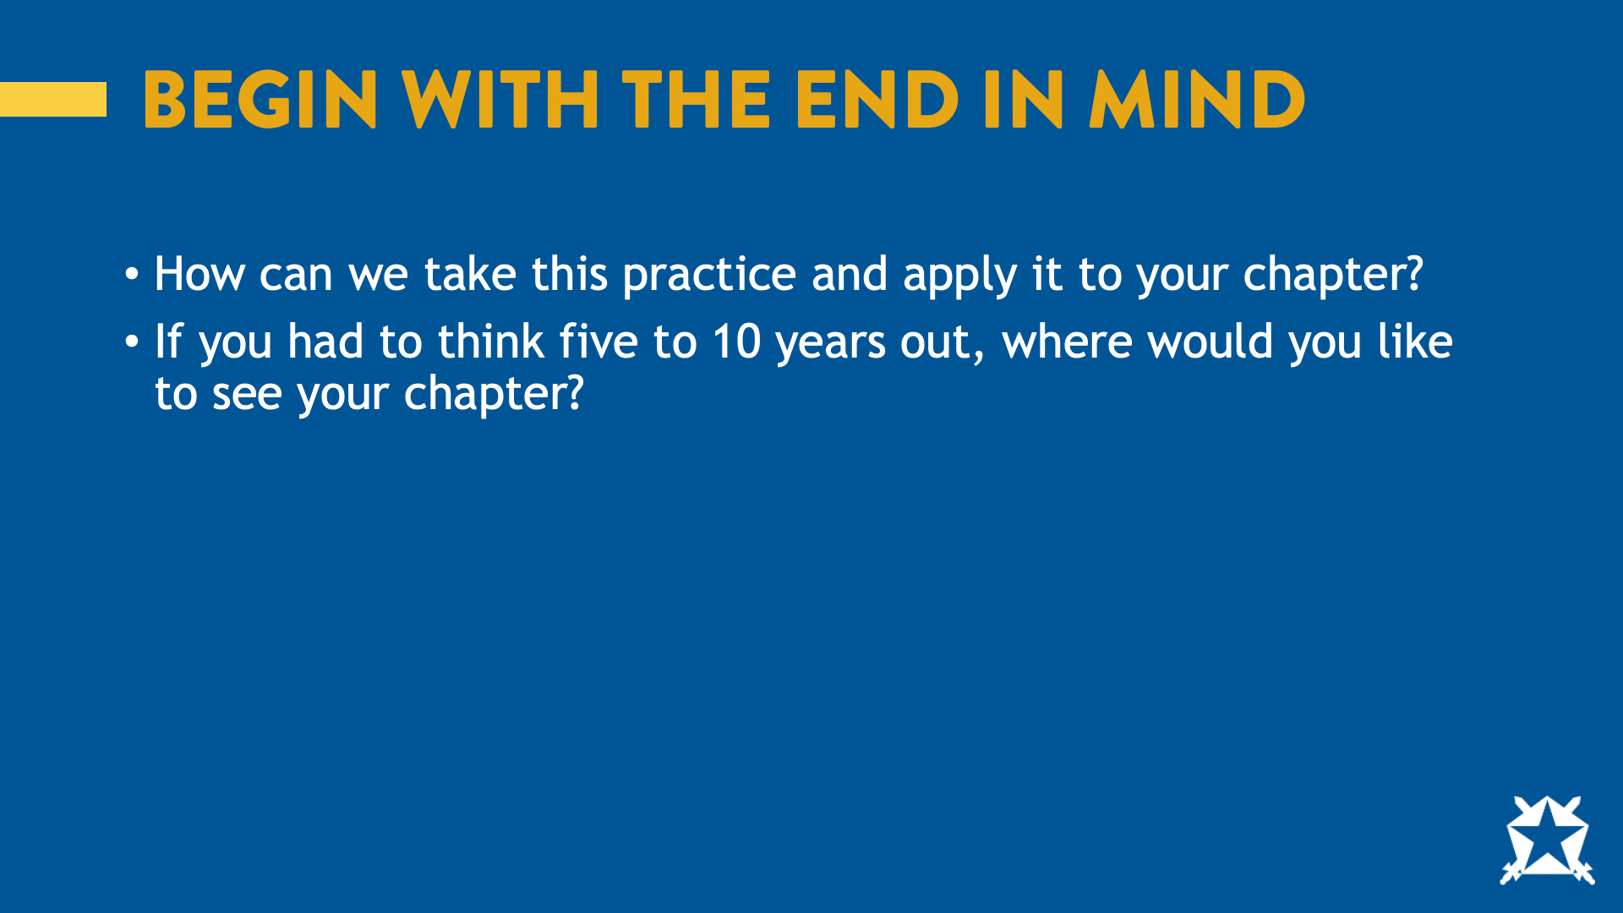
Notes:
Depending on the size of the group, you can split the group up, let them discuss with their neighbor or answer in the large group. After discussion in groups, have some participants share what they discussed.
Ask: How can we take this practice and apply it to your chapter? If you had to think five or 10 years out, where would you like to see your chapter?
Switch to slide #8

Slide 8

Notes:
Share: So now that we have an idea of where we want to go. Let’s talk about how we get there, and what could be getting in the way. One of the most overlooked leadership truths is that influence doesn’t require a title.
Ask: When you hear the word ‘leader,’ what kind of person comes to mind?
Ask: Do you need a title to be a leader? Why or why not?
Share: You don’t have to be archon, risk manager or warden to impact the culture of your chapter. Leadership isn’t about a title. It’s about impact. Every one of us sets the tone in some way, and people are watching you all the time to see how you speak, what you laugh at, what you tolerate and what you stand up for.
Ask: What are ways that members who do not hold a leadership position influence the chapter?
Allow for a few responses. Depending on how well the group responds some examples you could share are: Showing support for leadership’s initiatives, showing up on time to events, following policies, speaking up at chapter about issues that are important to them, etc.
Ask: Let’s talk about how we can influence each other even when we are not trying to. Have you ever changed your behavior because you thought your brothers expected something different from you?
Allow for a few responses.
Share: Sometimes we assume our peers feel a certain way when in reality, they don’t. This is what social psychologists call a false consensus or pluralistic ignorance. This can show up in fraternities all the time.
Ask: What are some behaviors or attitudes that might stick around due to false consensus?
Allow for a few responses. Some examples could be inside jokes, sexist/racist language, homophobia and/or drinking culture.
Note: fraternity men tend to perceive that all or most college students have a similar relationship with alcohol as they do.
Share: Thank you for sharing. By now, you should be starting to understand the impact you can have on your peers, and your peers can have on you. Every time we speak up, or stay silent, we’re shaping what the chapter values.
Switch to slide #9

Slide 9
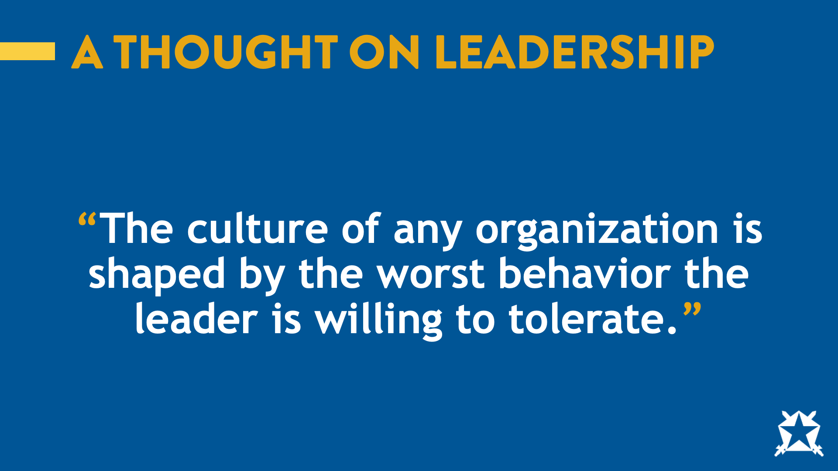
Notes:
Ask: Can someone please read the quote on the screen?
The culture of any organization is shaped by the worst behavior the leader is willing to tolerate.
Ask: What does this make you think of?
Allow for a few responses.
Switch to slide #10

Slide 10
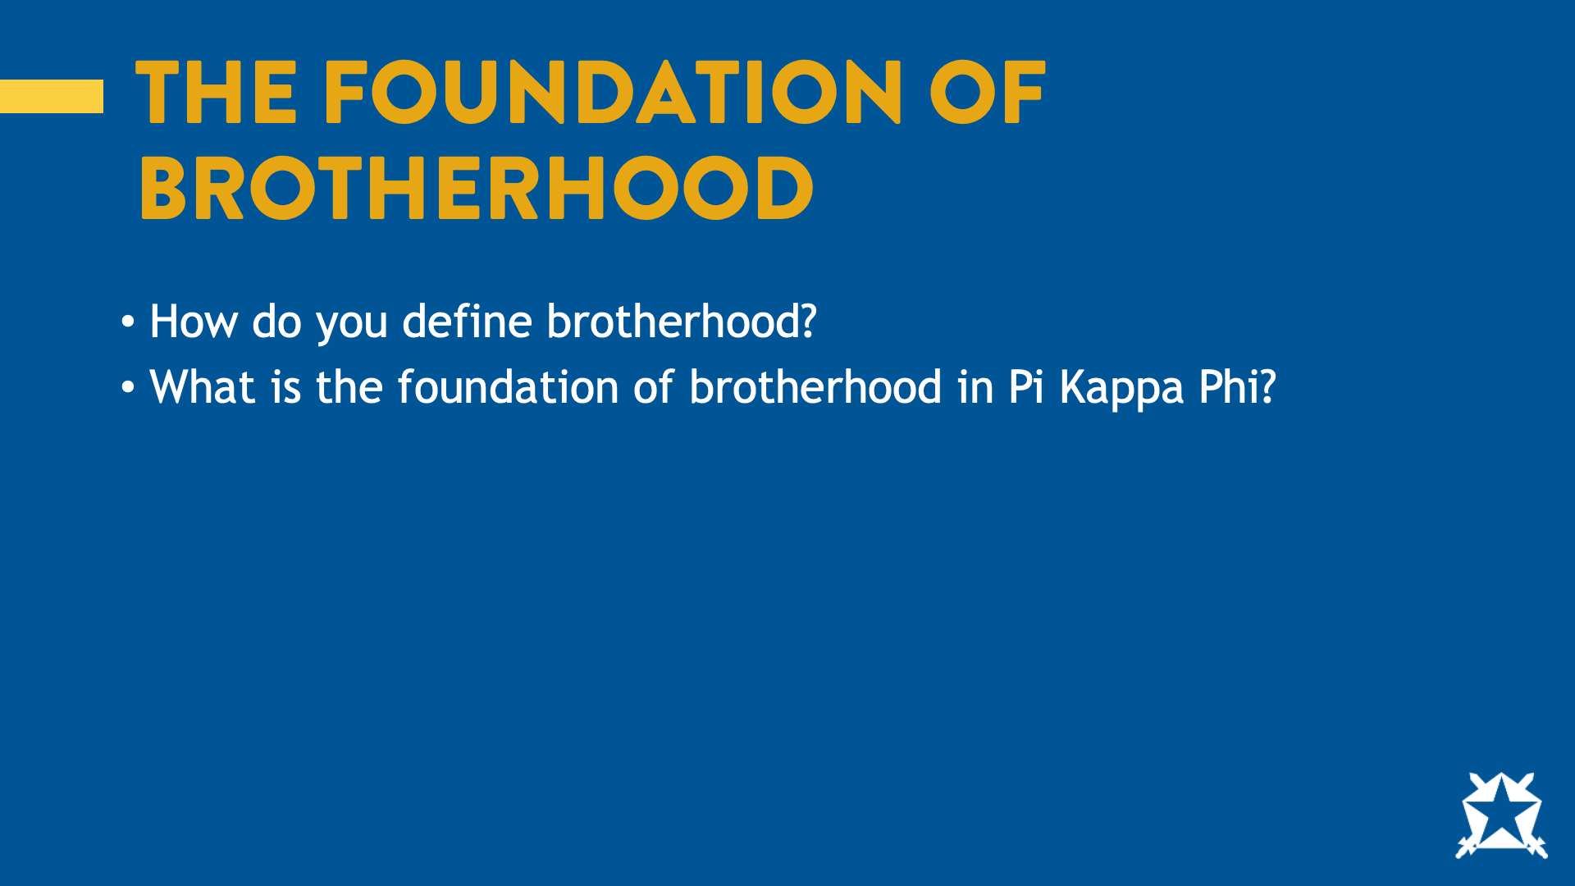
Notes:
Ask: How do you define brotherhood?
Allow for a few responses.
Ask: What is the foundation of brotherhood in Pi Kappa Phi?
Allow for a few responses unless you get the correct answer.
Switch to slide #11

Slide 11
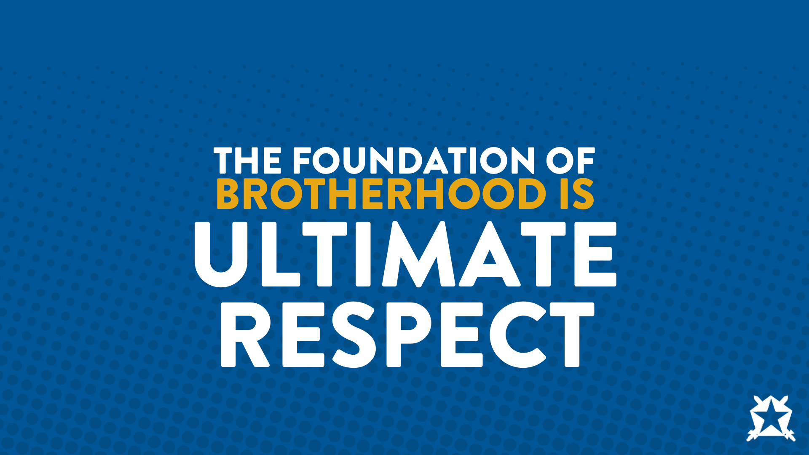
Notes:
Share: The foundation of brotherhood is Ultimate Respect.
Switch to slide #12

Slide 12
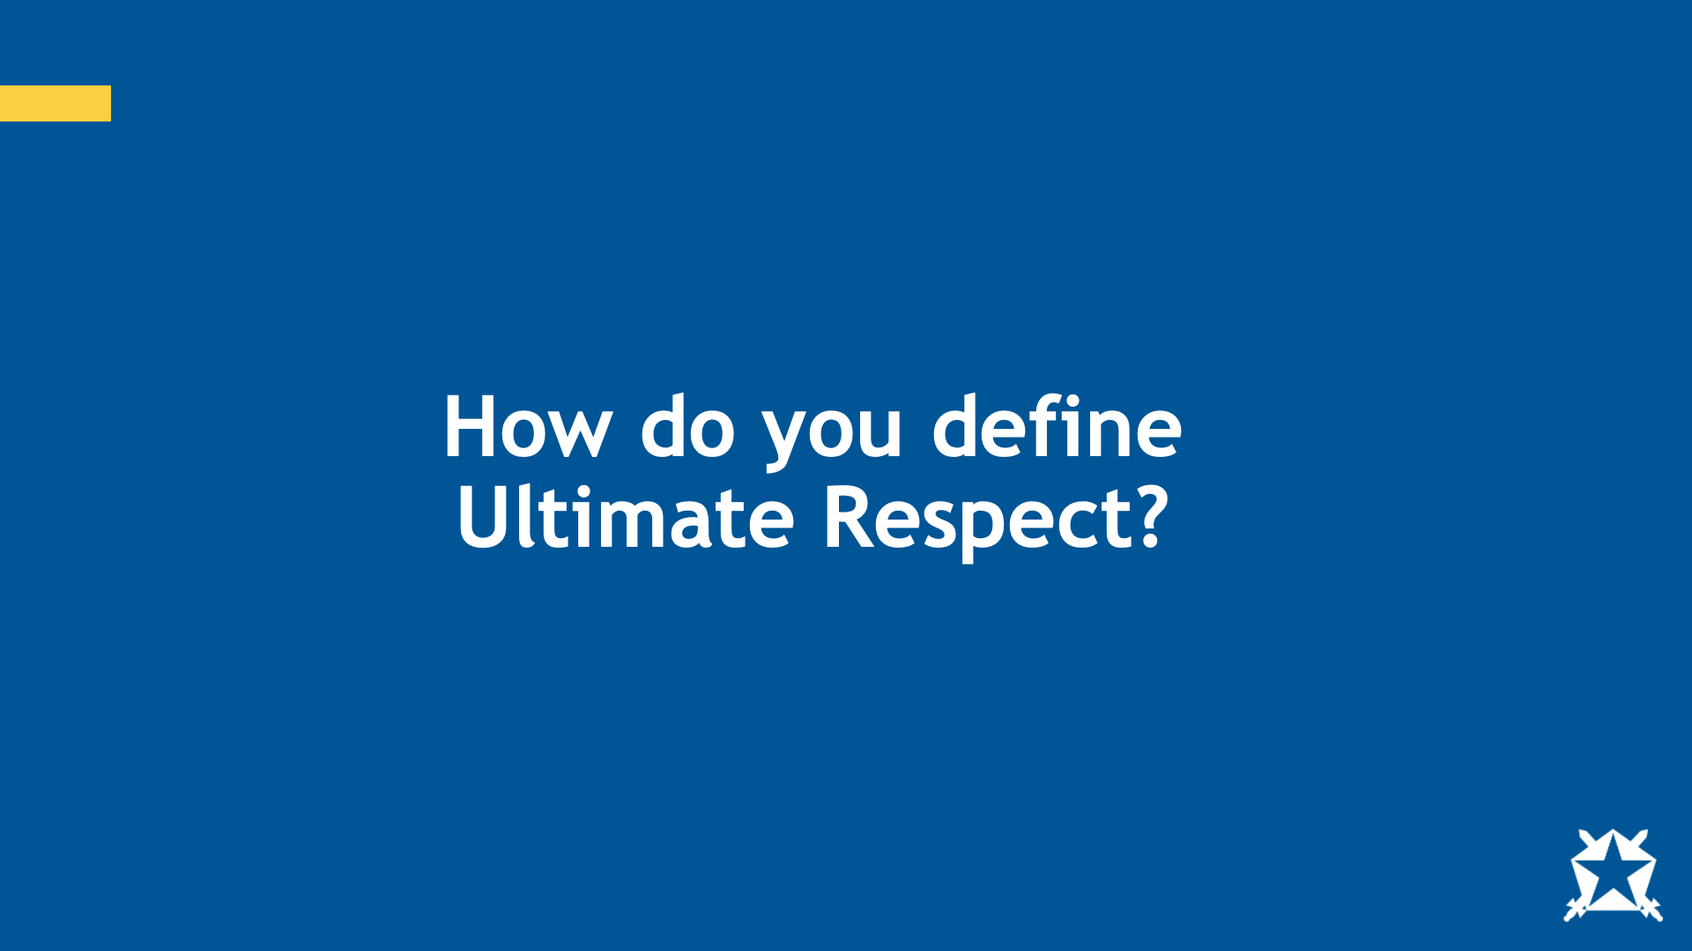
Notes:
Ask: How do you define Ultimate Respect?
Allow them to discuss this concept before moving to the next slide.
Switch to slide #13

Slide 13
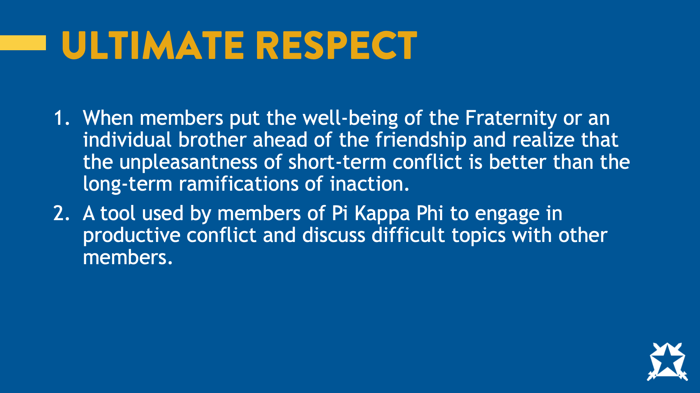
Notes:
You can invite someone to read the definition for the group
Ultimate Respect:
1) When members put the well-being of the Fraternity or an individual brother ahead of the friendship and realize that the unpleasantness of short-term conflict is better than the long-term ramifications of inaction.
2)A tool used by members of Pi Kappa Phi to engage in productive conflict and discuss difficult topics with other members.
Share: Another way to look at it is, once you establish expectations, Ultimate Respect is the tool in Pi Kappa Phi that we use to have difficult conversations with others when they don’t meet those expectations.
Ask: What are your thoughts on this definition?
Allow for a few participants to share.
Share: Ultimate Respect is not approaching a brother and saying, “Ultimate Respect bro, you’re a douche bag.” It is a dialogue between brothers that confronts a specific behavior and calls for a change for the benefit of that member or the greater organization.
Sometimes we don’t always understand the art of using Ultimate Respect properly, so I want to spend some time sharing tips and practicing what this looks like in action.
Switch to slide #14

Slide 14
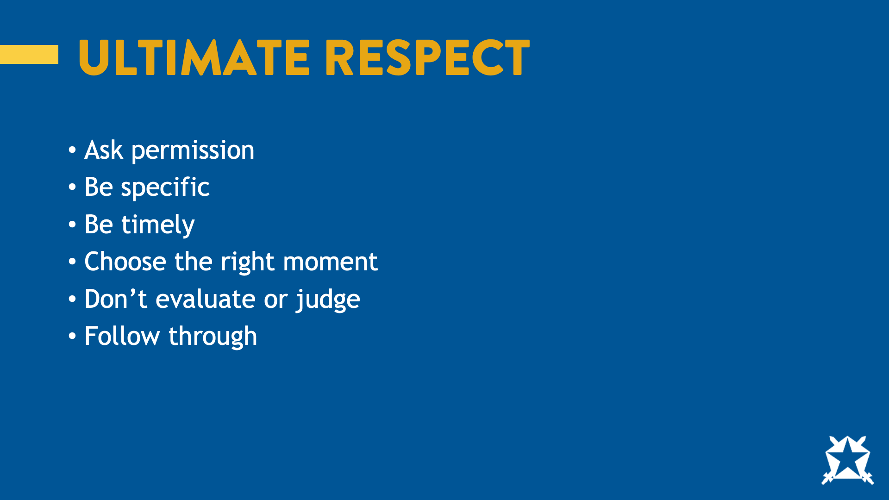
Notes:
Here are some quick tips for you to remember when confronting a brother through Ultimate Respect.
Ask Permission – Make sure that you ask the brother you are going to confront if they are willing to hear some critical feedback.
Be Specific – It is important to provide concrete examples of the behavior you are addressing. Don’t just say, “you have a poor attitude.” Share specific details about when, where and how you have seen the specific behaviors you are addressing.
Be Timely – Address issues in a timely manner. The closer you can provide feedback regarding the behavior to the time it occurred, the better. This will prevent behaviors from escalating further and will be more relevant for the brother whom you are confronting.
Choose the right moment – Because of the nature of the conversation you are having, make sure the environment is conducive to the confrontation. Privacy is important, so do not try to have these conversations in a crowded environment or when a brother is not in a mental state to engage in the conversation fully.
Don’t evaluate or judge – Remember, the goal is to provide information on their behavior and give them a chance to change. This conversation is about giving feedback regarding past behavior, in the present, with the hope of influencing future behavior. If you make the brother feel judged or evaluated, the natural reaction is to get defensive. Stick to facts, express concern and talk together about ways the behavior can be changed.
Follow Through – Finally, it’s important to hold the brother accountable to what you agreed upon by following through on the commitment you’ve made and ensuring he does as well.
If you are on the receiving end of Ultimate Respect or getting feedback, here are two things for you to keep in mind.
Give people the benefit of the doubt.
Listen to what they are saying and understand where they are coming from.
Switch to slide #15

Slide 15
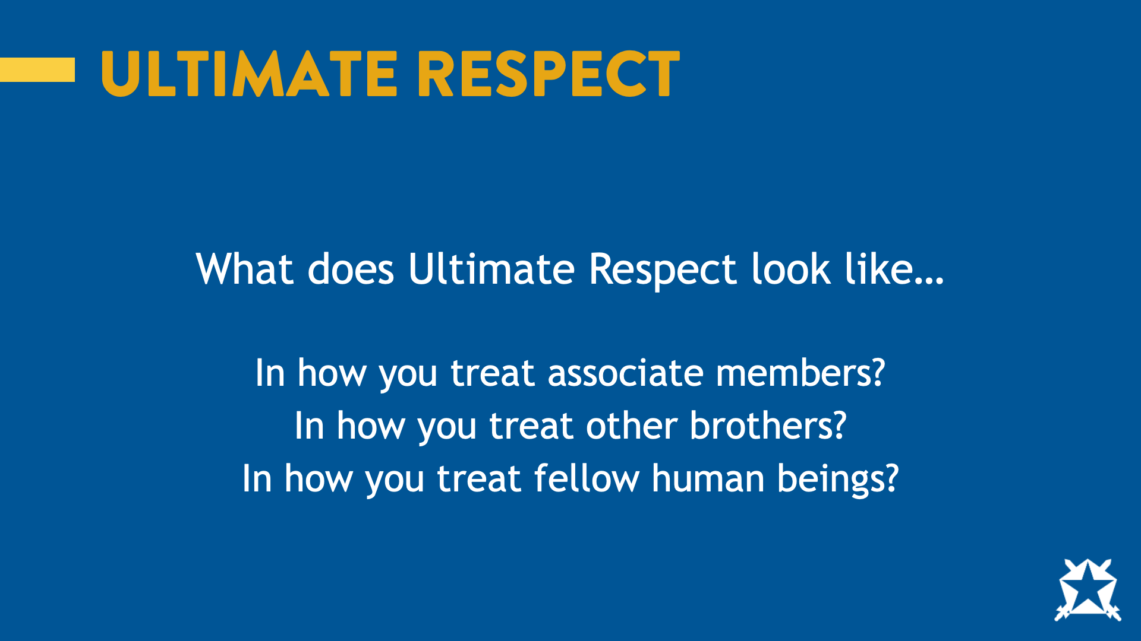
Notes:
Ask: So now that we know all of that, what does Ultimate Respect look like…
In how you treat associate members?
In how you treat other brothers?
In how you treat fellow human beings?
Ask each question one at a time and allow them to share after each. This may be a good place for you to pair and share, or allow them to discuss in groups.
Switch to slide #16

Slide 16
Notes:
The definition of Ultimate Respect is repeated here from slide 12 to allow participants to reference it when you ask the below questions.
Ask: How can we show Ultimate Respect for the fraternity?
Allow them to answer.
Share: Many of those were very good answers. Another way we can show ultimate respect by understanding and living our philosophy statements.
Ask: Is anyone familiar with the Fraternity’s philosophy statements?
Allow them to raise their hand, and you can challenge them to name them.
Switch to slide #17

Slide 17
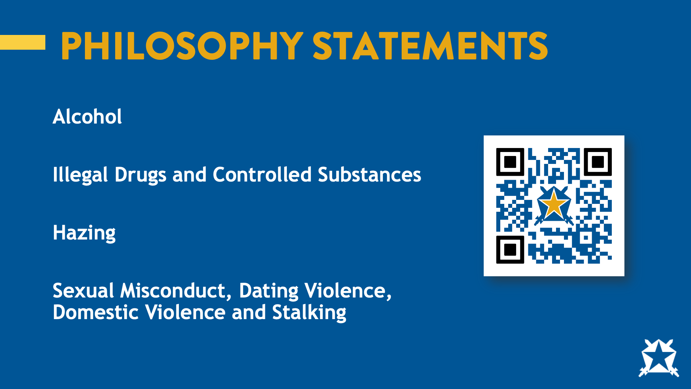
Notes:
Share: Pi Kappa Phi has four philosophy statements. They cover the topics of alcohol, illegal drugs and controlled substances, hazing and sexual misconduct. Using your phone, please scan the QR code on the slide and take a minute to read each of the philosophy statements. Once you’ve read each, discuss in a group of three or four what they each have in common.
Allow them about 10 minutes to read and discuss in small groups.
Ask: Who would like to share what your group decided about what each of the philosophy statements have in common?
Allow a few groups to share.
Switch to slide #18

Slide 18
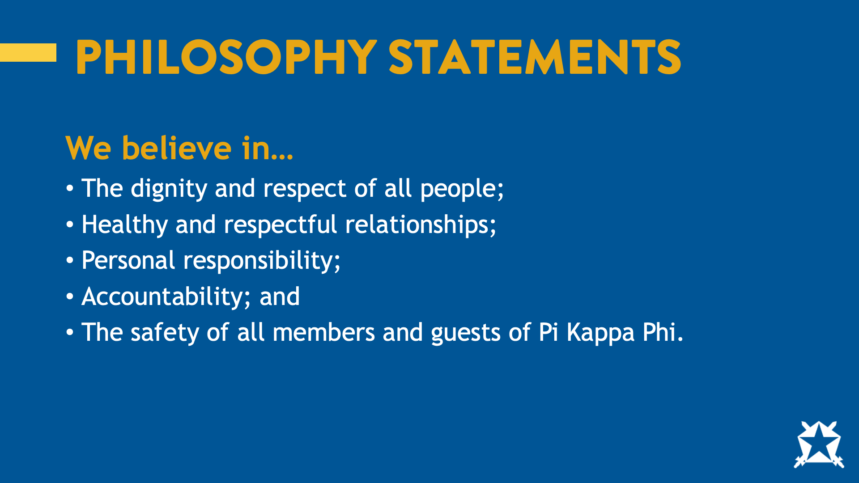
Notes:
Share: All four of these philosophy statements have these common themes woven through them that assert that members of Pi Kappa Phi believe in:
Dignity and respect of all people
Healthy and respectful relationships
Personal responsibility
Accountability
The safety of all members and guests of Pi Kappa Phi.
That last point really sums it up. Safety is a key component of each of our philosophy statements.
Switch to slide #19

Slide 19

Notes:
Share: When we think about safety, we usually think about physical harm. But to have healthy, high-functioning relationships, we need psychological safety. Psychological safety means feeling safe to speak up, be yourself and share ideas or concerns without fear of ridicule or retaliation.
Ask: Is anyone familiar with Maslow’s Hierarchy of Needs?
Allow someone from the group to answer/explain.
Switch to slide # 20

Slide 20
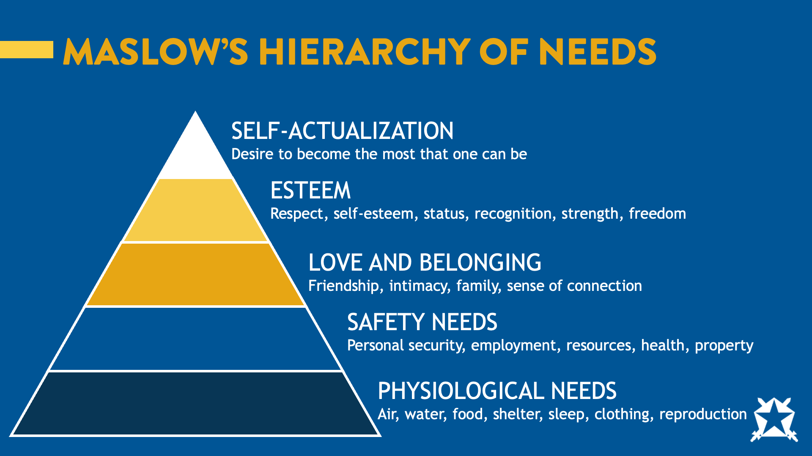
Notes:
Share: Maslow’s Hierarchy of Needs can be thought of as a pyramid with five levels. On the bottom, we have our physiological needs (food, water, sleep, etc.) and safety. In the middle are love and belonging (connection, friendships, family) and esteem needs (feeling valued). And at the top is self-actualization (where we are the best version of ourselves). The idea is we all have different needs, but the basic ones must be met before we can really focus on the higher ones like growth, purpose and leadership.
Ask: Where does psychological safety fall on the hierarchy?
Allow participants to share. Answer: It falls across the hierarchy, but particularly in the safety, love and belonging sections.
Ask: So, if psychological safety is a vital part of the foundation of our needs, what does it look like if we don’t have it?
Allow participants to share. Answer: When members don’t feel psychological safety, they can’t make real connections. They won’t feel like they can be themselves.
Ask: How can this impact the chapter experience?
Allow participants to share. Potential answers: Members won’t build real bonds, retention will struggle, relationships will not last beyond the undergraduate experience, etc.
Ask: So, how does this relate back to the concept of Ultimate Respect?
Allow participants to share. Answer: Ultimate Respect is a tool for meeting some of the hierarchy's most important needs: safety, belonging and esteem.
Safety: The idea that you can speak up, be yourself and challenge something that doesn’t feel right without fear of ridicule or retaliation.
Belonging: When we use Ultimate Respect the right way, we show brothers that we care about them not just as friends, but as brothers. We’re willing to have tough conversations because we care. That deepens the bond and builds real brotherhood.
Esteem: When you respectfully challenge a brother who’s not living up to our values, you’re showing that you believe in him and that he can be better. And when someone receives feedback with maturity, they gain confidence and respect from others.
Share: We’ve talked about psychological safety and how important it is in creating a space where people can be themselves, but that doesn’t just happen. Let’s dig into a key psychological theory that can help us understand how we can create a chapter that practices Ultimate Respect.
Switch to slide #21

Slide 21
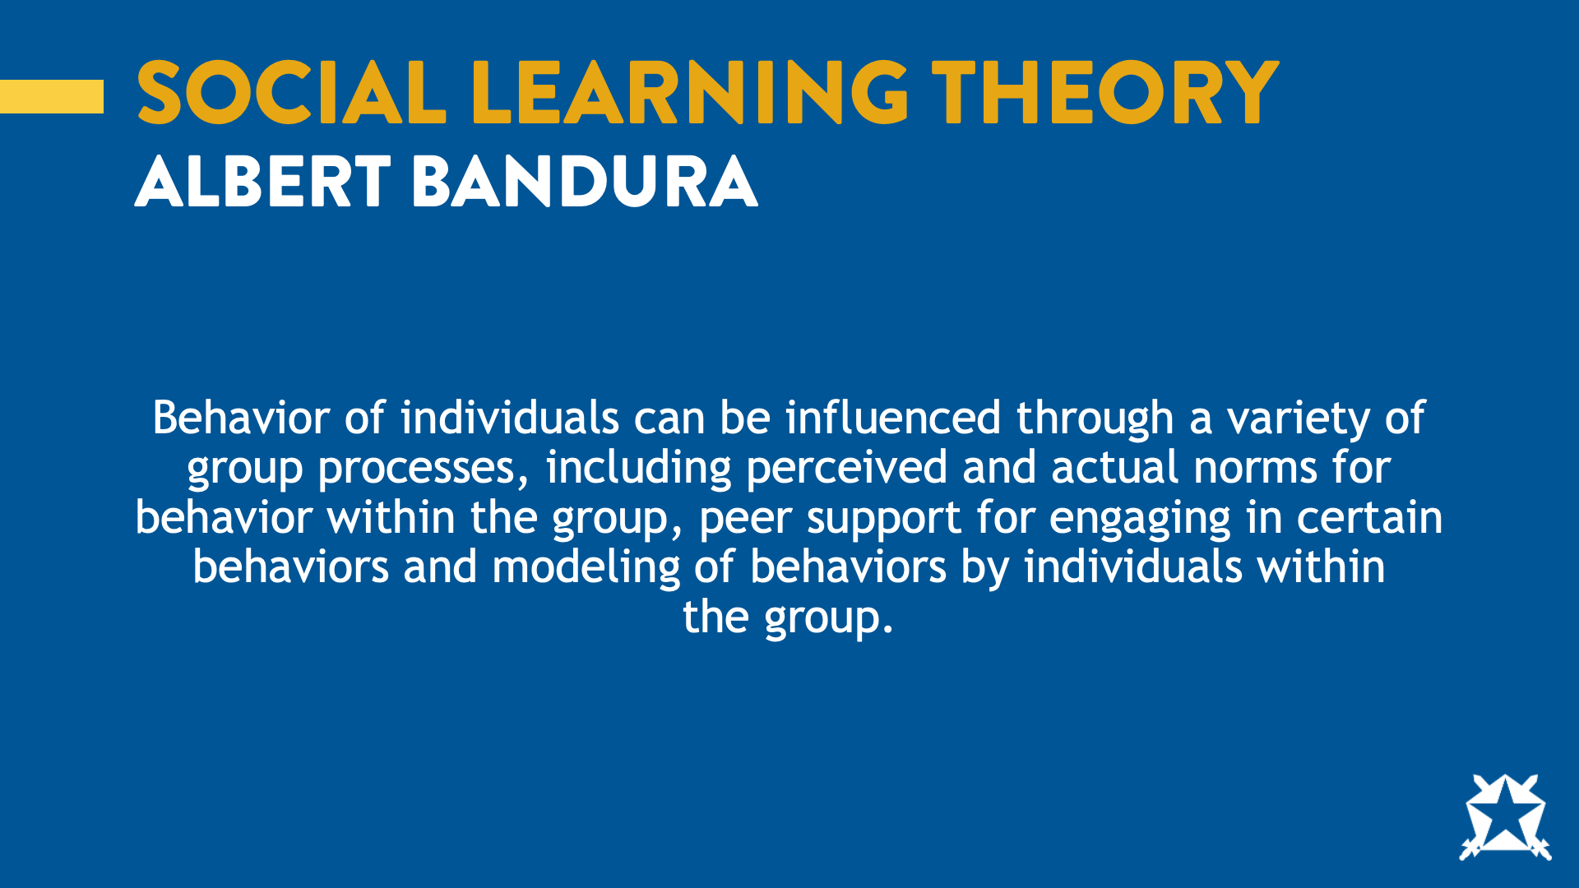
Notes:
Share: The theory I’d like to discuss is the Social Learning Theory by a psychologist named Albert Bandura. Bandura’s theory was that people learn behaviors by observing others. We watch what gets rewarded, what gets laughed at, what is ignored and what gets shut down. That is how we decide what is acceptable in a group.
Ask: What are some of the behaviors in the chapter we may learn just by watching others?
Allow participants to share.
Ask: Can you think of a time you may have acted a certain way because it was what you thought was expected of you?
Allow participants to share.
Ask: So, how does this relate to Ultimate Respect?
Allow participants to share.
Share: If we want to build a culture where Ultimate Respect is normal, we need to model it. This means showing what it looks like to give and receive feedback and engage in mature conflict, even when it is uncomfortable.
Switch to slide #22

Slide 22

Notes:
Share: Now that we know it is important to practice Ultimate Respect, I’d like to do just that.
This activity is known as a values scale. There are several ways to accomplish it, listed below. Based on group size, space restraints, etc., pick the directions that best work for the group.
Option 1 (Four Corners): Assign each corner of the room a value (strongly agree, agree, disagree, strongly disagree. Have each participant move to the corner that aligns with their answer for each statement.
Option 2 (Human Spectrum): Designate one end of the room as strongly agree and another as strongly disagree. Read each statement and ask participants to stand along an imaginary line that represents their view.
Option 3 (Seated Version): Read each statement and after each statement ask participants to raise their hand if they (strongly agree-strongly disagree). After each measurement, ask members of that group to explain their response.
Share: For this next activity, we will be participating in a values clarification exercise, which will challenge your ethical decision-making (personal scales of right and wrong) and will force you to justify your decisions. I am going to read aloud several statements, and you will need to make a personal decision based on your answer that best describes your feelings (agree-disagree). Once everyone has made their answer, I’m going to ask one person from each group to justify their answer. I’m going to challenge you to answer not based on how you believe other people want you to answer, but based on what you believe.
You will not use all the example statements below, and you do not have to ask them in any particular order. You are welcome to include your own statements at your own discretion. Remember, your role here is to help facilitate a discussion and not to share your own beliefs. When done well, the participants should engage in conversation about their personal values and the Fraternity’s values.
Warmup Statements (Ask 1-3):
Pineapple belongs on pizza.
Skipping class occasionally is totally fine.
You should always split the bill on a first date.
Values Statements (Ask around 10):
It’s OK to call a woman a “slut.”
It’s OK to stick up for an associate member if you think a brother is out of line.
It’s OK to call someone a “retard.”
It’s OK to ask a brother to leave a party because he is being creepy to a guest.
It’s OK to hook up with someone after drinking.
It’s OK to be a cock block if you think a brother or the other person is too drunk to have sex.
It’s OK to require associate members to be designated drivers.
It’s OK to host a “CEO and Office Hoes Party.”
It’s OK to talk shit about a brother to other brothers.
It’s OK to host an “ABC Party (Anything by Clothes).”
It’s OK to disregard the direction given by chapter officers.
It’s OK to lie to a brother.
It’s OK to make fun of a brother who has hooked up with someone you think is unattractive.
It’s OK to make fun of someone’s race if it’s all intended as a joke.
It’s OK to call someone a “pussy.”
It’s OK to make associate members do physical exercise.
It’s OK to require associate members to do things brothers don’t have to do.
It’s OK to have required activities for members.
It’s OK to post pictures of people passed out.
It’s OK to encourage brothers to drink until they black out.
It’s OK to give your little brother the family drink if he is not required to drink it.
It’s OK to treat associate members like pledges.
It’s OK to make associate members earn their right to initiation.
It’s OK to threaten to blackball associate members.
It’s OK to give a guy a bid that you know you are going to blackball (vote to remove from the chapter).
It’s OK to intentionally not invite brothers to certain events.
It’s OK to physically fight a brother.
Thank you for participating. Please return to your seats.
Ask: Was this easy?
How did it feel to hear and see that people felt differently from you did?
Share: Now that we’ve started a conversation about our values and where we stand, we’ll now talk about what it looks like to stand up for our positions.
Switch to slide #23

Slide 23
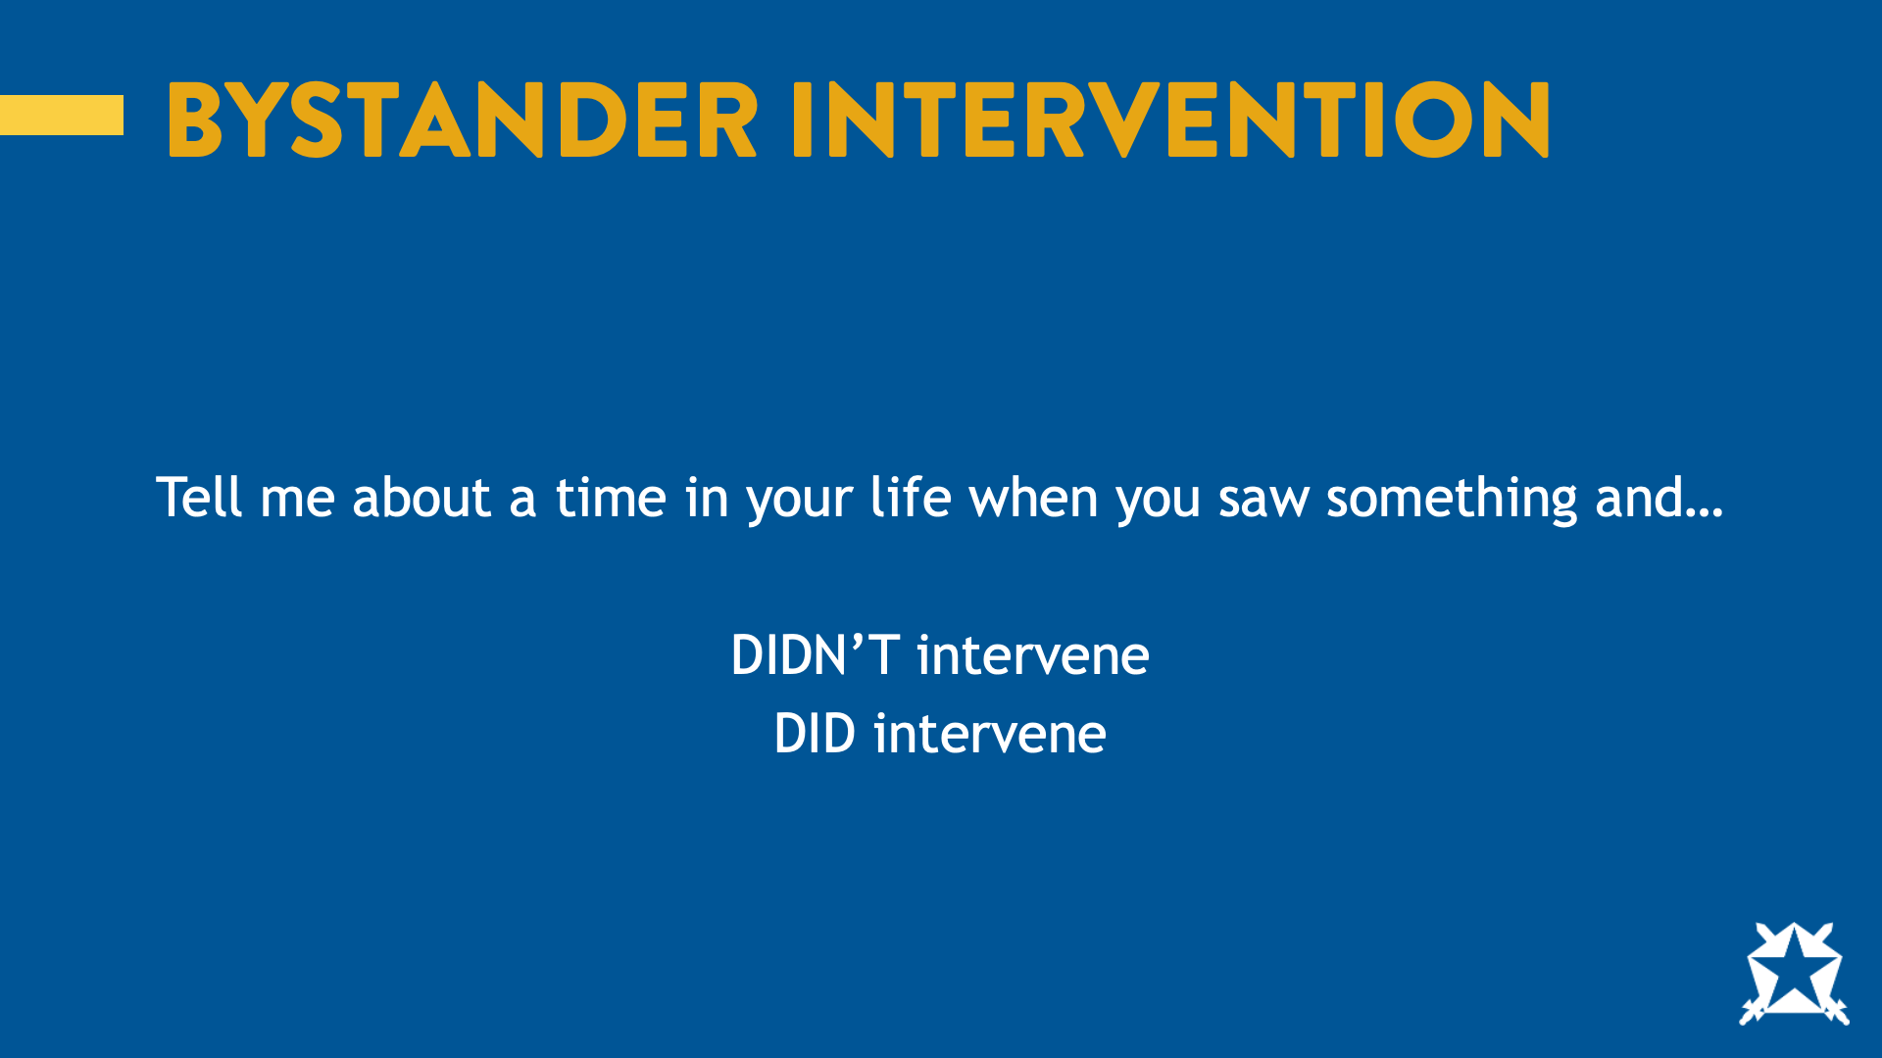
Notes:
Ask:
Tell me about a time in your life where you saw something and DIDN’T intervene.
Tell me about a time in your life where you saw something and DID intervene.
Depending on their participation, you can share a personal story about a time you did or didn’t intervene.
Switch to slide #24

Slide 24
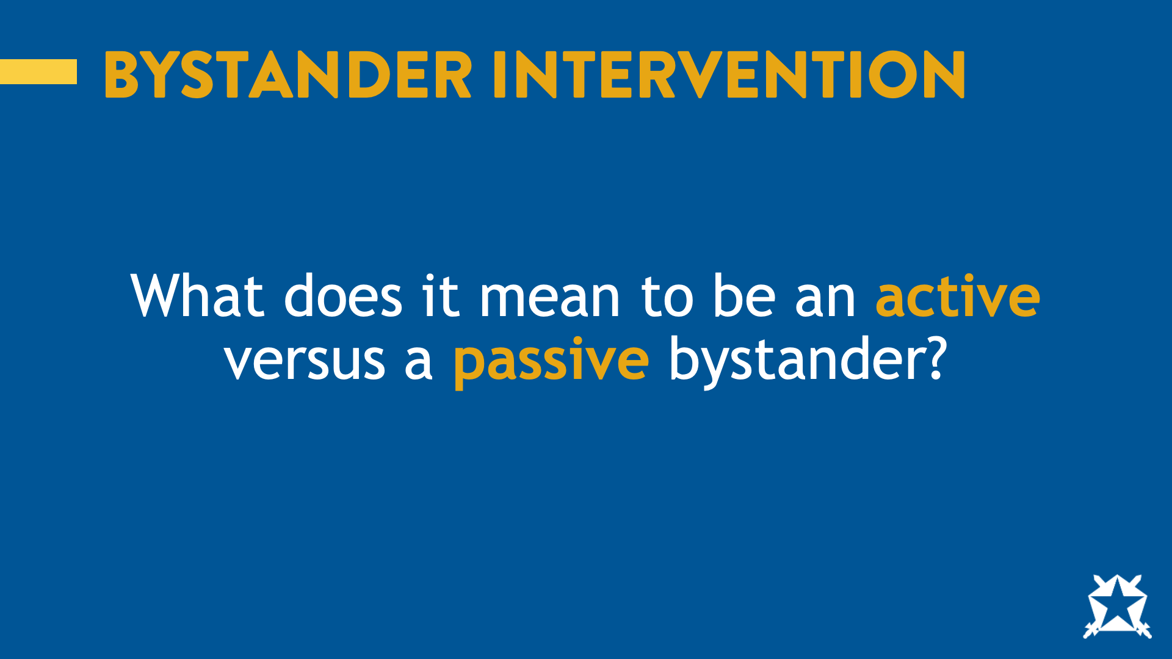
Notes:
Ask:
What does it mean to be an active bystander?
Someone who chooses to intervene or take action when they witness an act of harm, harassment or potential danger.
What does it mean to be a passive bystander?
Someone who witnesses a potentially harmful situation but chooses not to intervene or take any action to help
What may cause someone to be a passive bystander?
Bystander effect
Switch to slide # 25

Slide 25
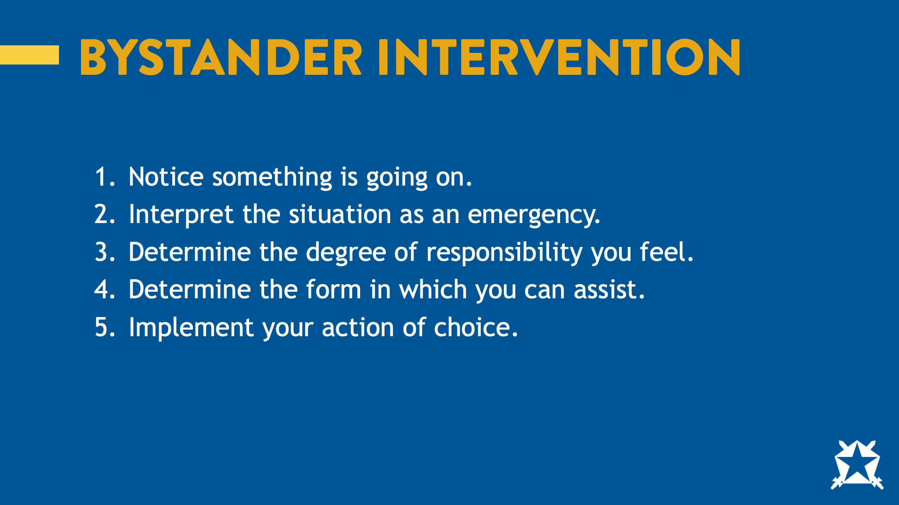
Notes:
Share: As you may know, the Bystander Effect essentially boils down to the fact that the more individuals who see someone in need, the less likely each person is to intervene, and the less likely that individual is to receive help.
An example that can be used to explain this is the idea behind the story of "The Good Samaritan." It was first studied and "discovered" through a study done by two social psychologists named John Darley and Bibb Latane in 1968. They discovered that when it came to everyday situations when there was only one person witnessing the situation where assistance was needed, they helped 85% of the time. That dropped to 65% when there were two witnesses present. And when there were four or more witnesses present, that statistic dropped to 31% and continued to decrease as the number of witnesses increased in an inverse manner.
They also discovered that an individual goes through a multi-step decision-making process when deciding whether or not to intervene. Each step follows with a cognitive decision made by the individual to proceed or pass on intervening. The steps published in their study are the following...
Notice that something is going on
Interpret that situation is an emergency
Determine the degree of responsibility felt
Determine the form in which they can assist
Implement their action of choice
Simplified, these steps break down to this easy-to-remember phrase: See, Think, Act.
Switch to slide #26

Slide 26
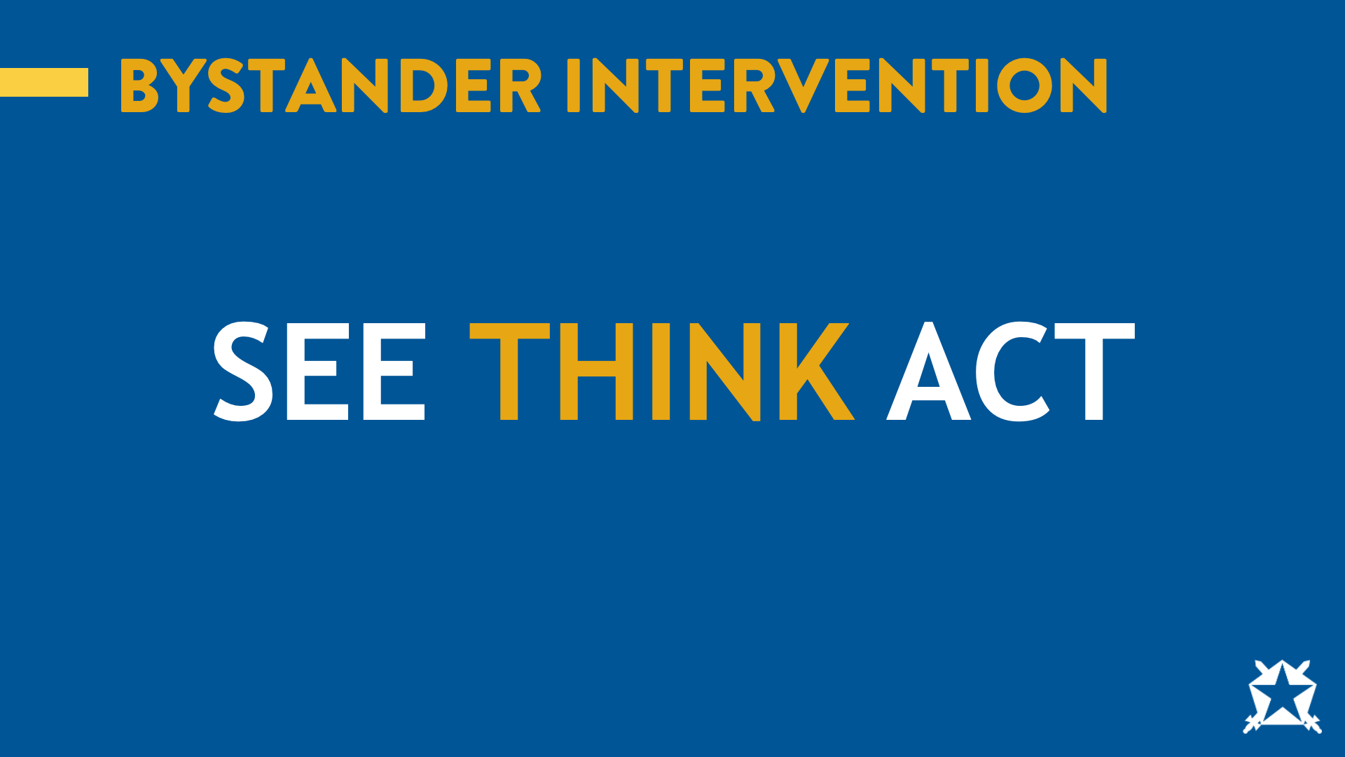
Notes:
Share: SEE
This boils down to a discussion about what we might see as an indicator of an individual in need of help. This centers around the idea that you have to notice the event before you can help, and reasons why we may overlook that event (being intoxicated, under the influence of marijuana, not wanting to be bothered, lack of caring/awareness, etc.). This stage is important because it determines whether someone will get the help they need.
Share: THINK
This is where you must decide if the situation you have noticed warrants any attention. Is someone at risk? What are the possible consequences of not intervening?
Ask: Why do you think individuals may fail to think they should intervene?
Examples could include personal safety, unsure if they are reading the situation correctly, not knowing how to help, bystander effect, thinking someone else will help, etc. The urgency of the situation may come into play.
Share: ACT
At this point, an active bystander will take personal responsibility for the situation. If you think to yourself, “Someone should do something,” then you should recognize that you are that someone. There are several ways to intervene, some direct and some indirect. Deciding how to intervene will depend on the urgency of the situation.
When thinking about how to ACT, the “3 Ds” can be helpful tools for remembering what to do.
Switch to slide # 27

Slide 27
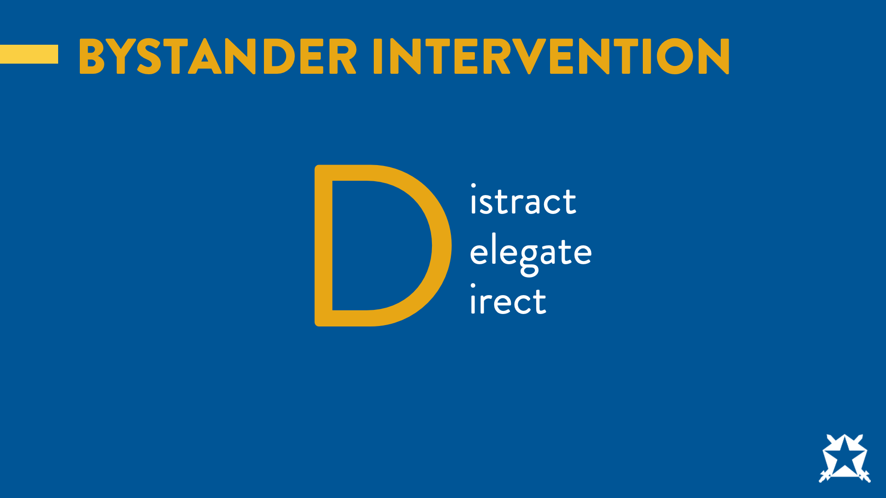
Notes:
By now, you may be short on time. To help keep the presentation interactive, you can ask for examples of situations where each of the 3 Ds may be used.
The 3 Ds of bystander intervention boil down to the following:
Distract: This method is an indirect method that is often used when individuals want to avoid a confrontation and is often found more comfortable for more introverted individuals to use. This method can be used with either party as the target. Any act that would take the focus of the situation away from the situation can work.
Delegate: This method is a good choice to use when personal safety is a worry. An active bystander may choose to intervene indirectly for a number of reasons. Using this method, the bystander may choose to go to another individual to get help (such as security, an RA, the chapter president or risk manager, another friend nearby, or anyone else who can help).
Direct: This method is obviously the direct method of intervention. This, like the distract method, can be used with the victim or perpetrator as the target. This would be where the bystander purposely inserts him/herself into the situation, often with an honest and vocal assessment of what is happening and that it needs to stop immediately for said reasoning.
Switch to slide #28

Slide 28
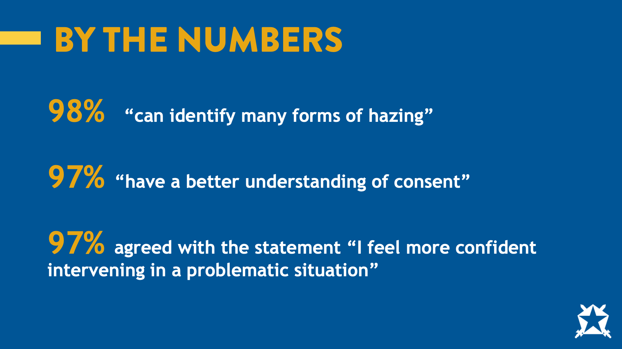
Notes:
Share: You might be asking yourself, “What does bystander intervention have to do with Ultimate Respect?” In a survey of associate members, 98% of respondents answered that they “can identify many forms of hazing,” 97% of respondents answered they have a better understanding of consent and 97% of respondents answered that they agreed or strongly agreed with the statement “I feel more confident intervening in a problematic situation.”
Ask: You tell me, how does bystander intervention relate to Ultimate Respect in Action?
Here, they should answer that they have the tools to intervene but that some people just don’t. But if we practice Ultimate Respect, we can intervene to try to prevent harm.
Switch to slide # 29

Slide 29
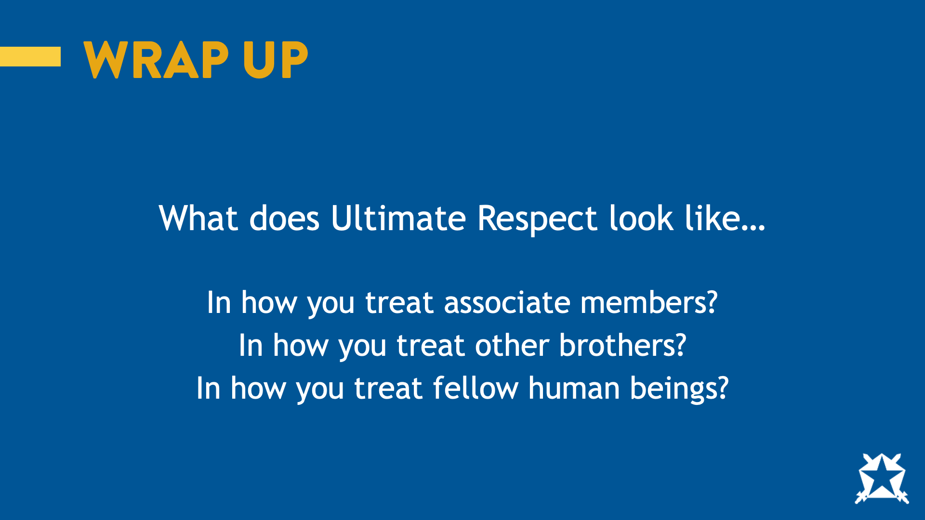
Notes:
Ask: So, after hearing all of this, what does Ultimate Respect look like…
In how you treat associate members?
In how you treat other brothers?
In how you treat fellow human beings?
Allow participants to share.
Share: Today, we talked about a lot: values, leadership, influence, bystander intervention and what it truly means to practice Ultimate Respect. We challenged some assumptions. We probably felt uncomfortable at times. That’s intentional; growth rarely happens in comfort.
But here is the big takeaway: Ultimate Respect isn’t just a concept; it’s a choice. It’s how you choose to lead without a title and hold yourself and those around you accountable, even when it’s hard.
Thank you for showing up today and for participating and for being present.
Switch to slide #30

Slide 30
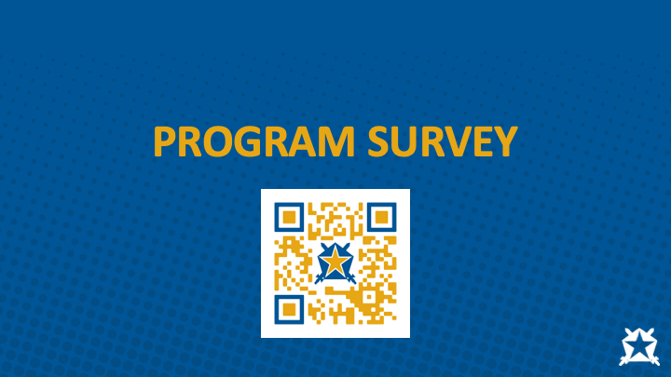
Notes:
Before we finish up the program, I’d like to invite you to scan the QR code on the screen to take a short survey about today’s program. While the survey is anonymous, HQ will compare the number of surveys submitted to the attendance list to verify the attendance count.

