Slide 1
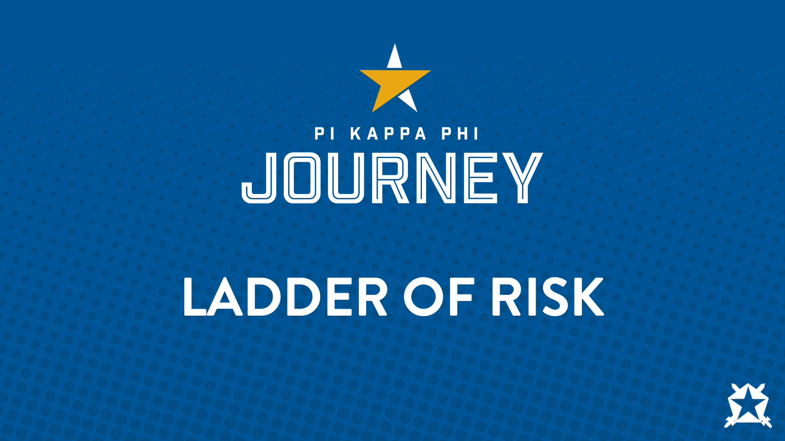
Notes:
Briefly introduce yourself: Name, current job, chapter you are from, volunteer experience with the Fraternity.

Slide 2

Notes:
Today we are going to spend some time discussing the fraternity’s Risk Management Policies, why they are important, and how operate within them.
Before we start the program, it is important to establish some shared expectations for our time together.
Ask: What do you hope to get out of this discussion?
Ask: What are some things we need to do in order to get the most out of our time together?
As a facilitator, you can insert your expectations for what community you would like to create will presenting. You can share some of the following and feel free to add your own!
Great! Now that we’ve established some expectations, let’s move forward.

Slide 3
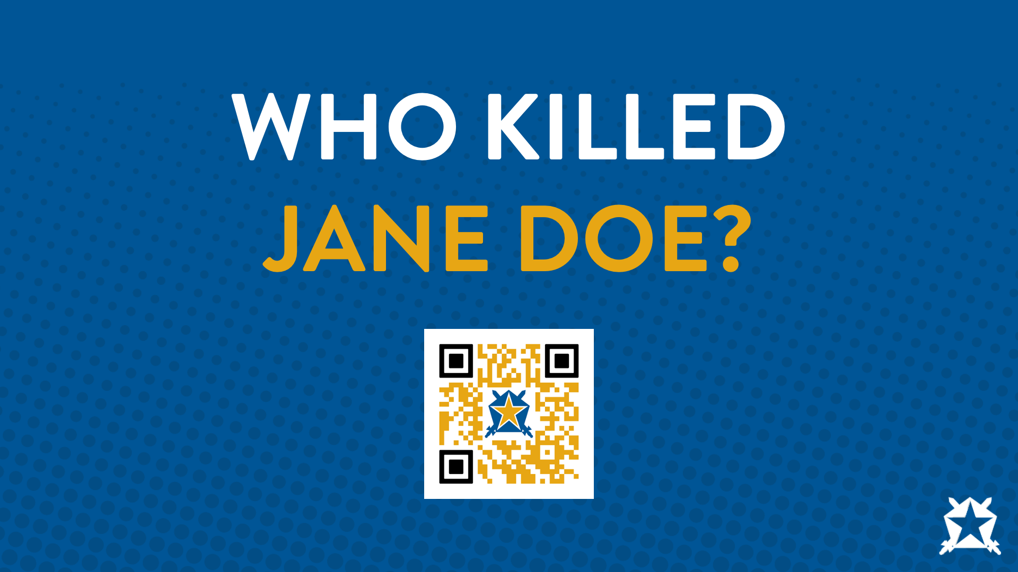
Notes:
Break the large group into smaller groups of 5-6 people each. Based on the group, you can be intentional and have them count off, encourage them to get with people they might now know as well or just have them self-select.
Read the scenario provided individually then as a group, gain consensus of who was to blame for the death of Jane Doe. Rank the nine in the order of most to least responsible.
Give them about 15 minutes for this task.
You might get questions regarding if we are ranking based on legal, suffering, moral or which perspective. Tell them they are able to complete however they prefer.
Bring the group back together.
Who is blame for Jane Doe’s death?
They will all likely yell out “Jane.” At this point you can agree. Jane is dead and her decisions contributed significantly to the tragedy. Then you move on...
“Who else is to blame?”
At this point you will facilitate for about five minutes and have folks say who was blame and justify their answer. Likely participants will challenge, and you can push back. At some point, the conversation will come to a point where the discussions are breaking into legal versus suffering.
There are two ways to look at Jane’s death. If we are looking at who will suffer the most because of Jane’s death, the participants will give you the logical answers in order (parents, Karen, sorority, fraternity, Greek community).
When a parent loses a child, they look at the evening/incidences and wonder who was to blame. Lawyers are hired and essentially, they start at the end of the evening and works towards the beginning.
Why do you think that is?
The alcohol that was last in her system ultimately was the alcohol the killed her. So, work backwards and tell me who was to blame?
National Fraternity, Local Chapter, Housing Corporation will likely all be named.
Individuals from the chapter will be named. “Who do you think?” Answer is it will be any officer that had their hands in coordinating event. Any member/associate that helped plan the event including collecting money, driving a car to purchase the alcohol, setting up the bar, etc. In this situation, individuals can serve jail time and be sued individually. Even if you have no money, they will go after your parents’ Homeowners Insurance usually capped at $500K.
Joe will be named. He will say he was told to stand there and serve alcohol and a hazing investigation will take place. Associates should not be the ones “managing” the party.
The bar will be named.
The bartender will likely be named.
Highly unlikely the sorority will be named as it was not a co-sponsored event.
Even though Karen, her friend, could have stayed with her or gotten her help based on past lawsuits, she will not be named.
It comes down to who provided the alcohol.
If this case were to go to trial, each party would have to prove who was responsible. If the suit were $10 million dollars (this is high, but it makes the numbers easy to divide) and the verdict was that Jane was 50% responsible, then the payout goes down to $5 million. If the jury said the fraternity was 40% responsible and bar was 10% responsible, they would pay out $4 million and the bar would pay out $1 million.
Thank you for participating in this activity. We will revisit this at the very end of our time together but lets move on to the next portion.

Slide 4
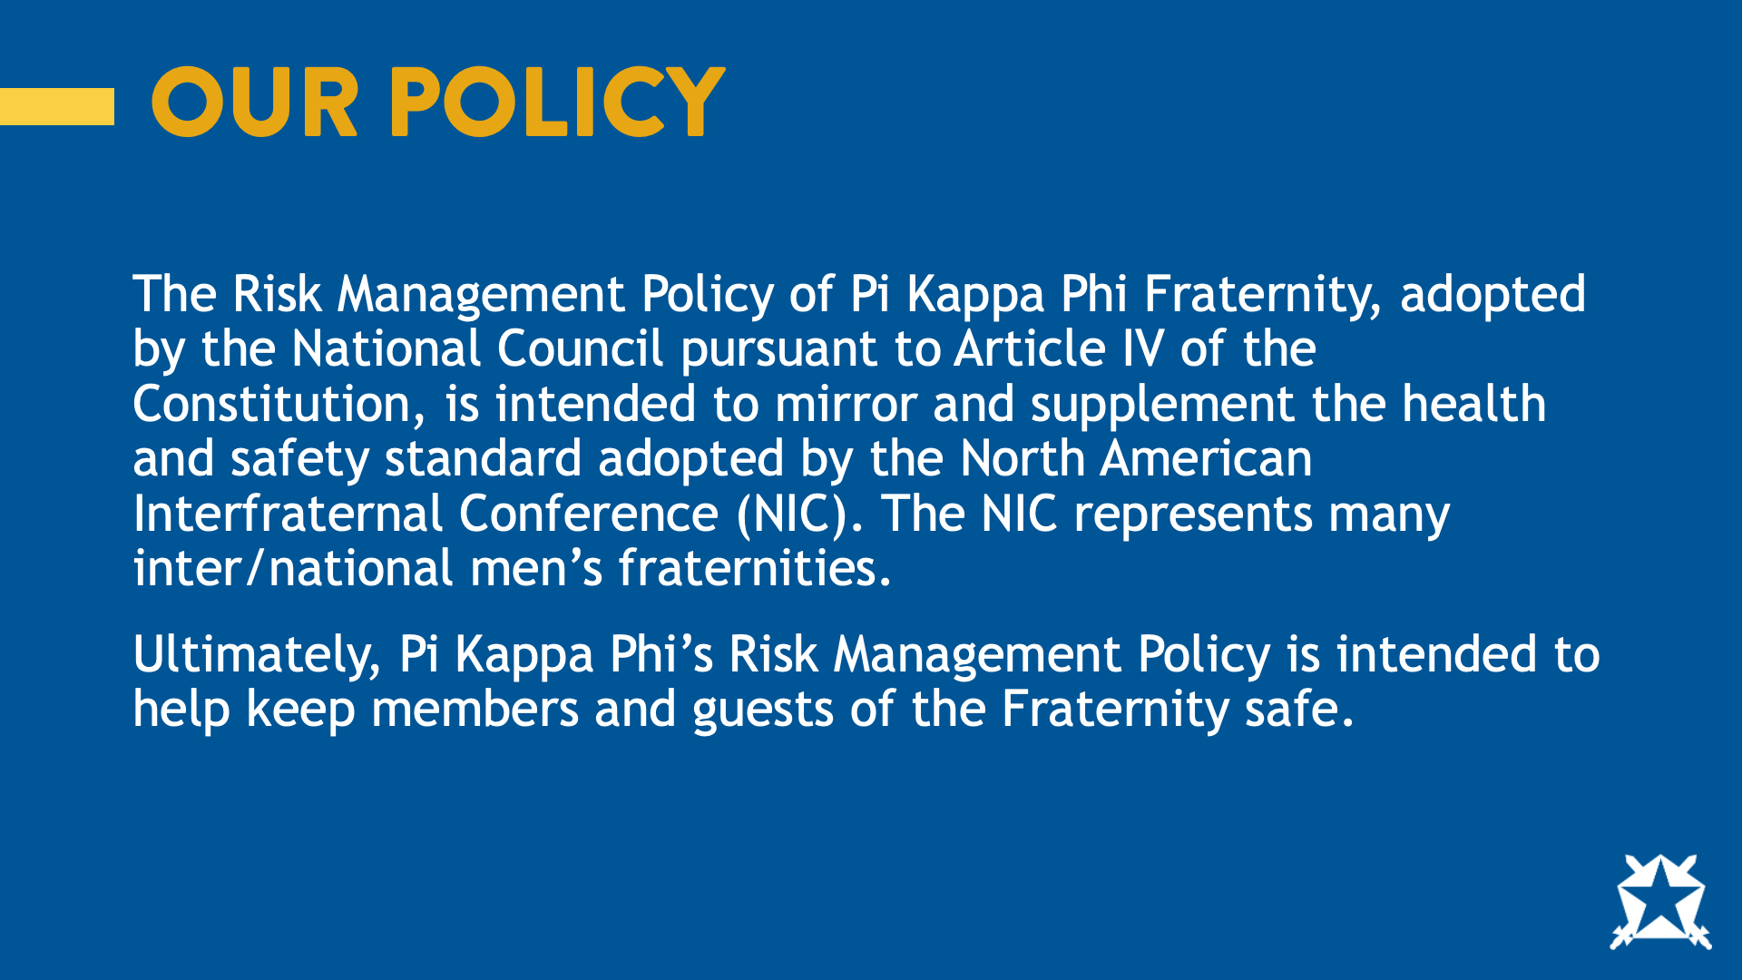
Notes:
In short, the Pi Kappa Phi Risk Management Policy is intended to help keep members and guests of the fraternity safe. For years, we’ve used the metaphor of the “ladder of risk” to explain the fraternity’s risk management policy. Each policy can be thought of as rung on a ladder and violating a policy is a step up that ladder. What happens if you fall from the top of a ladder?

Slide 5
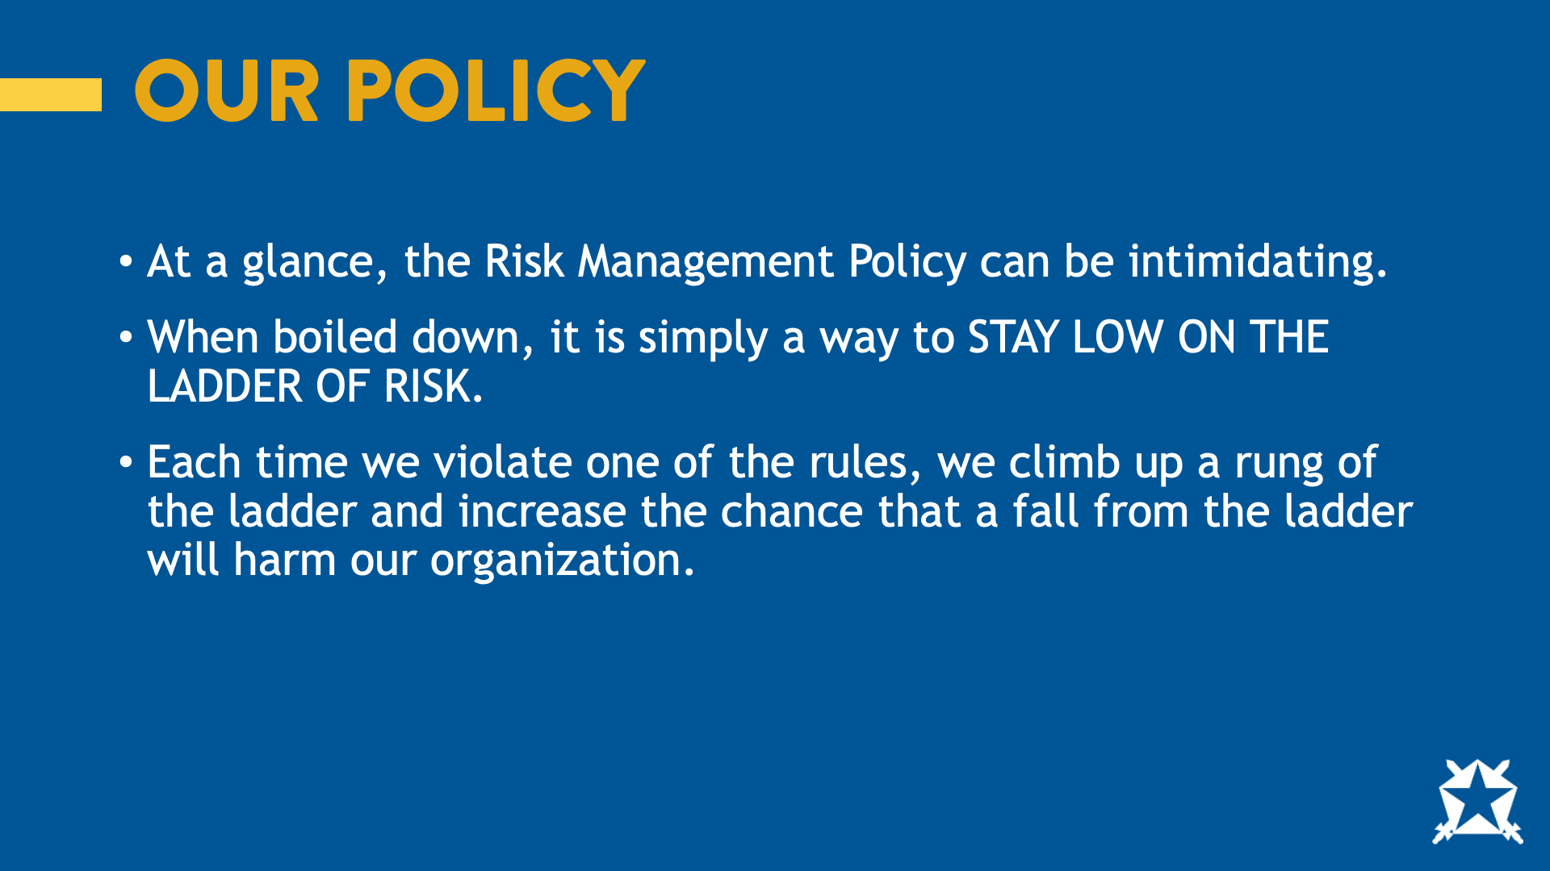
Notes:
If we fall from the ladder, we risk harm to the organization. While the policy may seem intimidating, it is intended to be a tool to stay low on the ladder of risk. Now that we know why we have a policy, lets talk about when it applies.

Slide 6
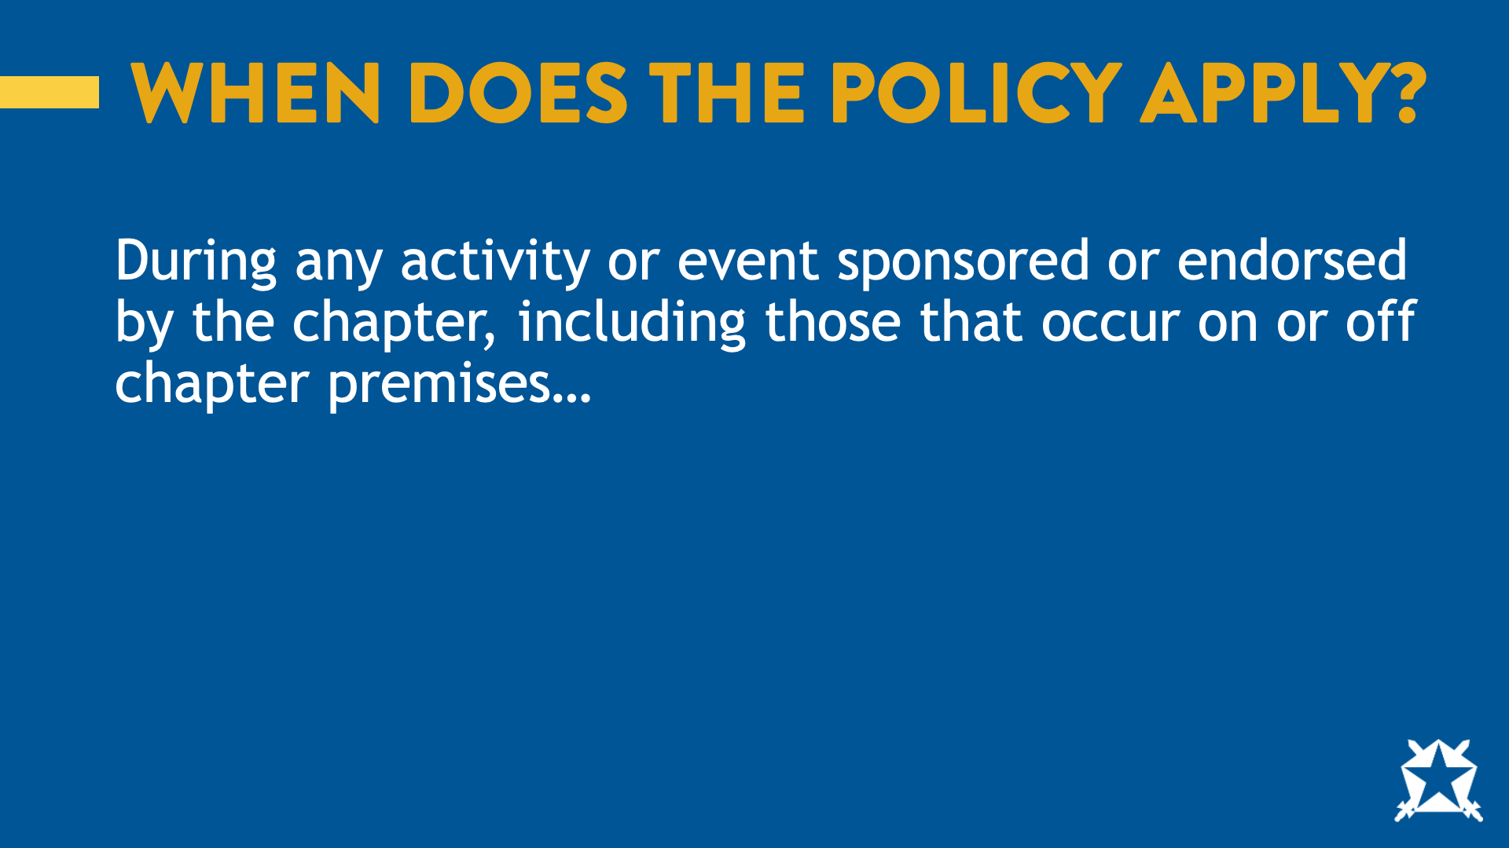
Notes:
When does the policy apply? During any event sponsored or endorsed by the chapter, including those that occur on or off chapter premises.
Ask: What are some examples of when the policy would apply?
Ask: What about when the policy would NOT apply?
You can reference the social event planning guide for how to determine if something is an event or not.

Slide 7
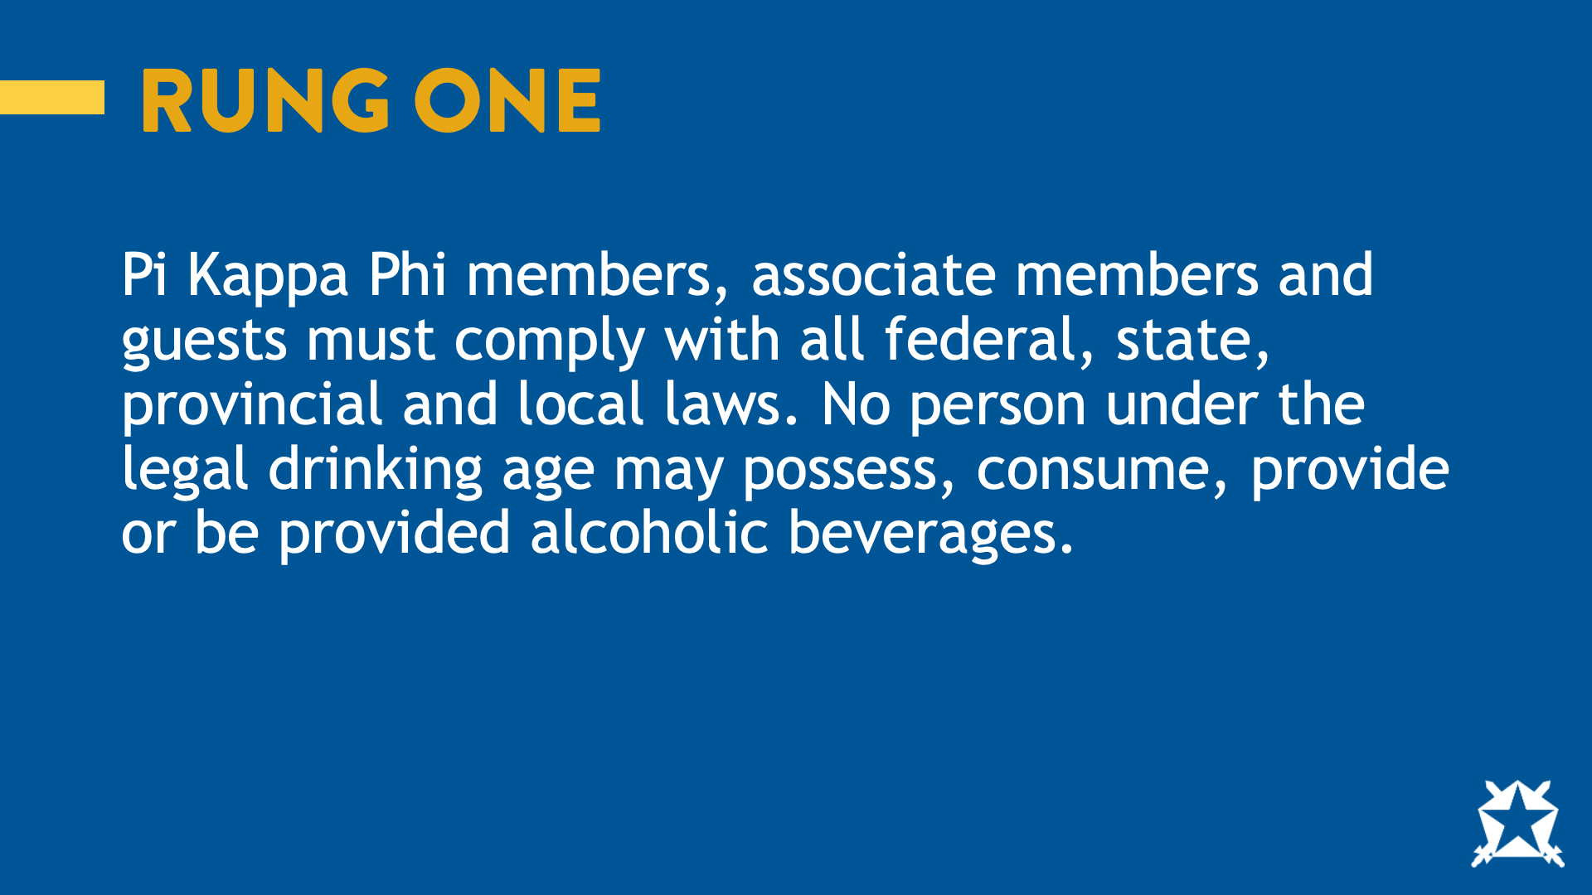
Notes:
Pi Kappa Phi members, associate members and guests must comply with all federal, state, provincial, and local laws. No Person under the legal drinking age may possess, consume, provide, or be provided alcoholic beverages.
Ask: What does this mean?

Slide 8
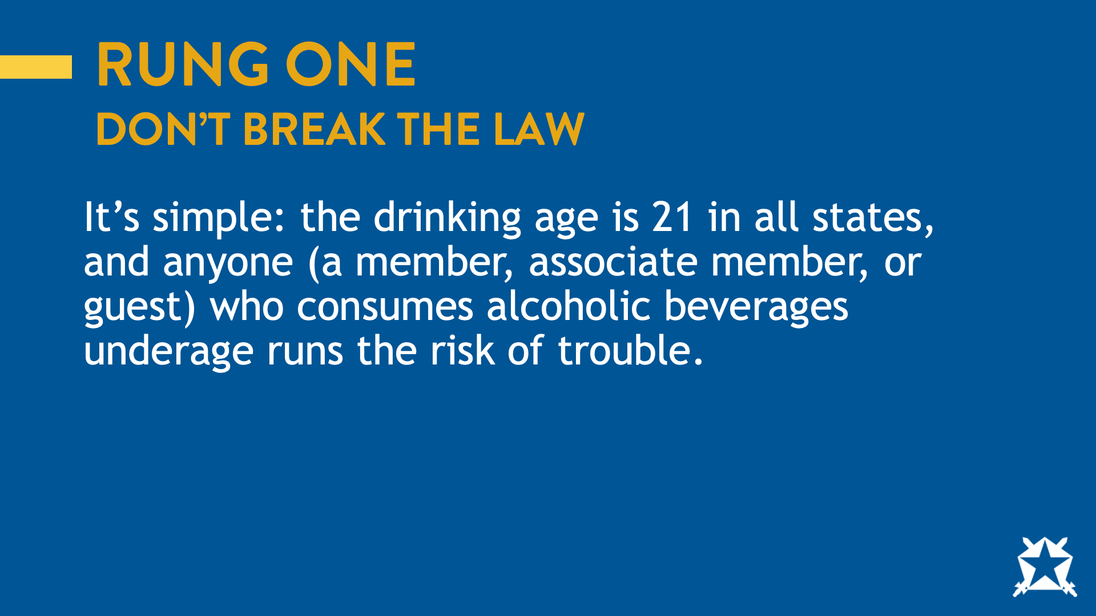
Notes:
In short, don’t break the law. The drinking age is 21 in all states, and anyone [a member, associate member, or guest] who consumes alcoholic beverages underage runs the risk of trouble.
Ask: if someone breaks the law, that person should expect consequences. What could the consequences be?

Slide 9
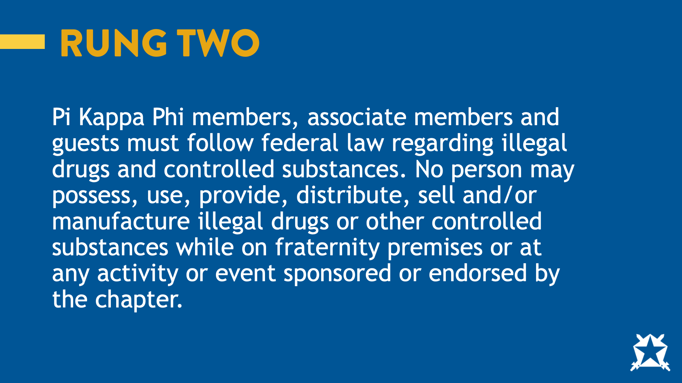
Notes:
Pi Kappa Phi members, associate members, and guests must follow federal law regarding illegal drugs and controlled substances. No person may possess, use, provide, distribute, sell, and/or manufacture illegal drugs or other controlled substances while on fraternity premises or at any activity or event sponsored or endorsed by the chapter.
Ask: What does this mean?

Slide 10
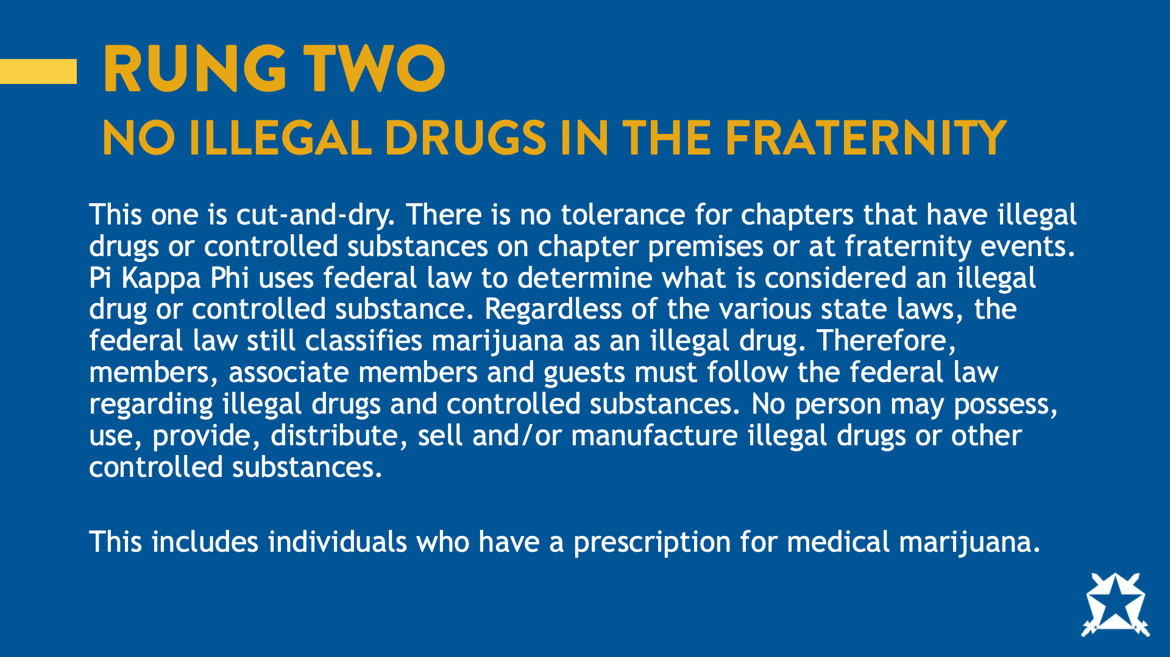
Notes:
No illegal drugs in the fraternity. You’ll notice this rung references the federal law. The fraternity must comply with federal law when it comes to drugs meaning regardless of the various state laws, the federal law still classifies marijuana as an illegal drug. Therefore, members, associate members and guests must follow the federal law regarding illegal drugs and controlled substances.

Slide 11
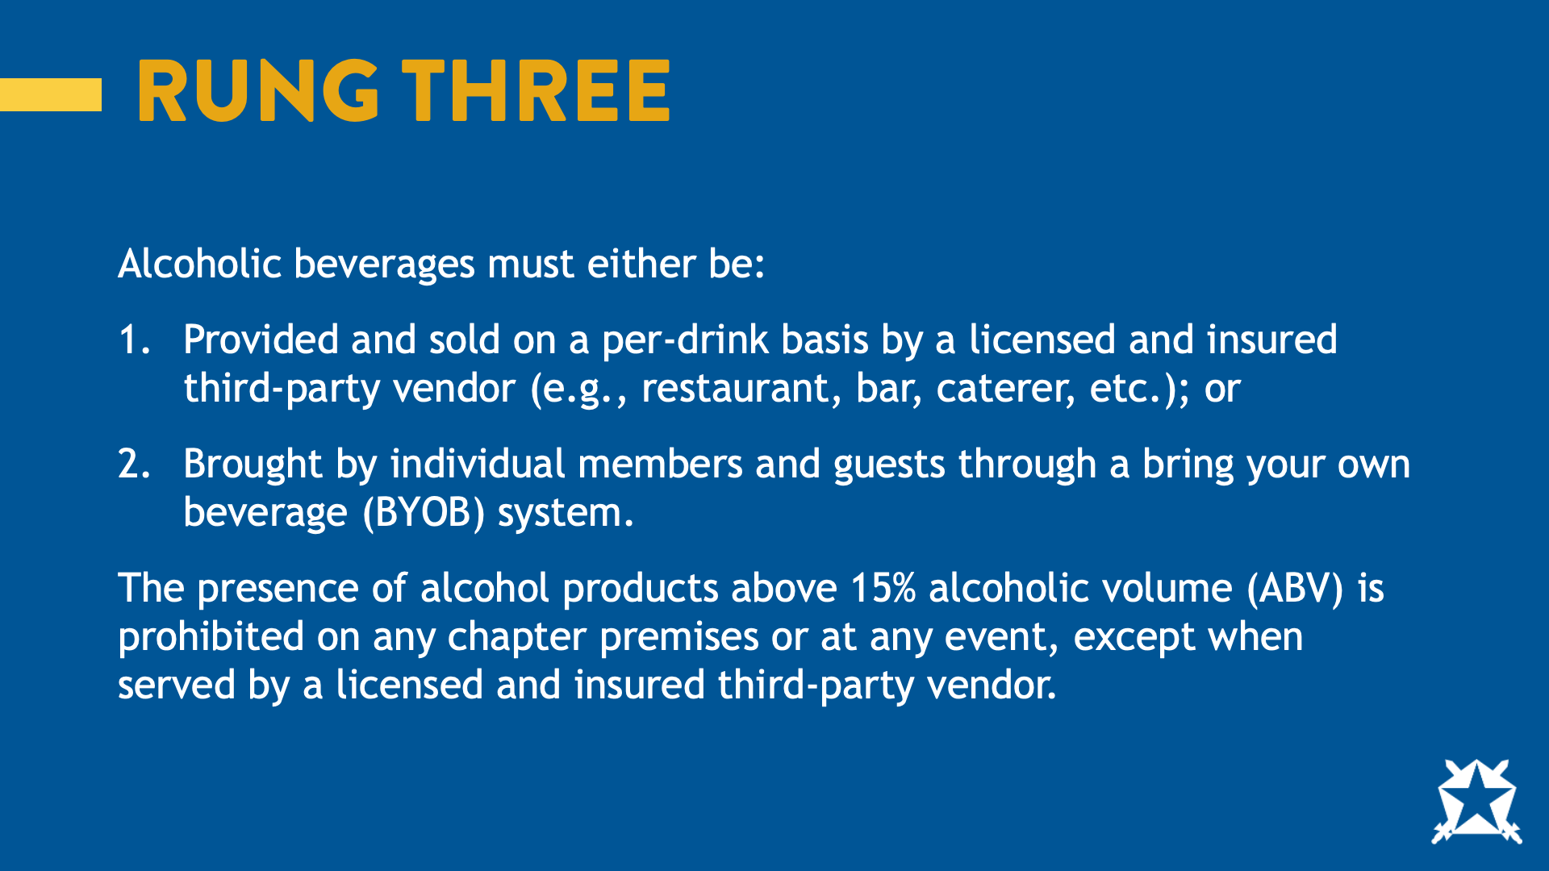
Notes:
Alcoholic beverages must either be: (1) provided and sold on a per-drink basis by a licensed and insured third-party vendor (e.g., restaurant, bar, caterer, etc.); or (2) brought by individual members and guests through a bring your own beverage (“BYOB”) system.
The presence of alcohol products above 15% alcoholic volume (“ABV”) is prohibited on any chapter premises or at any event, except when served by a licensed and insured third-party vendor.

Slide 12
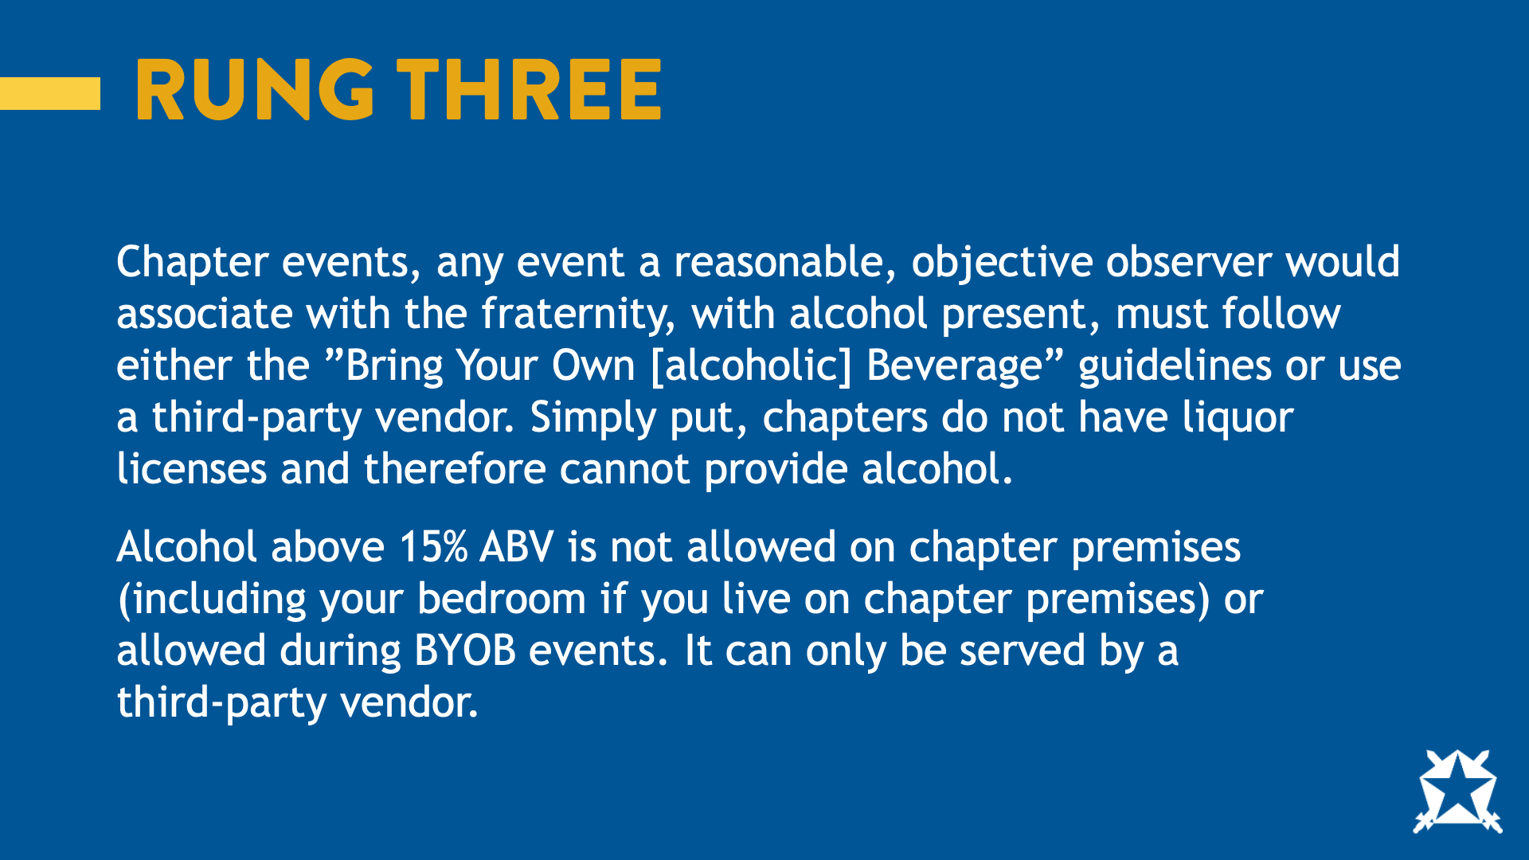
Notes:
Lets break this one down a bit: Any event with alcohol must follow BYOB guidelines or use a third-party vendor. The chapter does not have a liquor license and therefore cannot provide alcohol. Additionally, alcohol above 15% ABV is not allowed on chapter premises and can only be served by a third-party vendor.
Ask: What are some reasons we would not want hard alcohol (liquor) at events?
Ask: What is the highest predictor of sexual assault? Answer: alcohol
Ask: What are some examples of beverages that are below 15% ABV?
Ask: What could be hard about enforcing this?

Slide 13
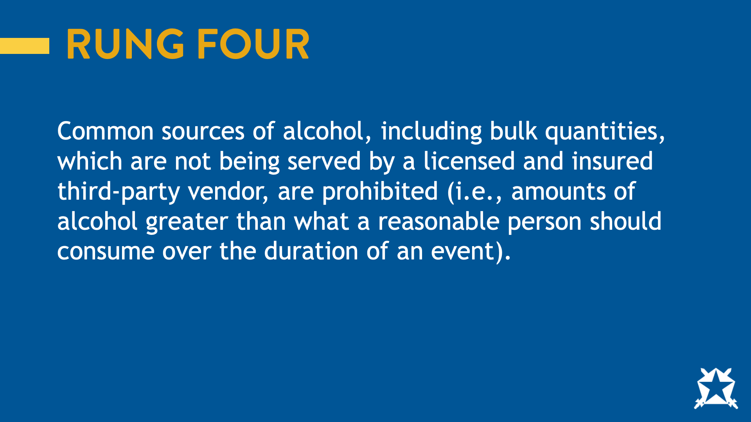
Notes:
Common sources of alcohol, including bulk quantities, which are not being served by a licensed and insured third-party vendor, are prohibited (i.e., amounts of alcohol greater than what a reasonable person should consume over the duration of an event).
What does this mean?

Slide 14
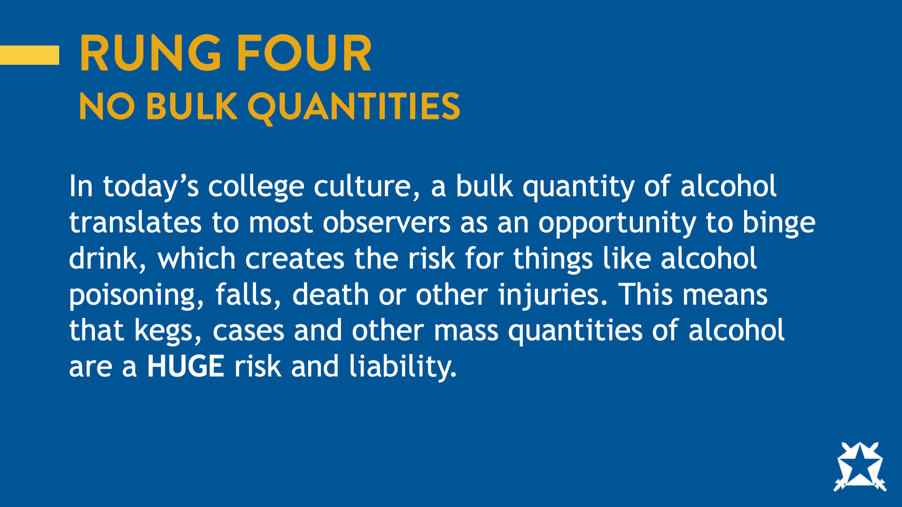
Notes:
No bulk quantities. In today’s college culture, a bulk quantity of alcohol translates to most observers as an opportunity to binge drink, which creates the risk for things like alcohol poisoning, falls, death, other injuries. This means that kegs, cases, and other mass quantities of alcohol are a HUGE risk and liability.

Slide 15
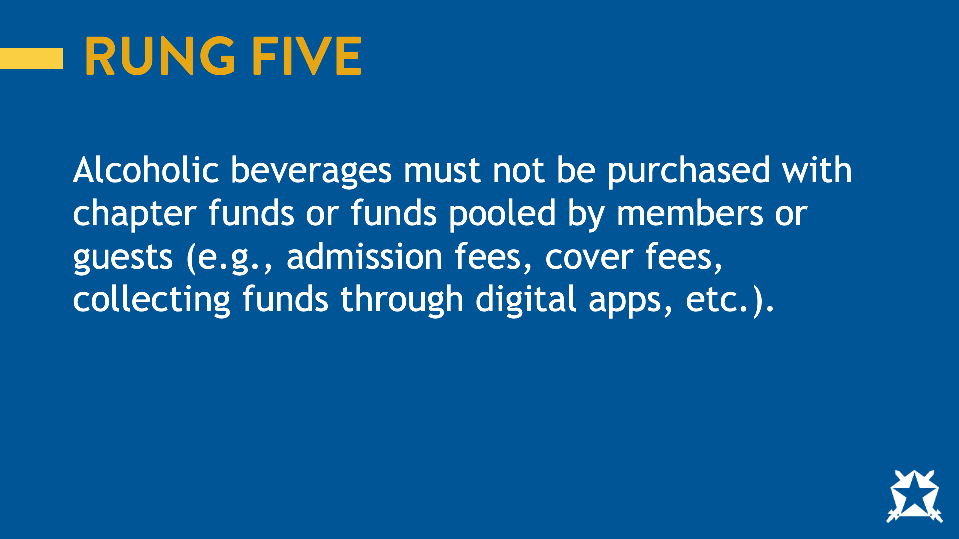
Notes:
Alcoholic beverages must not be purchased with chapter funds or funds pooled by members or guests (e.g., admission fees, cover fees, collecting funds through digital apps, etc.).
Ask: what does this mean?

Slide 16
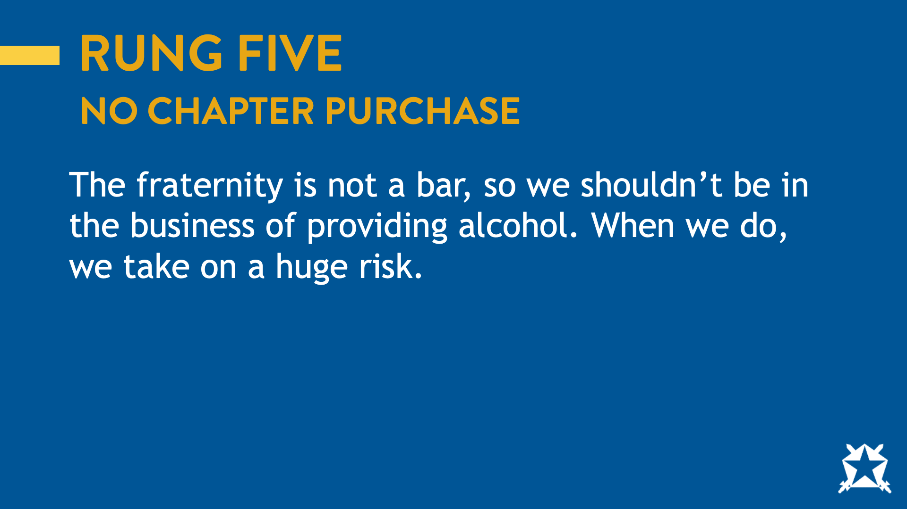
Notes:
The fraternity is not a bar and cannot purchase alcohol.
Ask: why is this important?

Slide 17
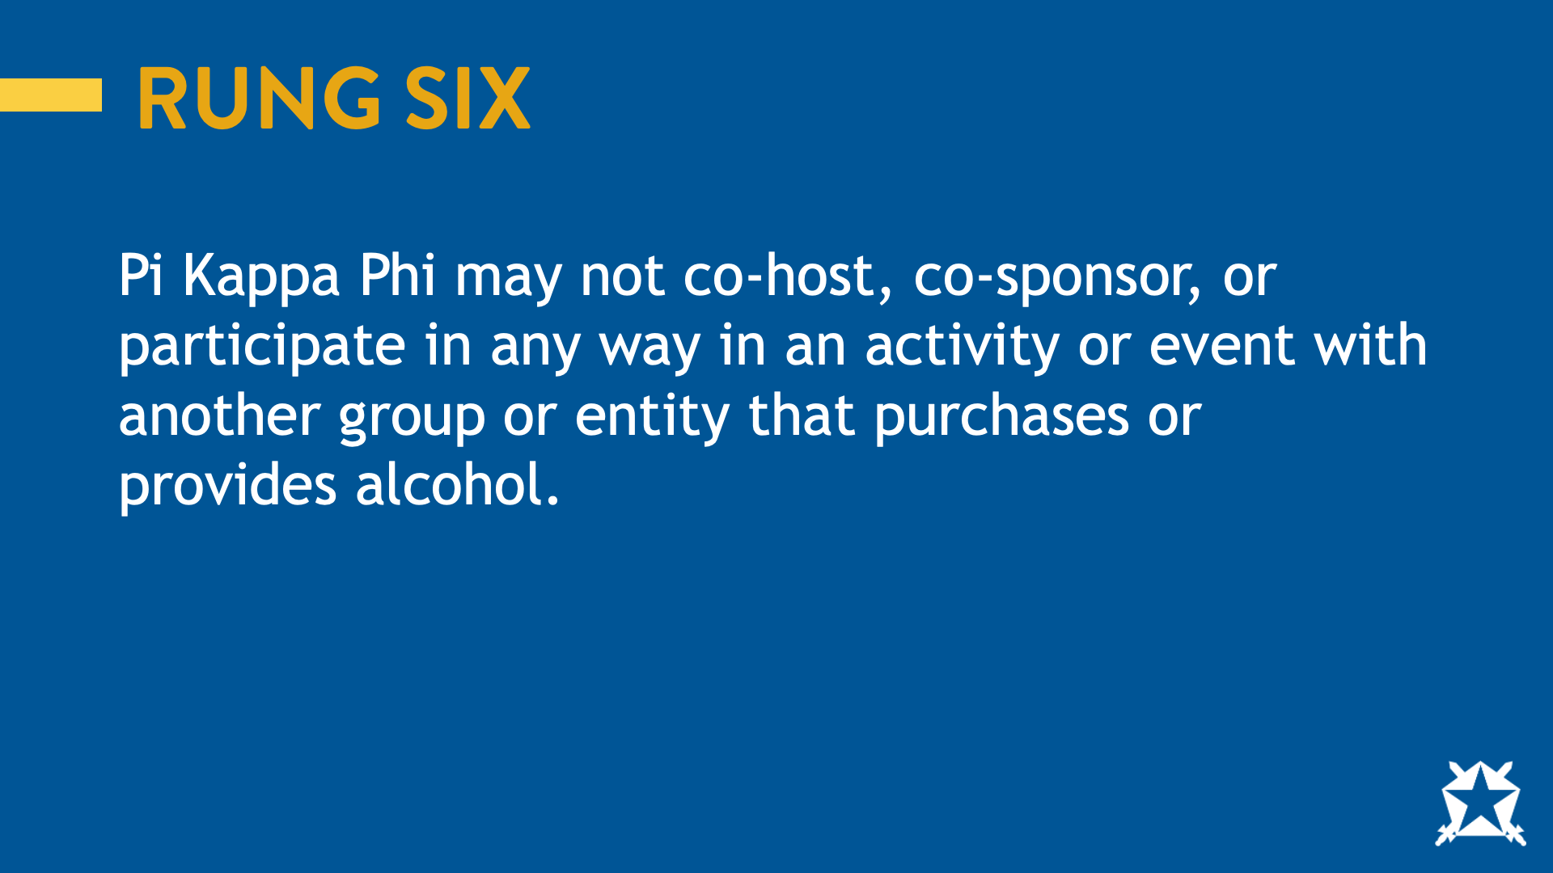
Notes:
Pi Kappa Phi may not co-host or co-sponsor, or in any way participate in, an activity or event with another group or entity that purchases or provides alcohol.
Ask: What does this mean?

Slide 18
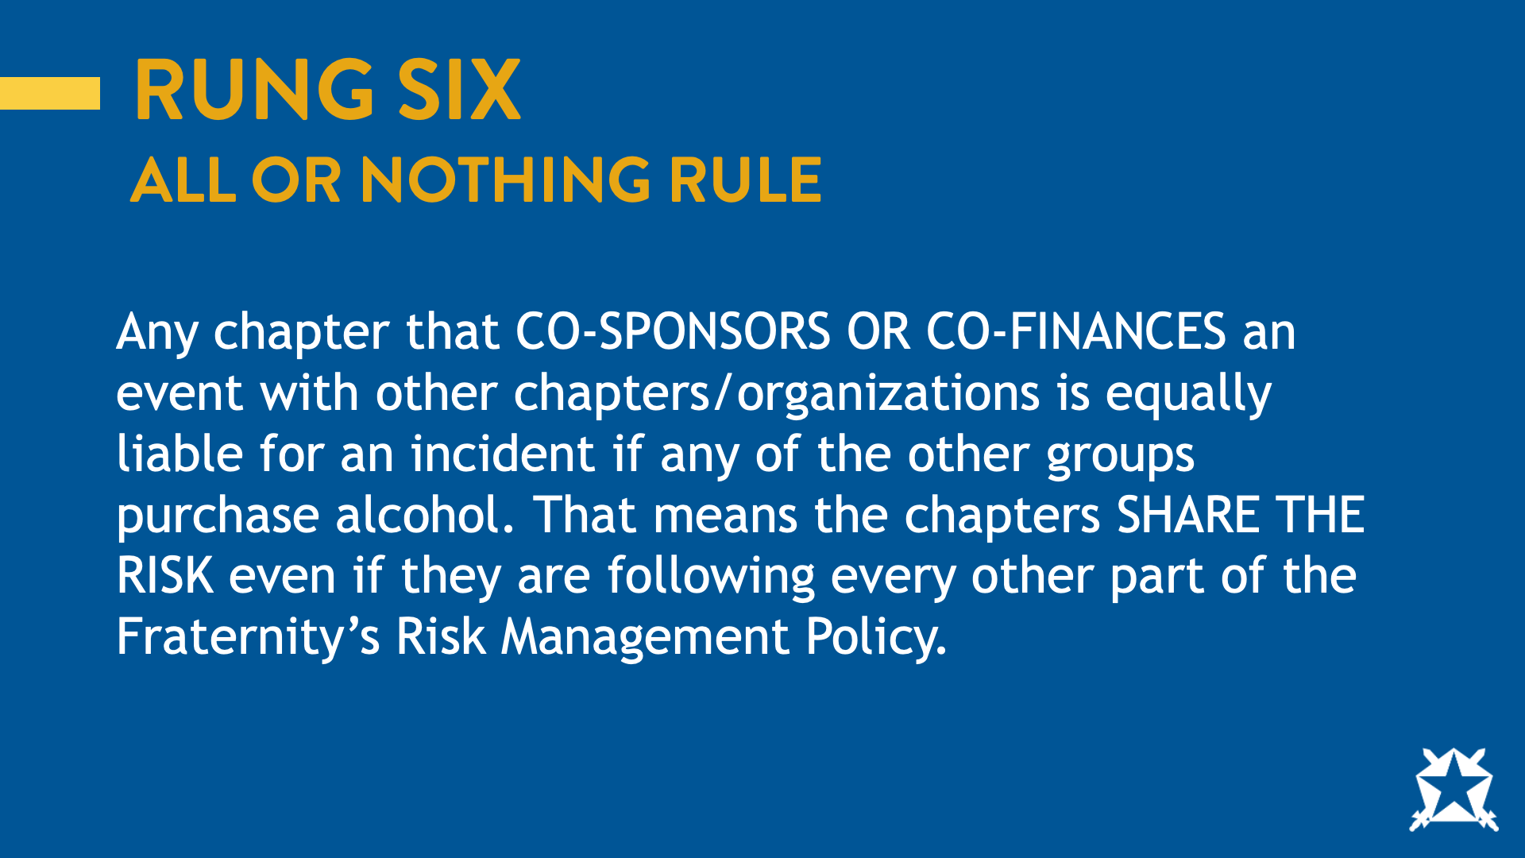
Notes:
We call this the all or nothing rule. If the chapter cohost/cosponsors an event with another organization that purchases alcohol, the chapter is equally liable for any incidents that could occur. The fraternity expects any group that we cohost/cosponsor with to follow our policies.

Slide 19
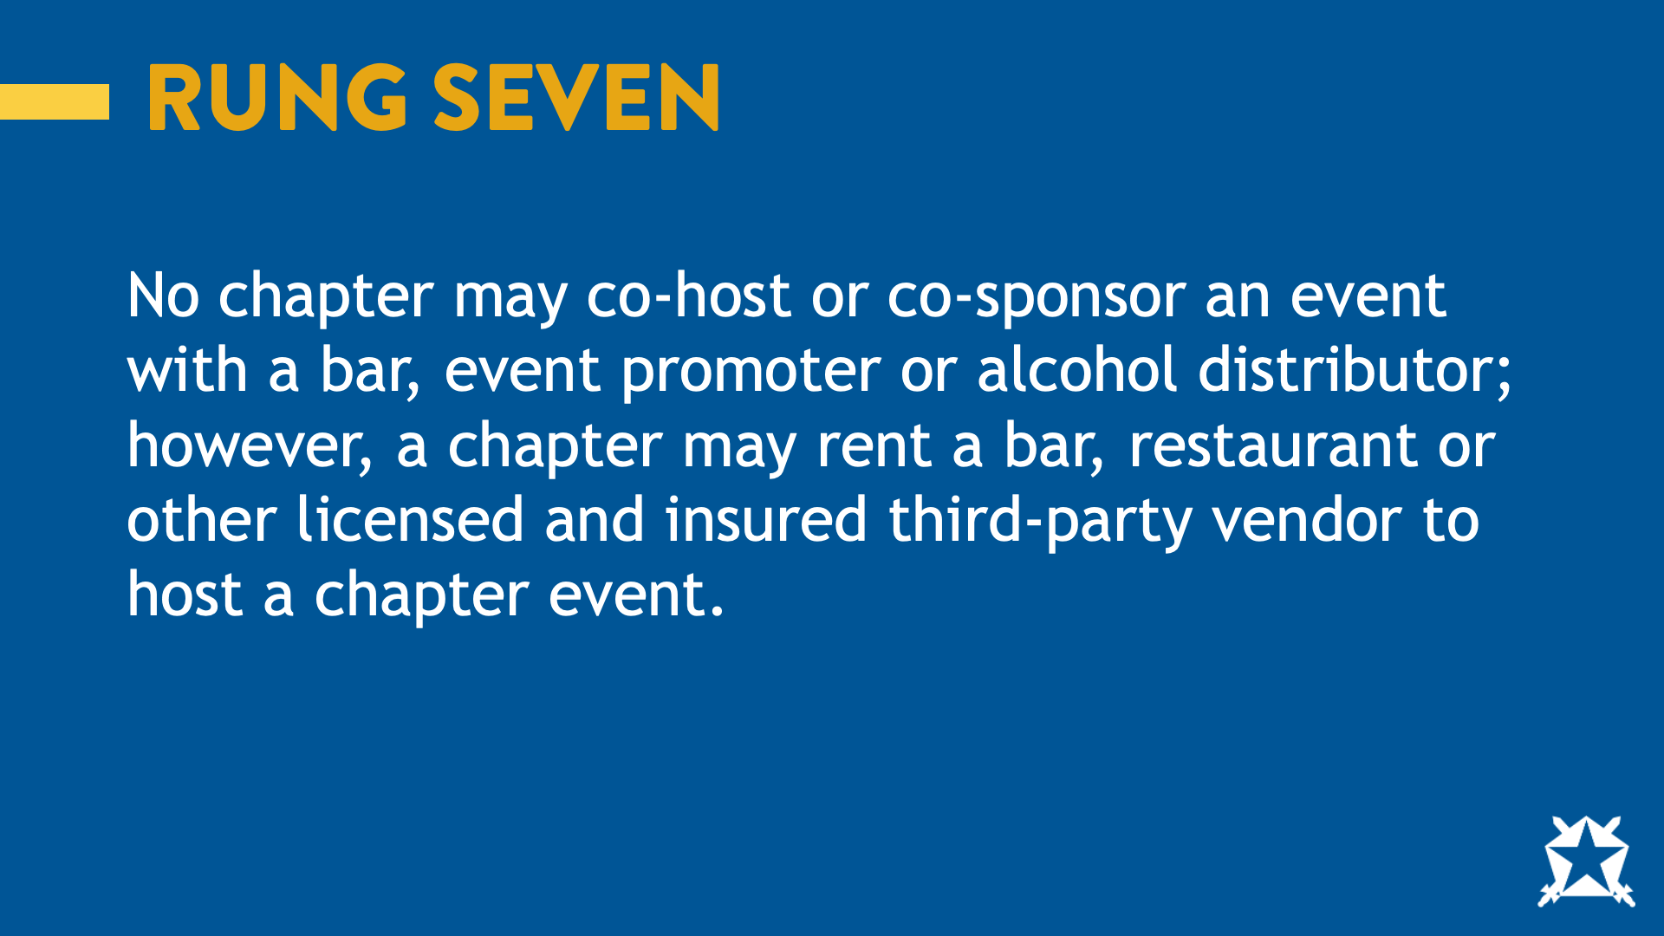
Notes:
No chapter may co-host or co-sponsor an event with a bar, event promoter, or alcohol distributor; however, a chapter may rent a bar, restaurant, or other licensed and insured third-party vendor to host a chapter event.
Ask: who can break this down for us?

Slide 20
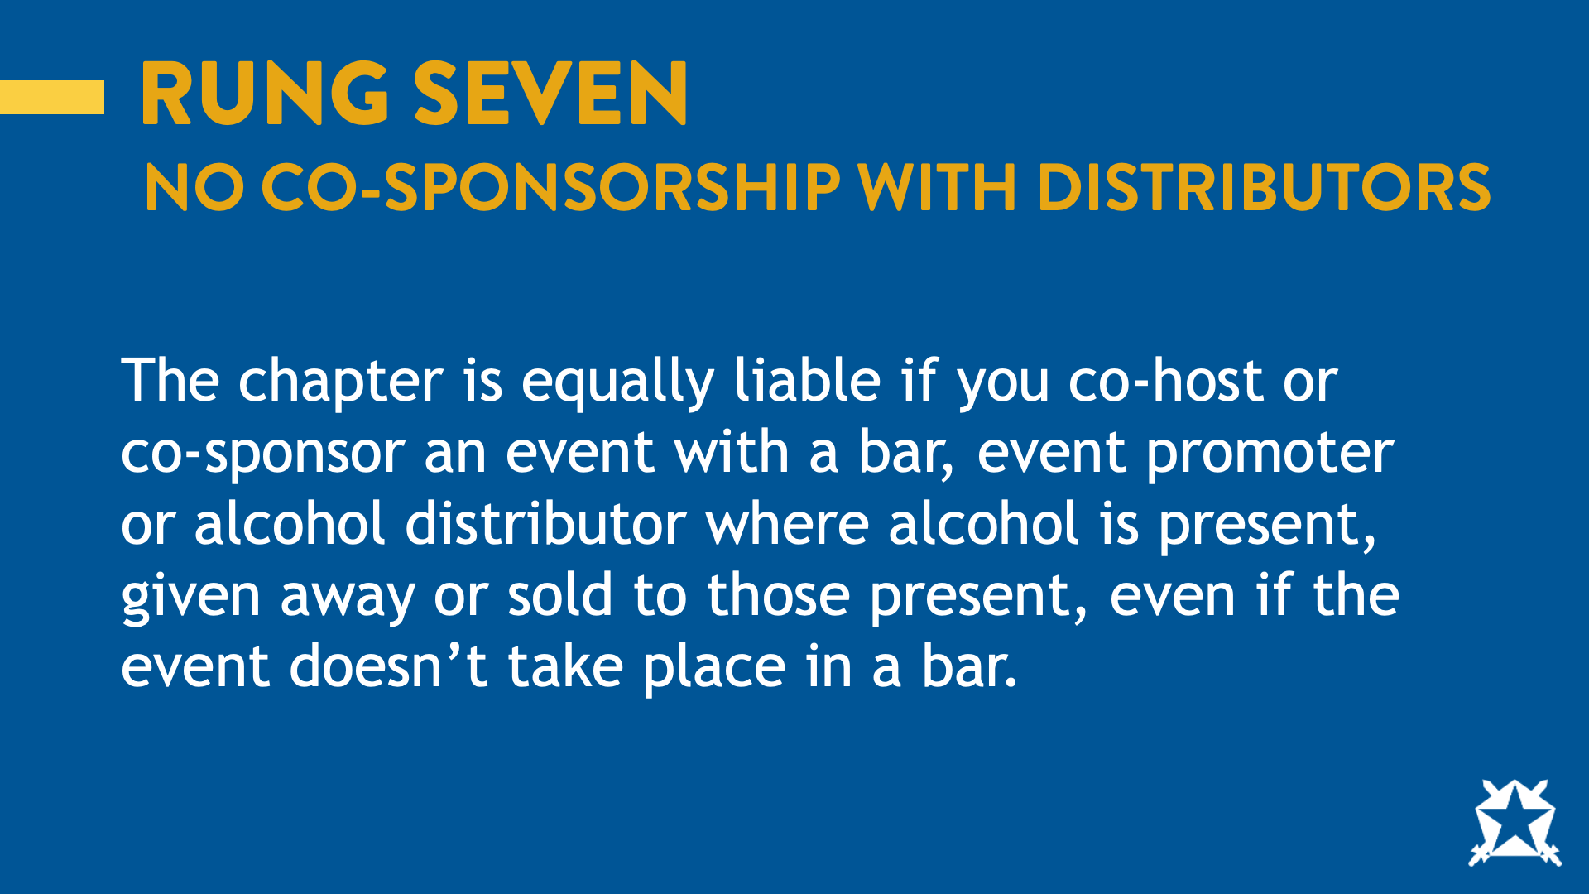
Notes:
Similarly, to rung six, any group that cohosts/cosponsors an event with the chapter must comply with our policies. Alcohol distributors by nature cannot comply with our policy therefore, we cannot cohost/cosponsor an event with a distributor.
Ask: Why do we think this is a policy?

Slide 21
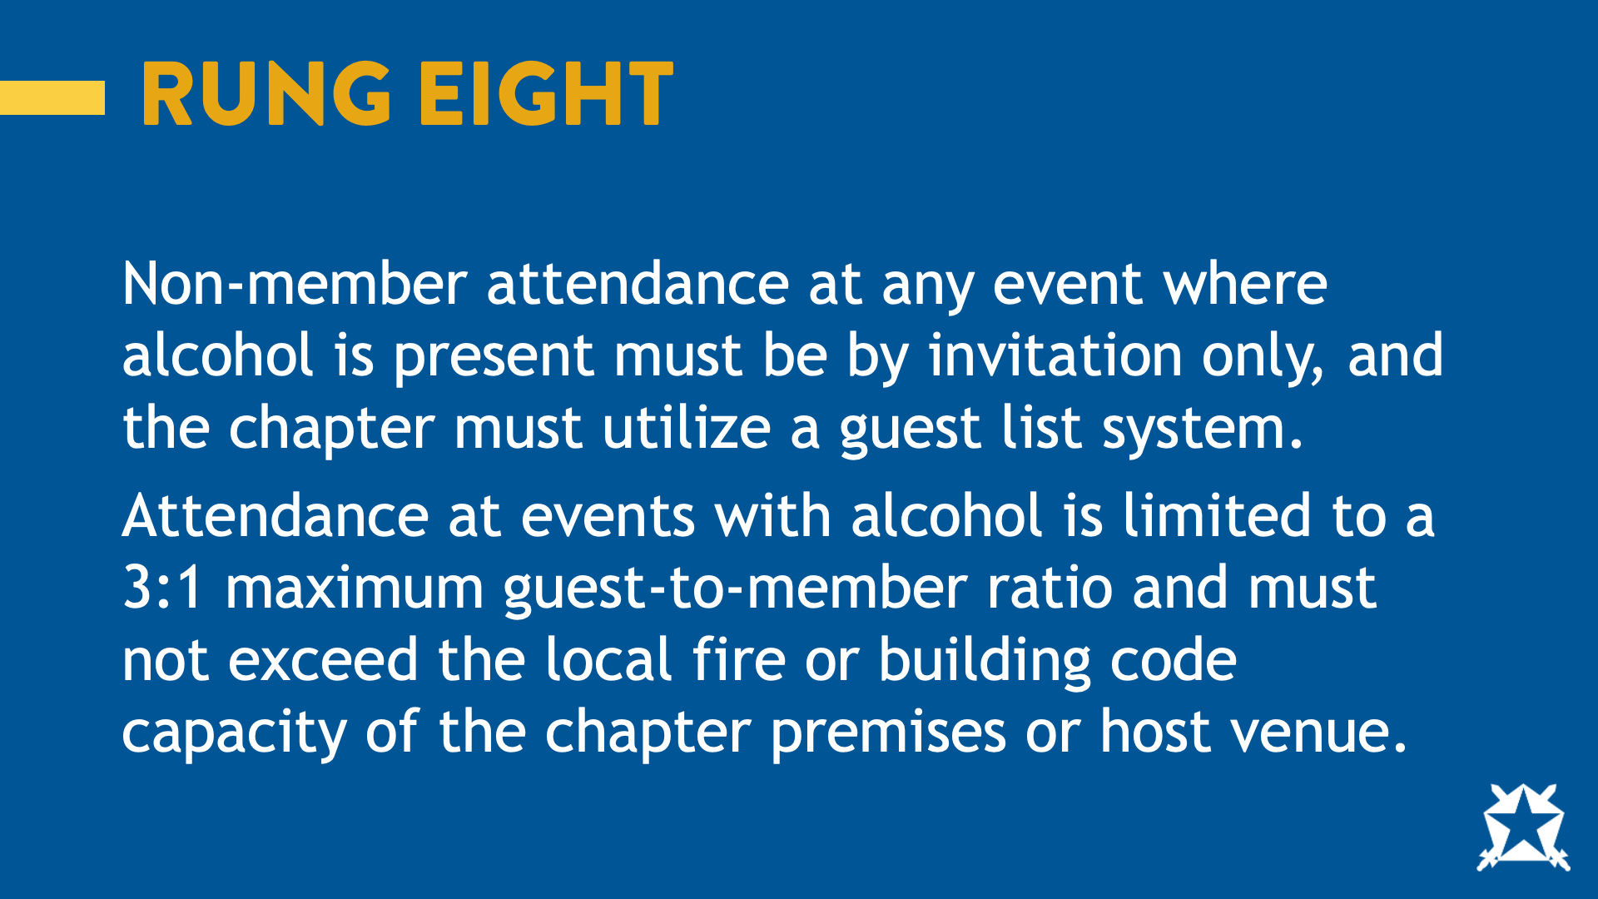
Notes:
Attendance by non-members at any event where alcohol is present must be by invitation only, and the chapter must utilize a guest list system. Attendance at events with alcohol is limited to a 3:1 maximum guest-to-member ratio and must not exceed local fire or building code capacity of the chapter premises or host venue.
Ask: what does this mean?

Slide 22
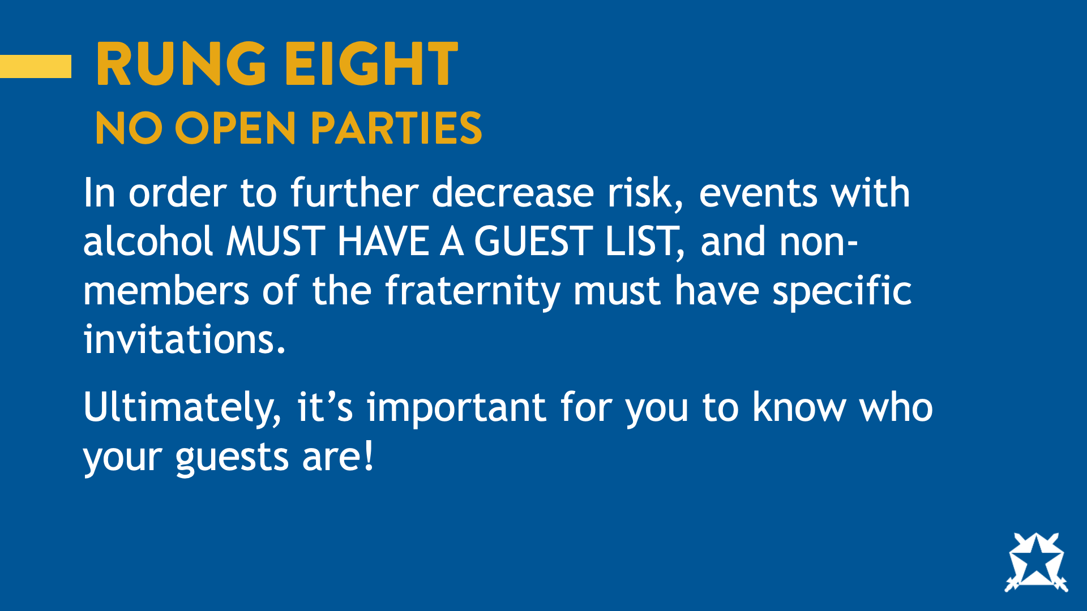
Notes:
No open parties. You should know who your guests are. To further decrease risk, events with alcohol MUST HAVE A GUEST LIST and non-members of the Fraternity must have specific invitations.
Ask:
Are women guests?
What should be included on your guest list?
What if someone shows up that is not on the guest list?
Why is there a 3:1 guest to member ratio?

Slide 23
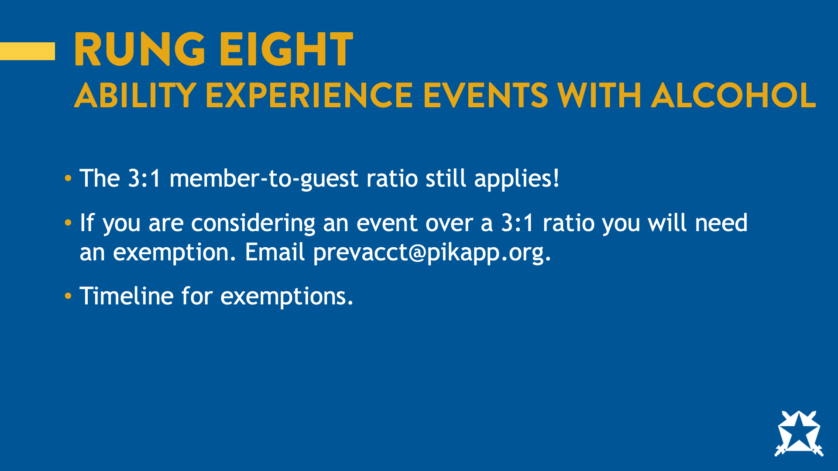
Notes:
This risk management policy also applies to philanthropy events. If the chapter is looking to host an event that would exceed the 3:1 guest to member ratio, they should reach out to the Senior Director of Harm Reduction as well as Ability Experience Staff to ensure they’ve planned adequately and so they can apply for an exemption.

Slide 24
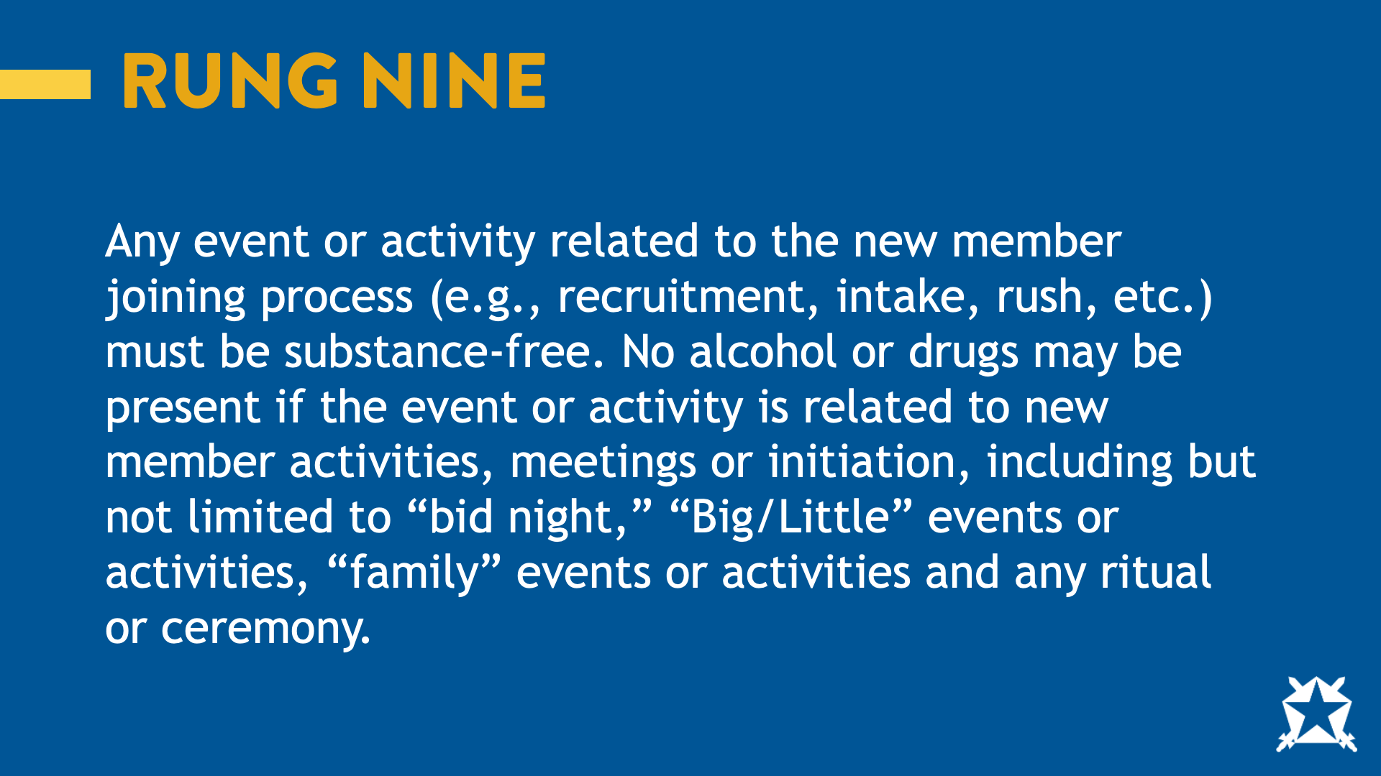
Notes:
Any event or activity related to the new member joining process (e.g., recruitment, intake, rush, etc.) must be substance free. No alcohol or drugs may be present if the event or activity is related to new member activities, meetings, or initiation, including but not limited to “bid night,” “Big/Little” events or activities, “family” events or activities, and any ritual or ceremony.
Ask: What does this mean?

Slide 25
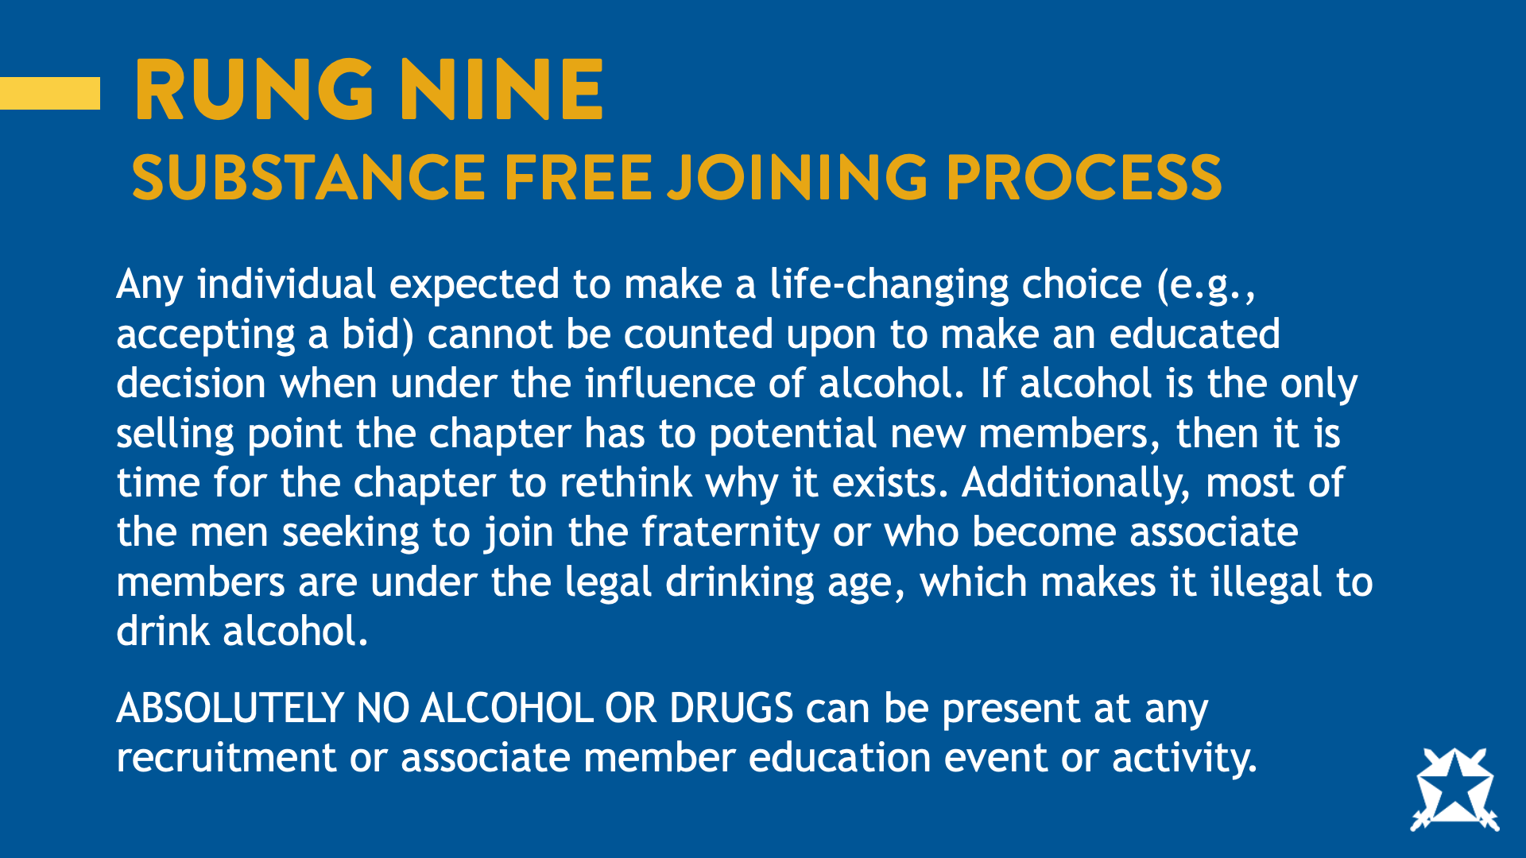
Notes:
That the new member process must be substance free. Making the decision about whether or not to join a fraternity is a life-changing choice and a potential new member should not make that choice while under the influence of alcohol. If alcohol is the only selling point for the chapter, then it is time to rethink why the chapter exists. It is true that most of the men looking to join the fraternity are under the legal drinking age. We also know that many of the hazing deaths that have occurred in recent history have involved alcohol at new member activities. We can step down the ladder by removing alcohol from these activities.
Ask: What types of events would this policy apply at?

Slide 26
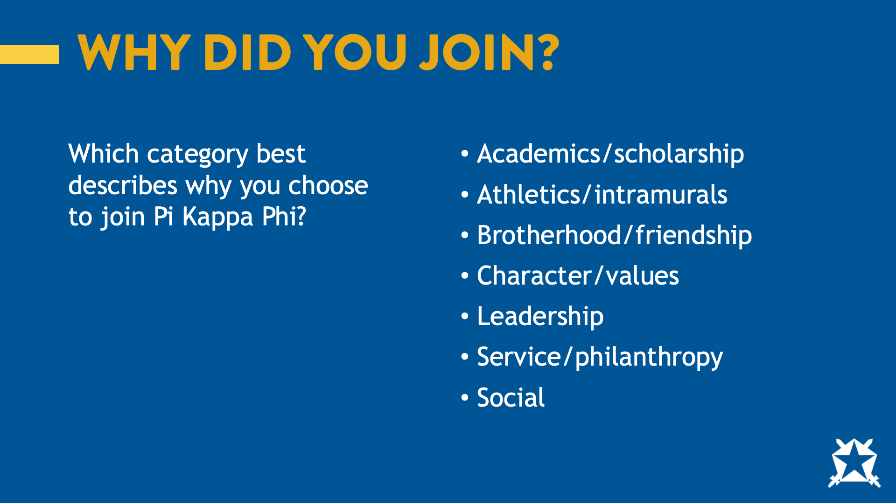
Notes:
Now I want you to think about why you joined Pi Kappa Phi. When asked, this question and given the answers on the screen. How do you think most men answered?

Slide 27
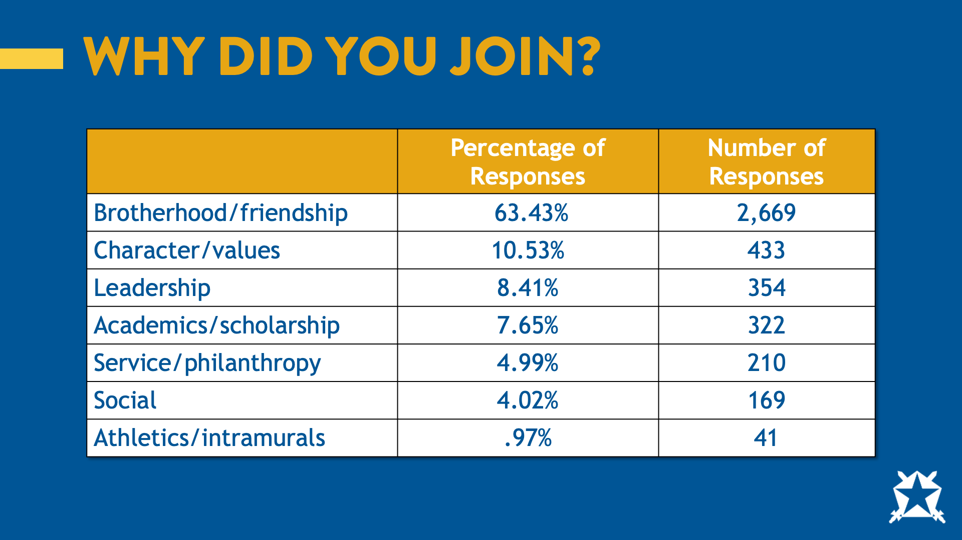
Notes:
If you answered “Brotherhood and friendship” you’re right. You can see that “social” was the second lowest response.

Slide 28
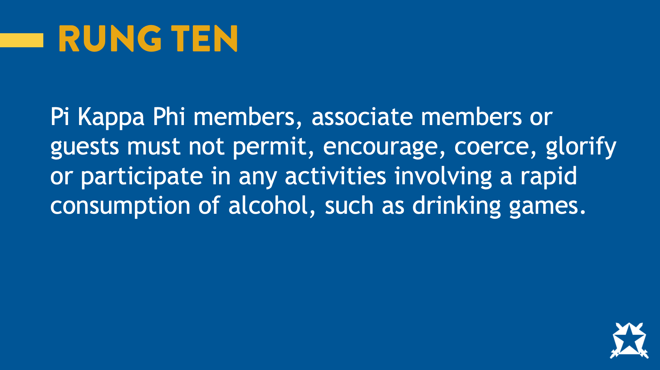
Notes:
Pi Kappa Phi members, associate members, or guests must not permit, encourage, coerce, glorify, or participate in any activities involving a rapid consumption of alcohol, such as drinking games.
Ask: why do you think this policy is needed?

Slide 29
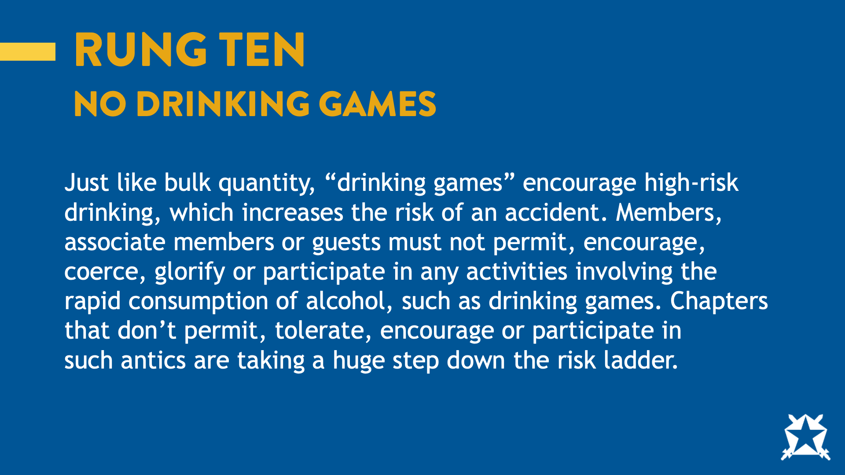
Notes:
Just like bulk quantity, “drinking games” encourage high risk drinking, which increases the risk of an accident. Members, associate members, or guests must not permit, encourage, coerce, glorify or participate in any activities involving the rapid consumption of alcohol, such as drinking games. Chapters that don’t permit, tolerate, encourage, or participate in such antics are taking a huge step down the risk ladder.

Slide 30

Notes:
Often whether you’re paired with a partner or playing as a group, drinking game involve women.

Slide 31
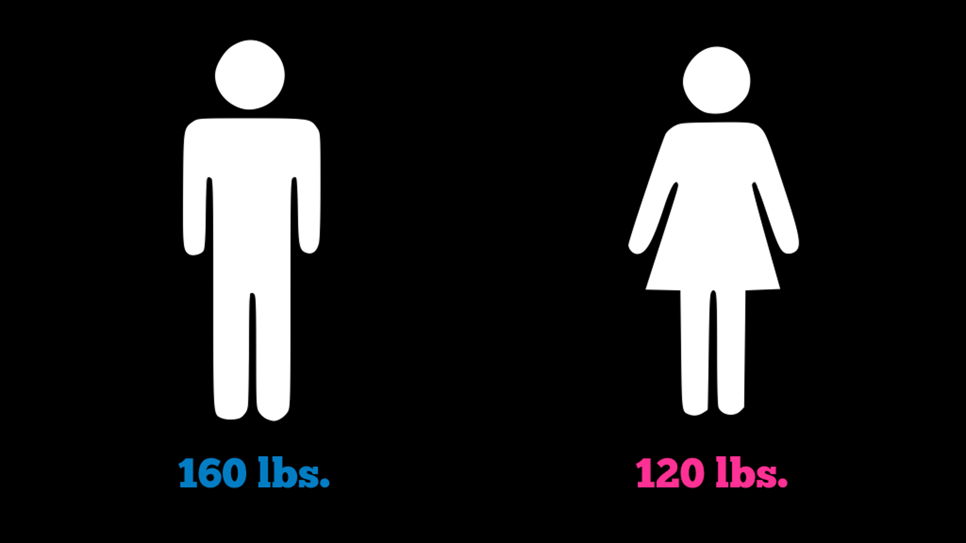
Notes:
So, let’s say you weigh 160 lbs., and you meet a woman at a party who weighs 120 lbs.

Slide 32

Notes:
And you pair up to play a few games of beer pong.

Slide 33
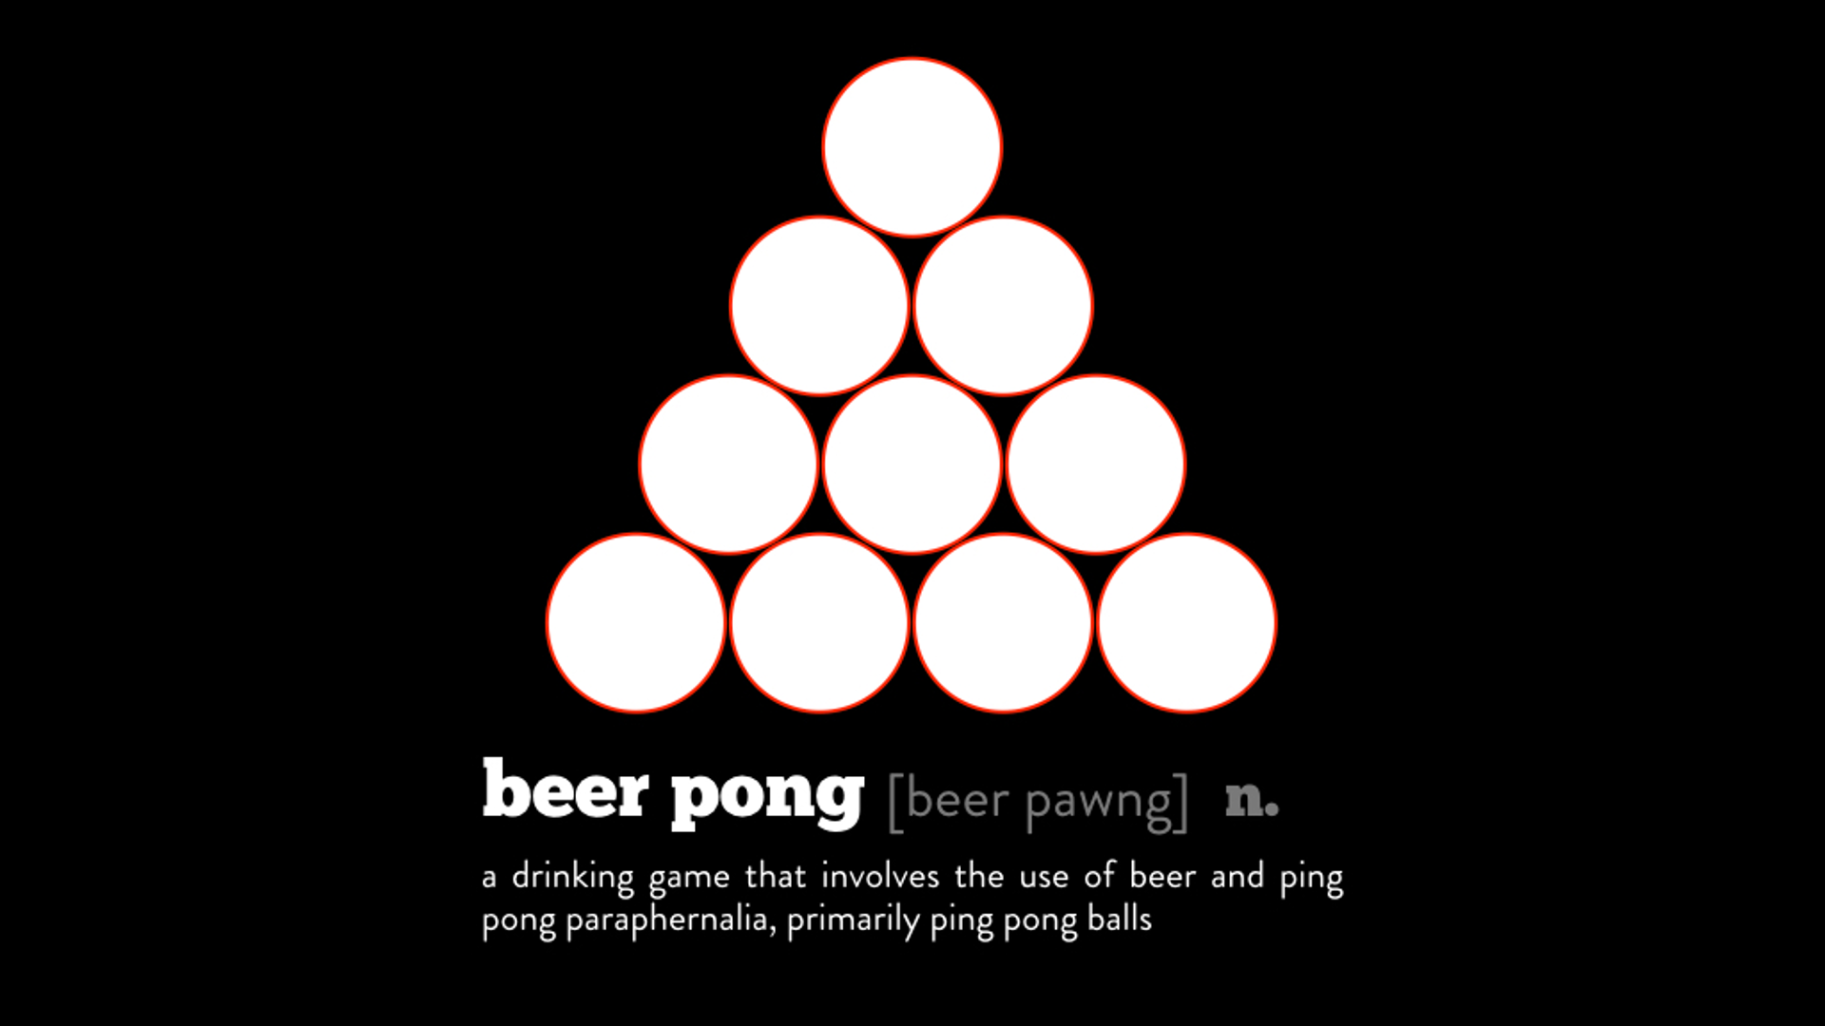
Notes:
If you haven’t been drinking before you start the game, you’d both start out at a .00 BAC. But let’s say each game lasts about 15 minutes both people are drinking about the same amount each game. At the end of the first game, you would be at .02 and at this BAC you’d feel relaxed, and your female partner would be at a .04, double your BAC. At a .04 BAC your partner would be feeling a buzz

Slide 34

Notes:
If you haven’t been drinking before you start the game, you’d both start out at a .00 BAC. But let’s say each game lasts about 15 minutes both people are drinking about the same amount each game.

Slide 35
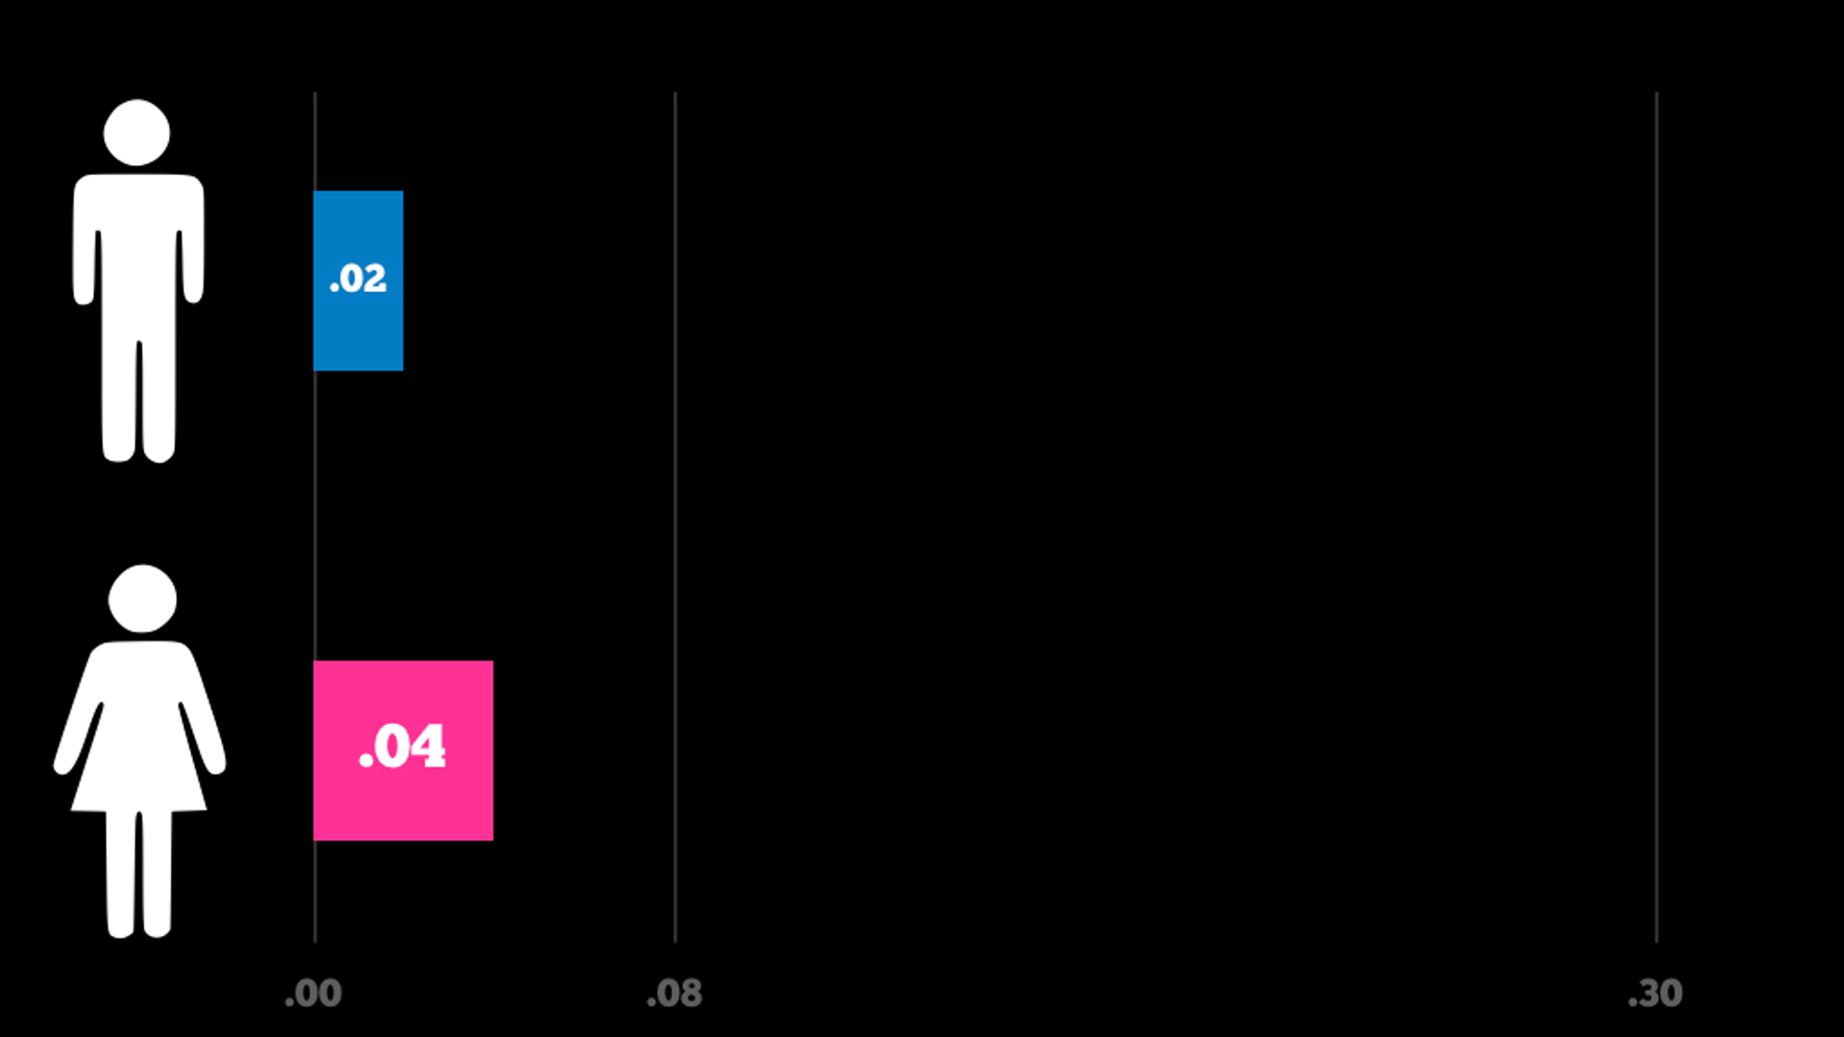
Notes:
At the end of the first game, you would be at .02 and at this BAC you’d feel relaxed, and your female partner would be at a .04, double your BAC. At a .04 BAC your partner would be feeling a buzz

Slide 36
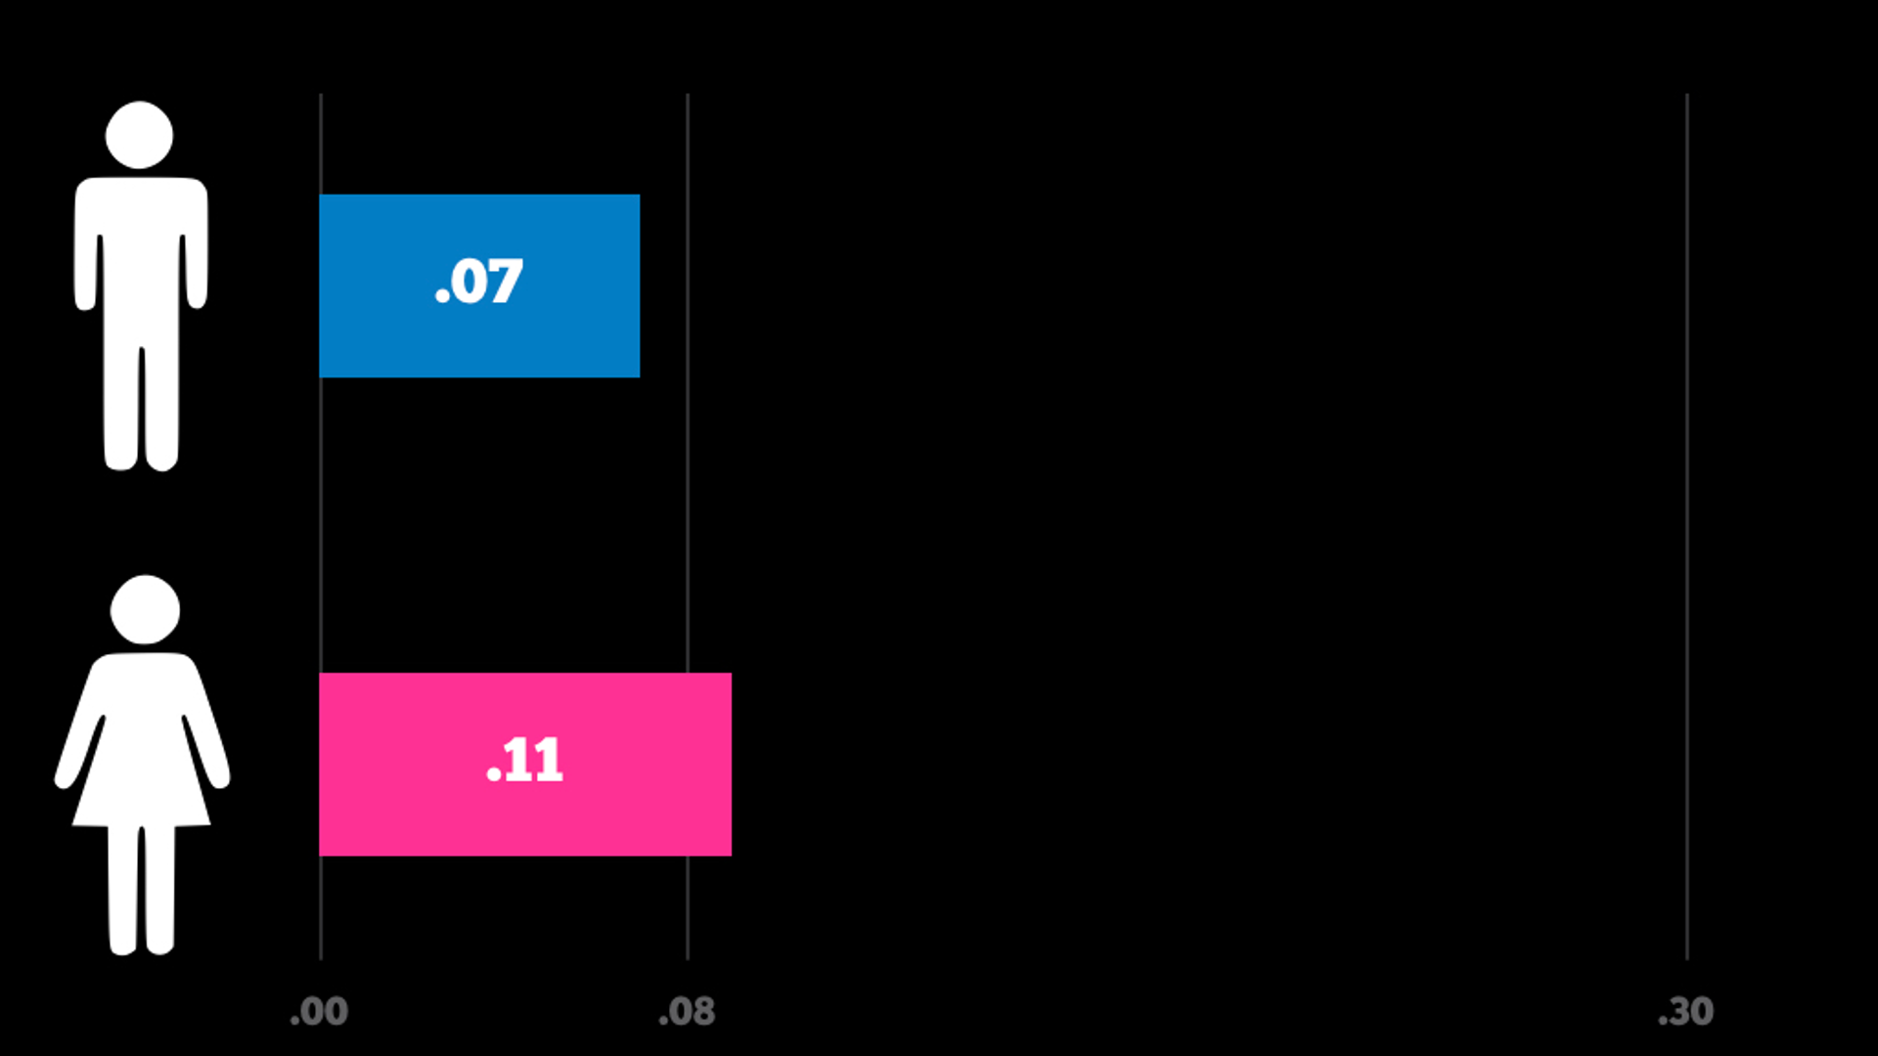
Notes:
If you play a second game and drink about the same. You’d be .07 (just below the legal limit to drive) and your partner would be at a .11. At a .11 we typically see clear deterioration in cognitive judgement and motor coordination.

Slide 37
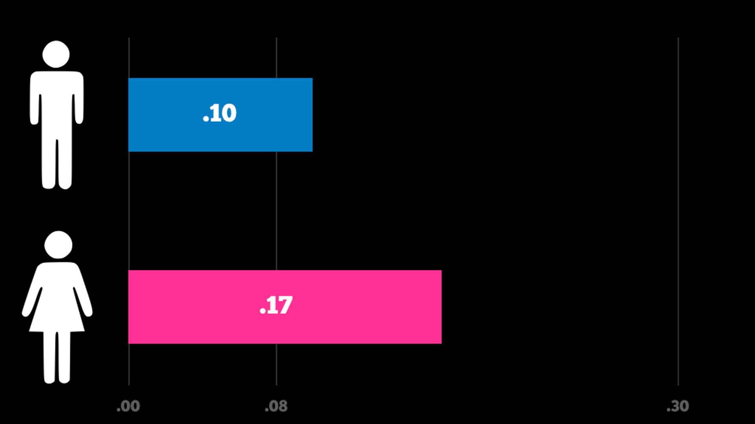
Notes:
But you’re both having fun, so you decide to play another game. At the end of this game, your BAC is now hovering around a .10 (so just below what your partner was feeling after the last game), and your partner is now at a .17. At a .17, your partner has the potential to black out.

Slide 38
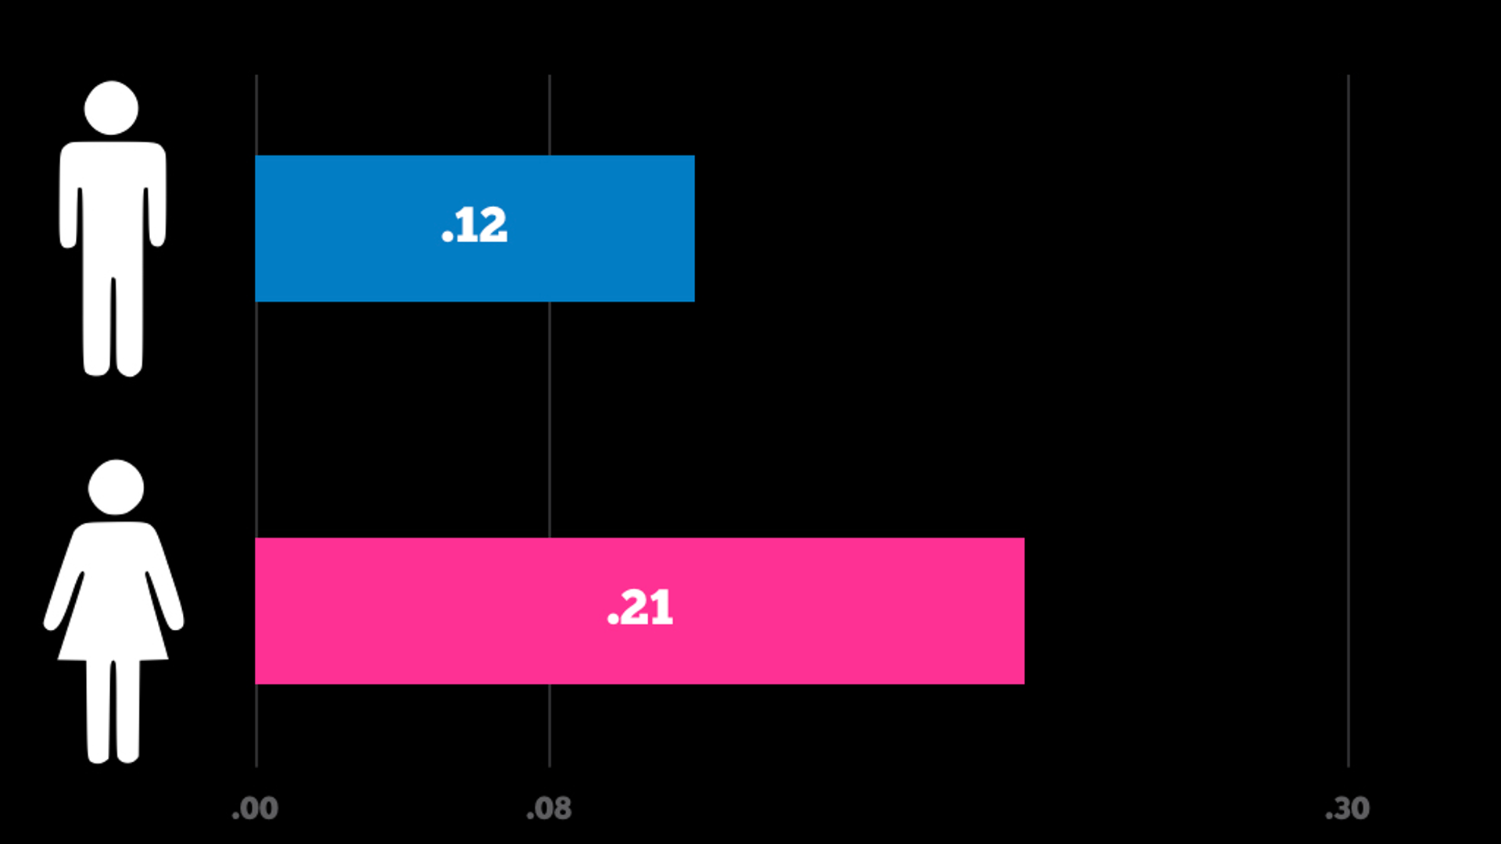
Notes:
Somehow, you’re now playing a fourth game and at the end your BAC is around a .12 (just above what your partner was at two games ago) while your partner now has a .21 BAC. Almost double your BAC.

Slide 39
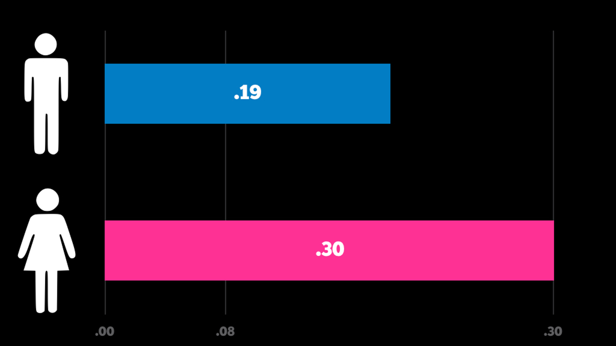
Notes:
But you decide to play just one more game. At the end of this game, your BAC is at a .19 and you’re now at risk of blacking out. But your partner is at a .30 and she now has the potential to pass out, lose consciousness and even risks death.
It’s important to note that this scenario assumes that the game is being played with a 12oz of a regular 5% ABV beer.
Ask: what are some takeaways from this scenario?

Slide 40

Notes:
Pi Kappa Phi chapters, associate chapters, students, alumni and volunteers must comply with all federal, state, provincial and local laws regarding hazing.

Slide 41
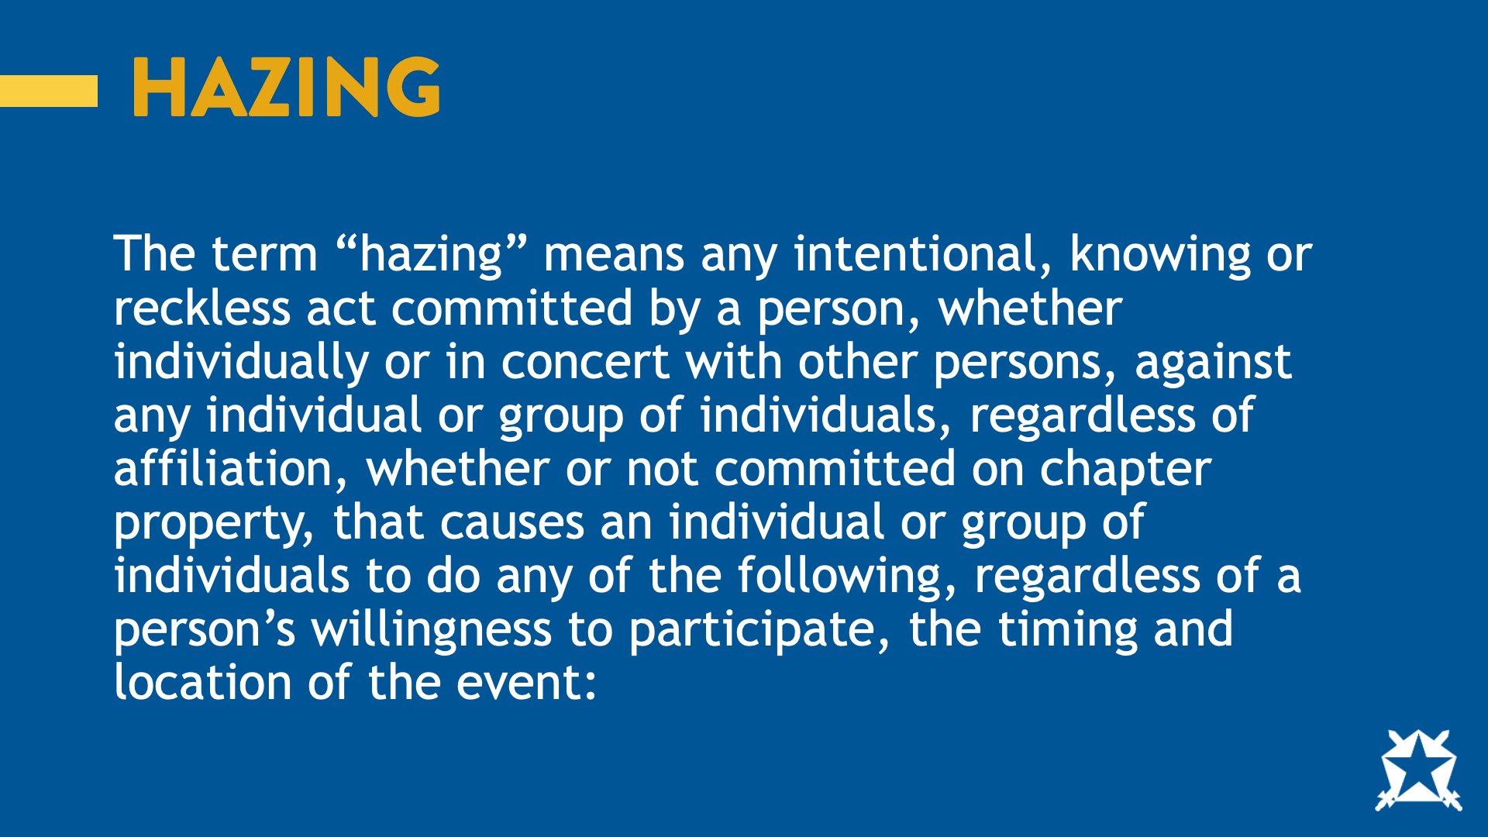
Notes:
The term “hazing” means any intentional, knowing or reckless act committed by a person, whether individually or in concert with other persons, against any individual or group of individuals, regardless of affiliation, whether or not committed on chapter property, that causes an individual or group of individuals to do any of the following, regardless of a person’s willingness to participate, the timing and location of the event:

Slide 42
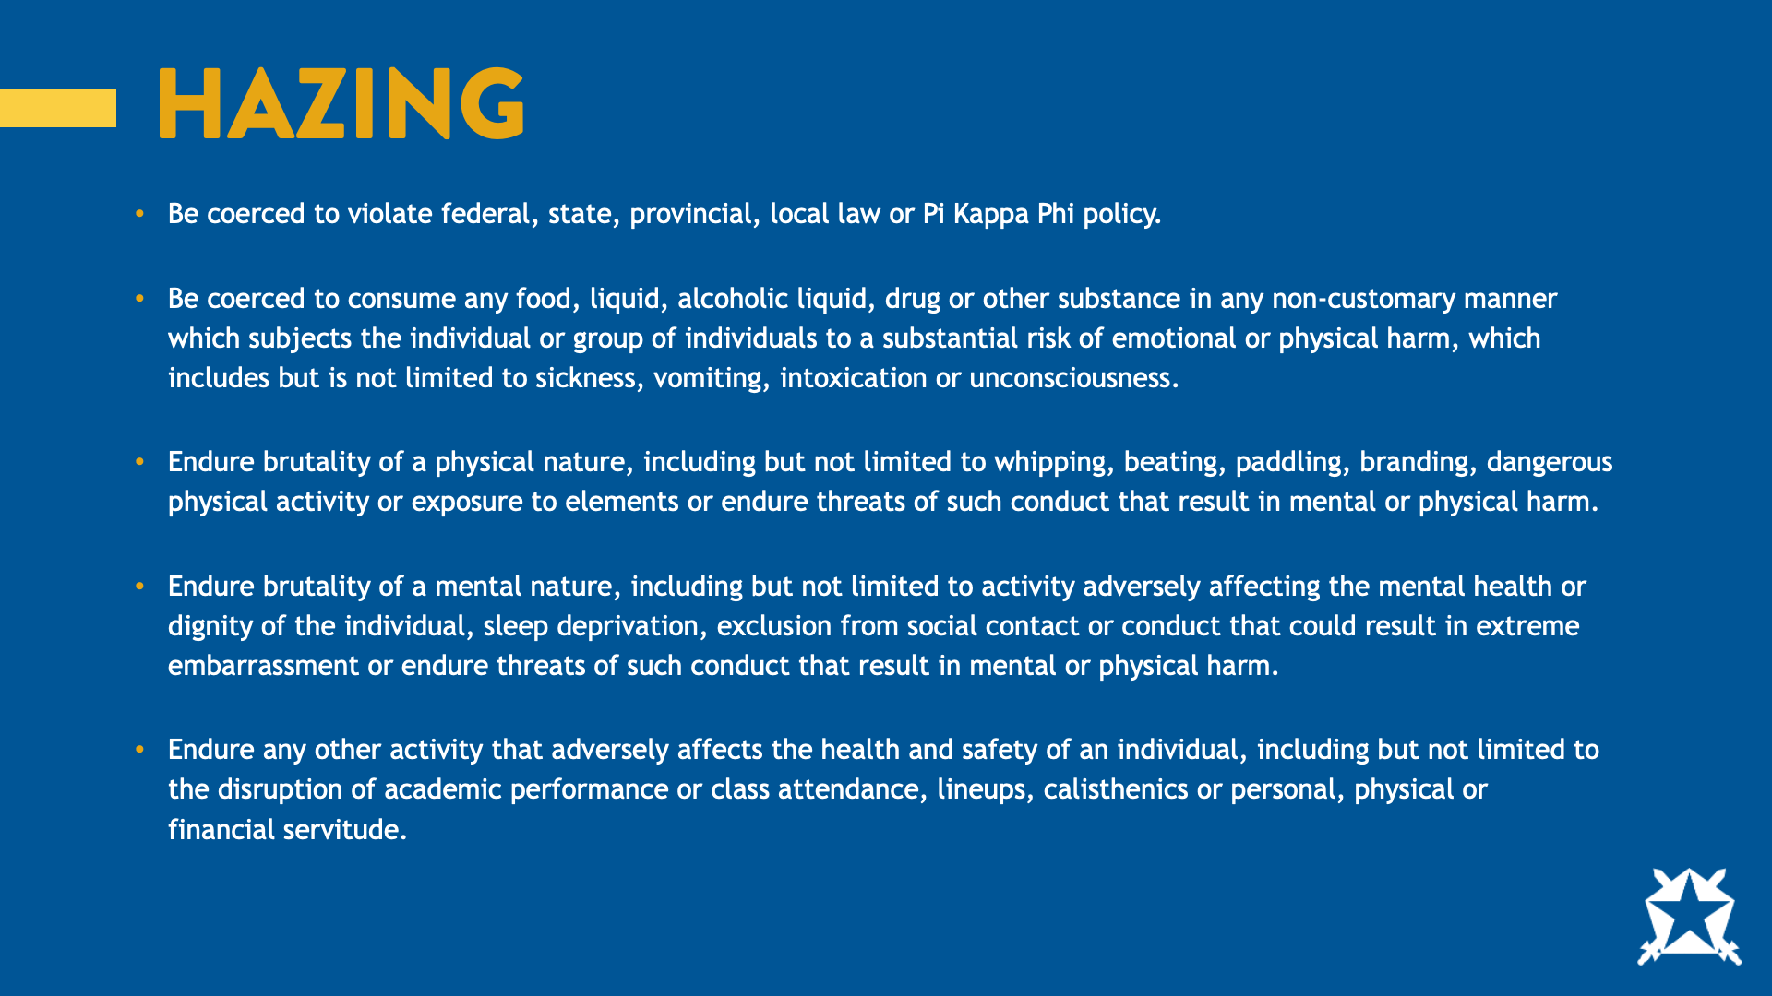
Notes:
Be coerced to violate federal, state, provincial, local law or Pi Kappa Phi policy.
Be coerced to consume any food, liquid, alcoholic liquid, drug or other substance in any non-customary manner which subjects the individual or group of individuals to a substantial risk of emotional or physical harm, which includes but is not limited to sickness, vomiting, intoxication or unconsciousness.
Endure brutality of a physical nature, including but not limited to whipping, beating, paddling, branding, dangerous physical activity or exposure to elements or endure threats of such conduct that results in mental or physical harm.
Endure brutality of a mental nature, including but not limited to activity adversely affecting the mental health or dignity of the individual, sleep deprivation, exclusion from social contact or conduct that could result in extreme embarrassment or endure threats of such conduct that result in mental or physical harm.
Endure any other activity that adversely affects the health and safety of an individual, including but not limited to the disruption of academic performance or class attendance, line ups, calisthenics or personal, physical or financial servitude.

Slide 43
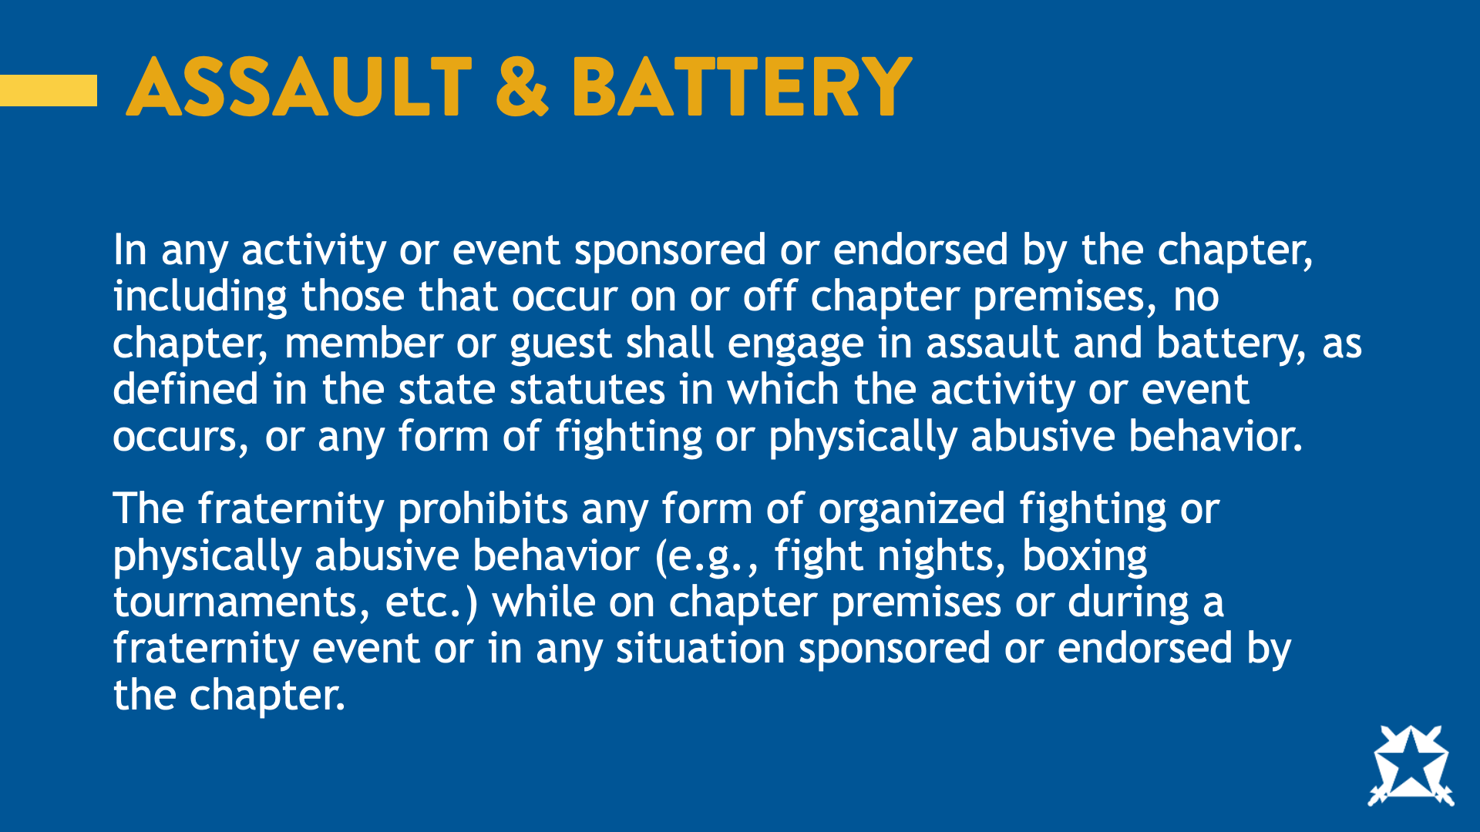
Notes:
In any activity or event sponsored or endorsed by the chapter, including those that occur on or off chapter premises, no chapter, member or guest shall engage in assault and battery, as defined in the state statutes in which the activity or event occurs, or any form of fighting or physically abusive behavior.
The fraternity prohibits any form of organized fighting or physically abusive behavior (e.g., fight nights, boxing tournaments, etc.) while on chapter premises or during a fraternity event or in any situation sponsored or endorsed by the chapter.
Ask: What about physically removing someone from an event?

Slide 44
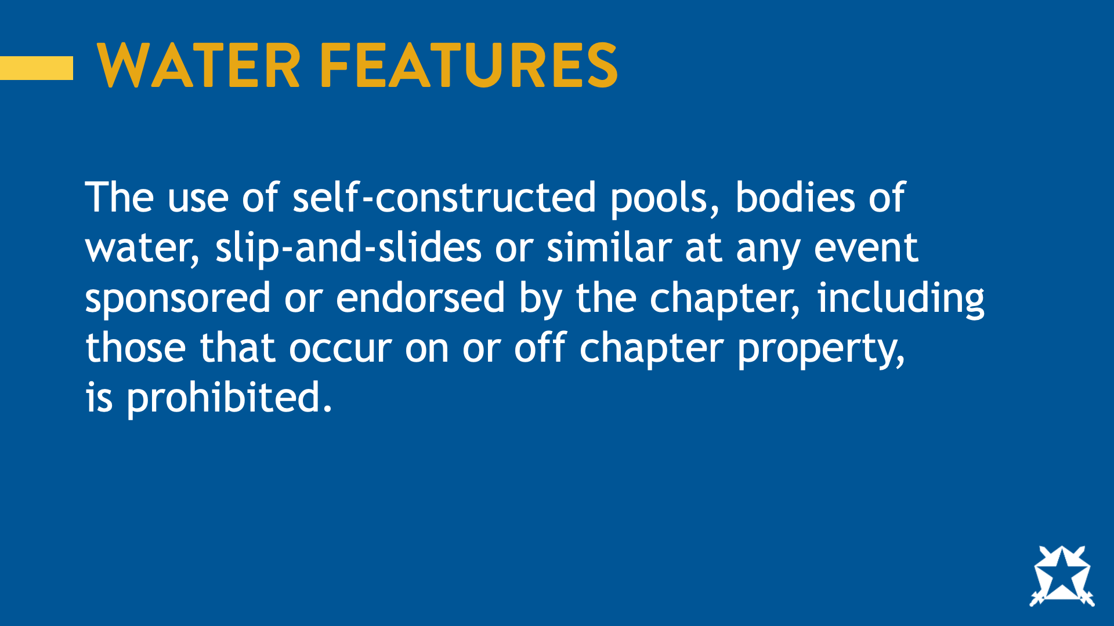
Notes:
The use of self-constructed pools, bodies of water, slip-and-slides or similar at any event sponsored or endorsed by the chapter, including those that occur on or off chapter property, is prohibited.
Ask: Why do you think this is in the policy?

Slide 45
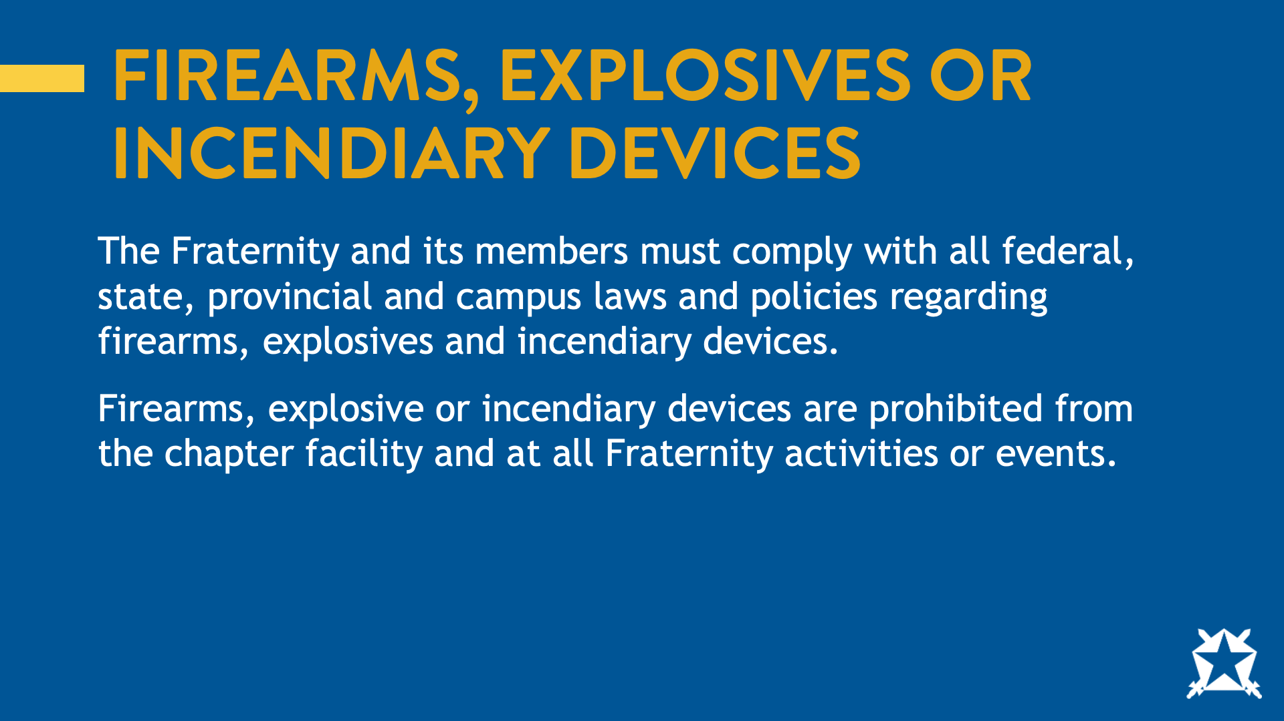
Notes:
The fraternity and its members must comply with all federal, state, provincial, local laws and campus policy as it relates to firearms or explosive or incendiary devices.
Firearms or explosive or incendiary devices are prohibited from the chapter facility and at all fraternity activities or events.
Ask: What sticks out here? (Call attention to explosive or incendiary devices like fireworks)

Slide 46
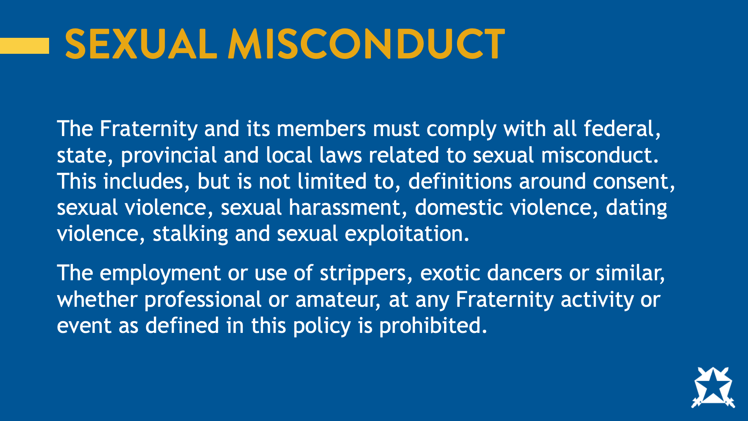
Notes:
The fraternity and its members must comply with all federal, state, provincial, and local laws related to sexual misconduct. This is including, but not limited to, definitions around consent, sexual violence, sexual harassment, domestic violence, dating violence, stalking, and sexual exploitation.
The employment or use of strippers, exotic dancers or similar, whether professional or amateur, at any fraternity activity or event as defined in this policy is prohibited.
Ask: What sticks out here? (call attention to no adult entertainers as well as no sexually abusive behavior)

Slide 47
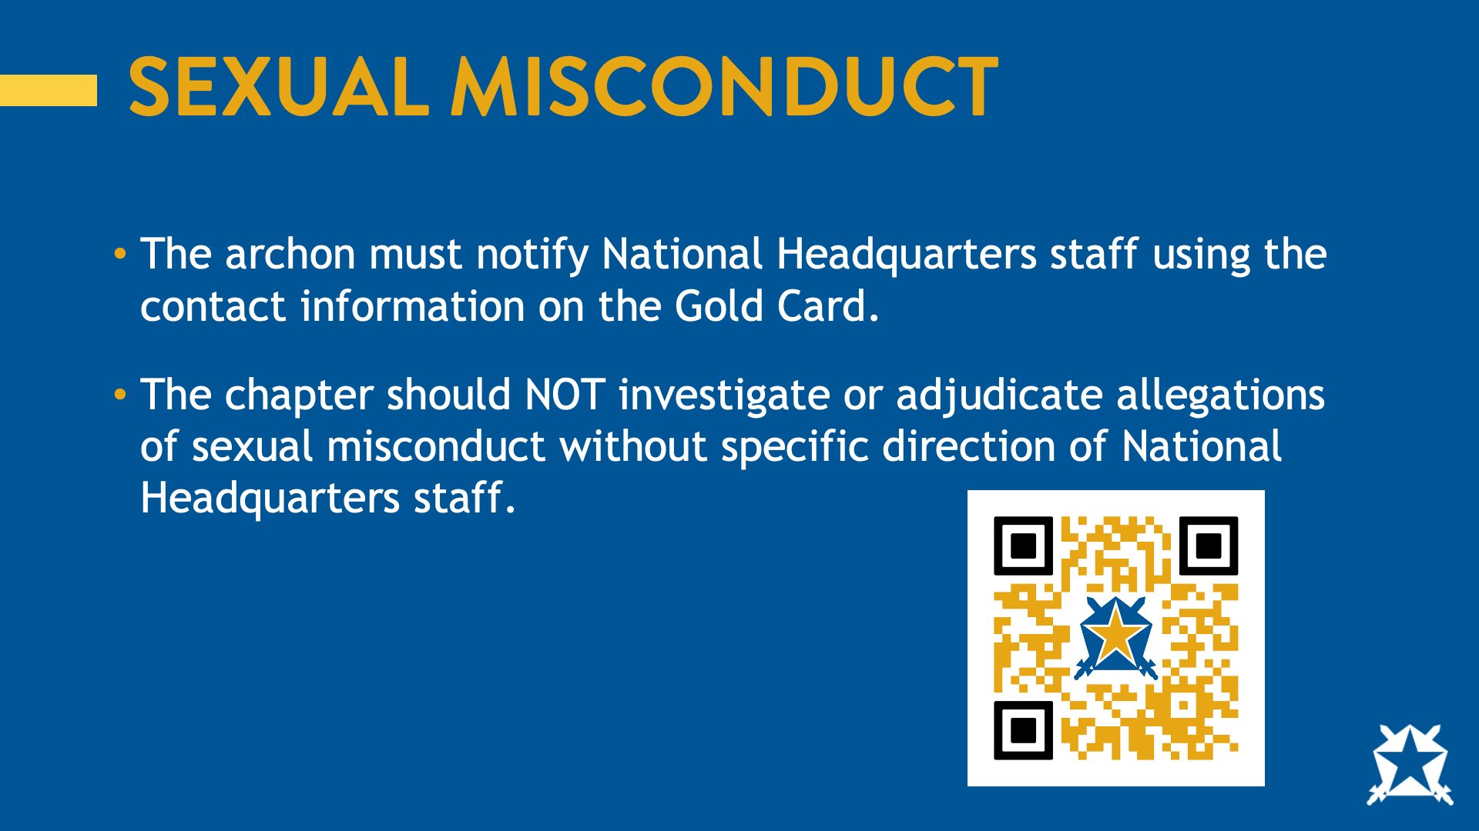
Notes:
The fraternity has a unique process for handling claims of sexual misconduct. Over the next few slides, I will explain that process and your reporting expectations. It is important to note that this process is meant to fair, and trauma informed.
If an allegation of sexual misconduct is reported, you should:
The archon must notify National Headquarters staff utilizing the contact information on the Gold Card.
The chapter should NOT investigate or adjudicate allegations of sexual misconduct without specific direction of National Headquarters Staff.

Slide 48
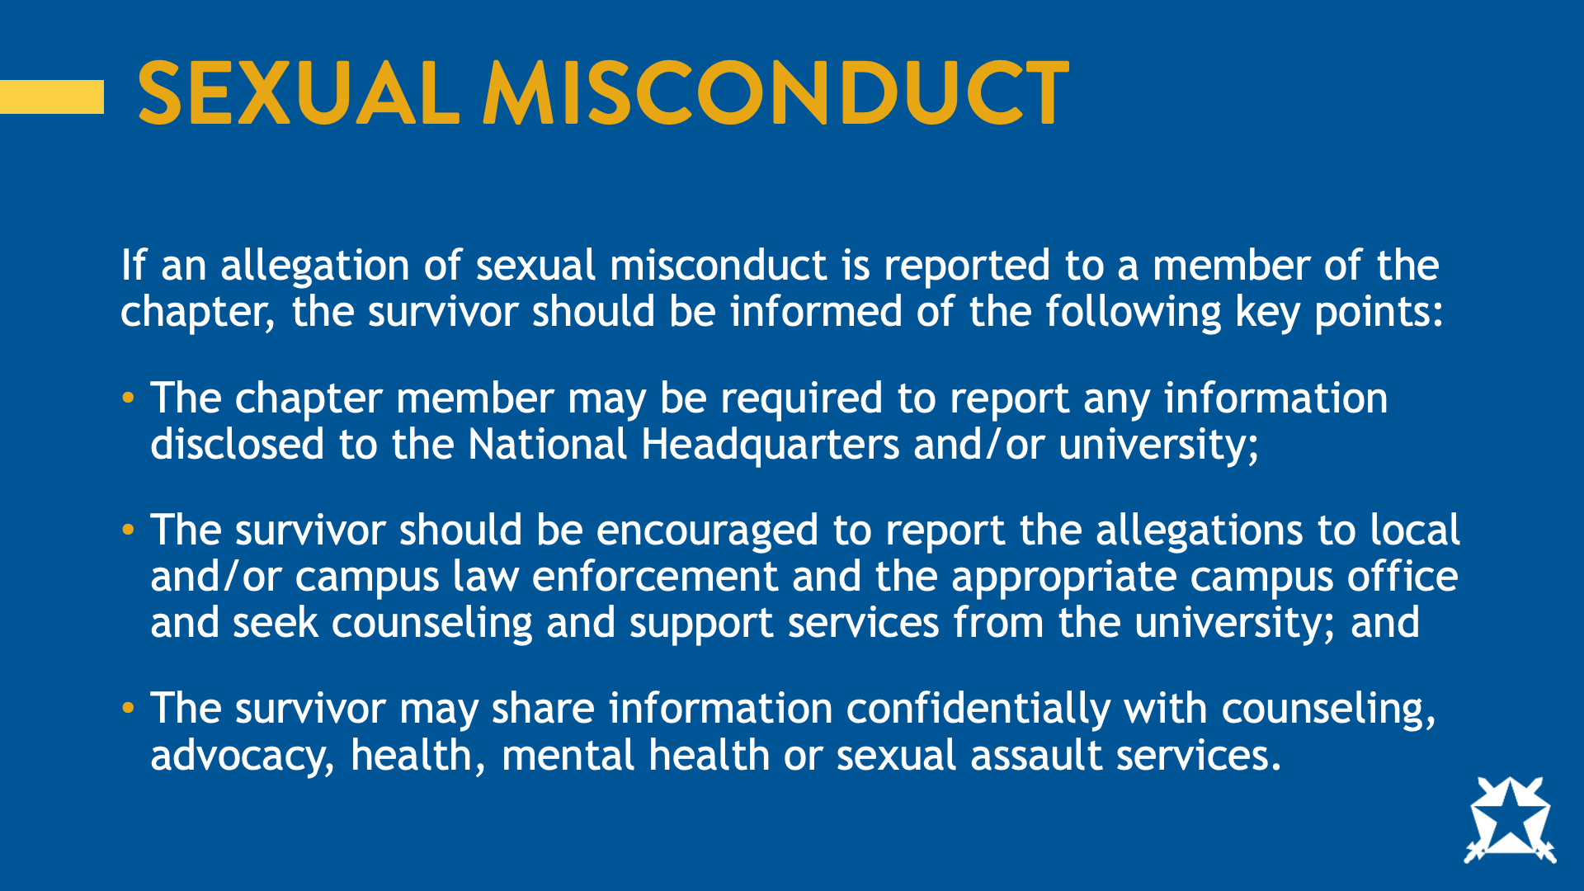
Notes:
If an allegation of sexual misconduct is reported to a member of the chapter, the survivor should be informed of the following key points:
The chapter member may be required to report any information disclosed to the National Headquarters and/or University;
The survivor should be encouraged to report the allegations to local and/or campus law enforcement to the appropriate campus office and seek counseling and support services from the university; and
The survivor may share information confidentially with counseling, advocacy, health, mental health, or sexual assault services.

Slide 49
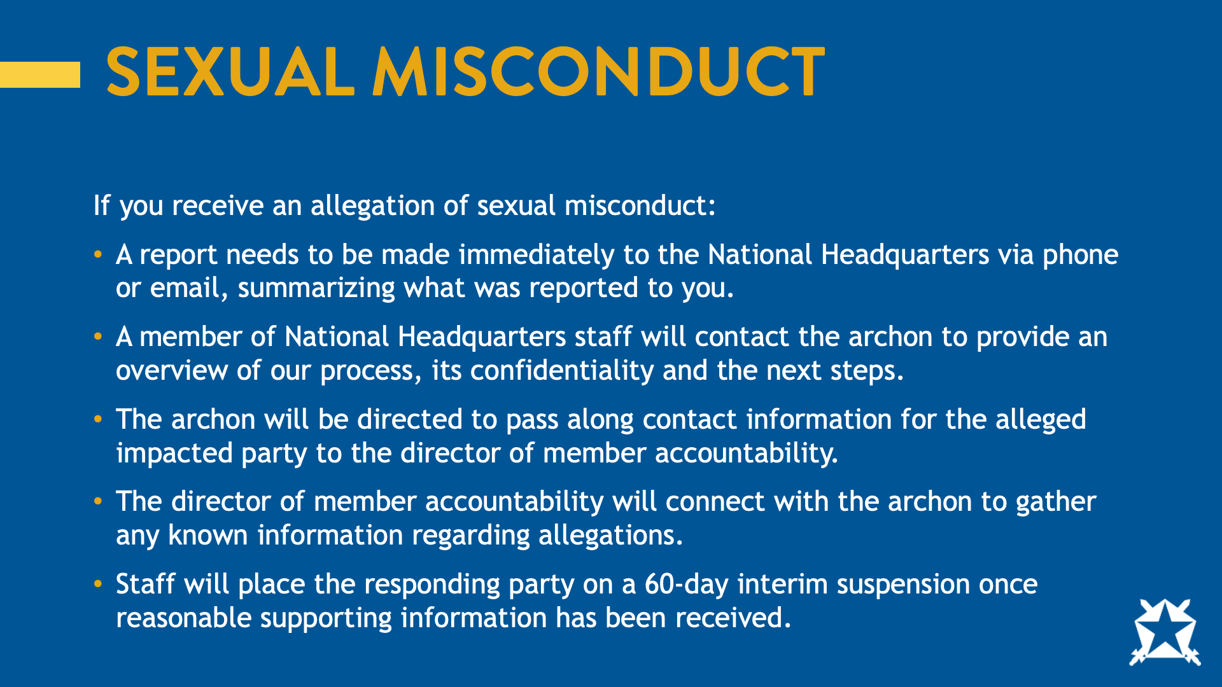
Notes:
If you receive an allegation of sexual misconduct:
A report needs to be made without any delay to the National Headquarters via phone or email summarizing what was reported to you
A member of HQ staff will connect with the Archon to provide an overview of our process, confidentiality of the process and next steps
The Archon will be directed to pass along the Director of Member Accountability contact information the alleged impacted party
The Director of Member Accountability will connect with the Archon to gather any known information regarding allegations
Staff will place the responding party on a 60-day interim suspension once reasonable supporting information has been received.

Slide 50
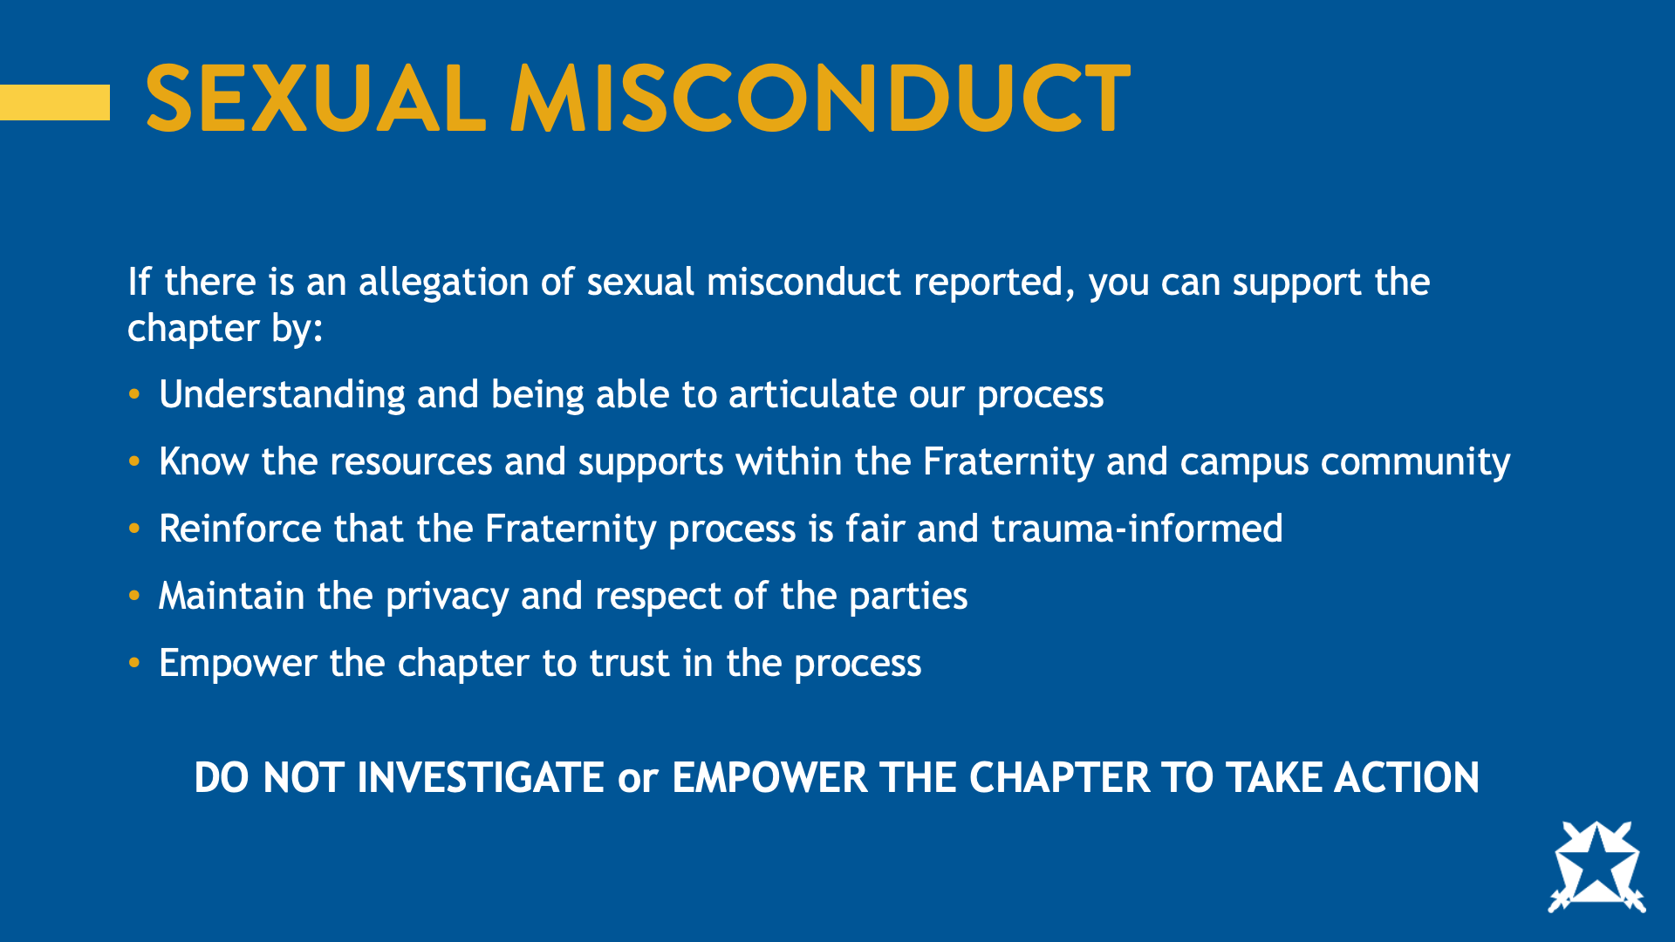
Notes:
If there is an allegation of sexual misconduct reported, you can support the chapter by:
Understanding and being able to articulate our process.
Know the resources and supports within the Fraternity and campus community.
Reinforce that the Fraternity process is FAIR and TRAUMA INFORMED
Maintain privacy and respect of the parties.
Empower the chapter to trust in the process.
DO NOT INVESTIGATE or EMPOWER THE CHAPTER TO TAKE ACTION
Ask: What questions do you have about this process? (Reminder: do your best to answer but if you do not know the answer, it is okay to defer to fraternity staff)

Slide 51
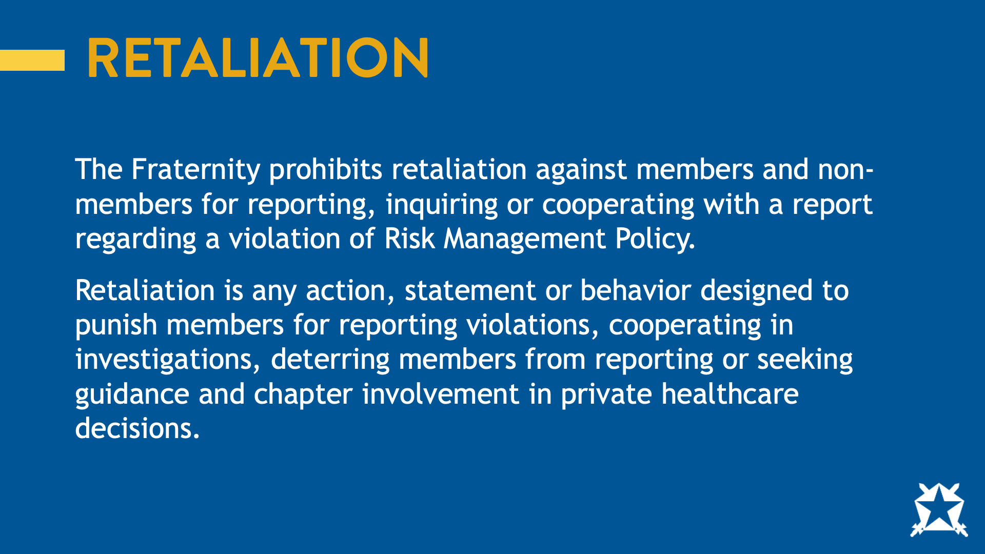
Notes:
The fraternity prohibits retaliation against members and non-members for reporting, inquiring or cooperating with a report around a violation of Risk Management Policy.
Retaliation is any action, statement, or behavior designed to punish members for reporting violations, cooperating in investigations, deterring members from reporting or seeking guidance and chapter involvement in private healthcare decisions.

Slide 52
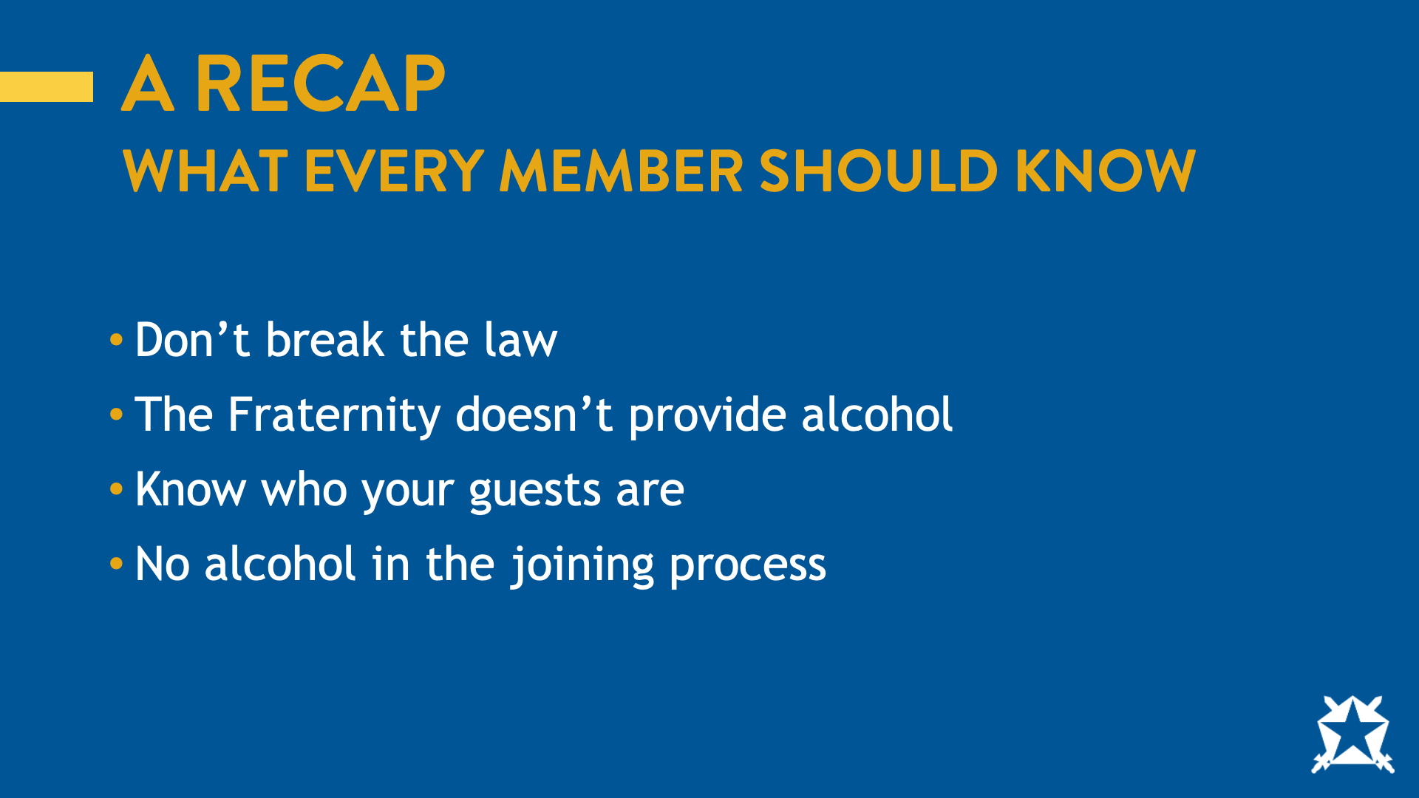
Notes:
WHAT EVERY MEMBER SHOULD KNOW
Don’t break the law.
Fraternity doesn’t provide alcohol.
Know who your guests are.
No alcohol in the joining process.
Now over the next few slides, I’d like to share a few resources you have available to you as a member.

Slide 53
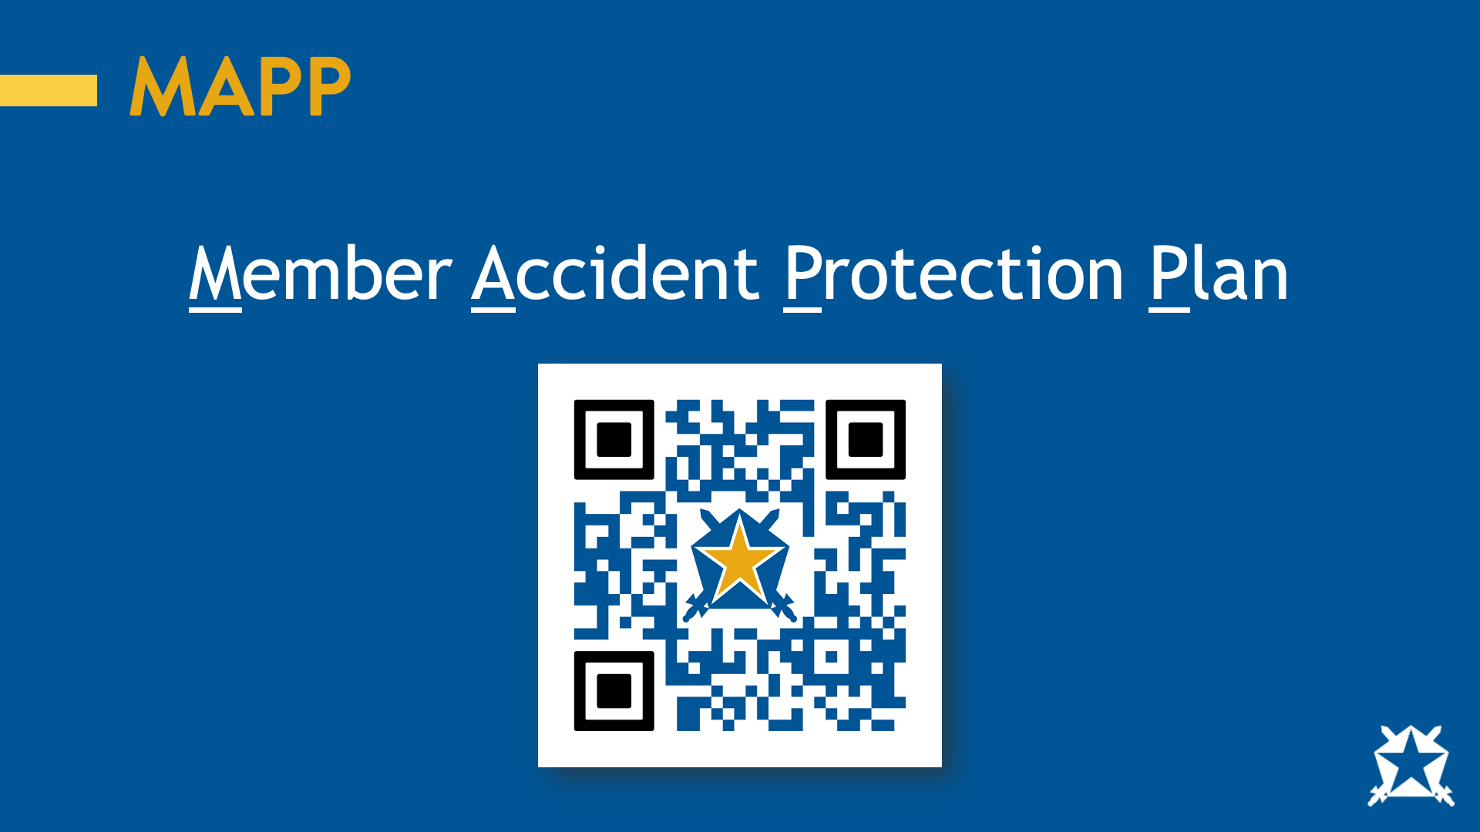
Notes:
The member accident protection program of the fraternity is a benefit of membership. The program is intended to compliment the health insurance program of every undergraduate member of the fraternity for injuries as a result of an accident. The premium for this program is paid by the fraternity and the program may be canceled or changed at the sole discretion of the fraternity at any time. The information provided is for informational purposes only and is not intended to replace the insurance contract. For specific information regarding any claim, please contact Holmes Murphy.

Slide 54

Notes:
We all know how important it is to take care of our mental health and support one another. The fraternity provides all undergraduate and alumni members access to a free and licensed counselor 24/7 at the number on this slide. Other mental health resources are available at https://pikapp.org/mentalhealth

Slide 55
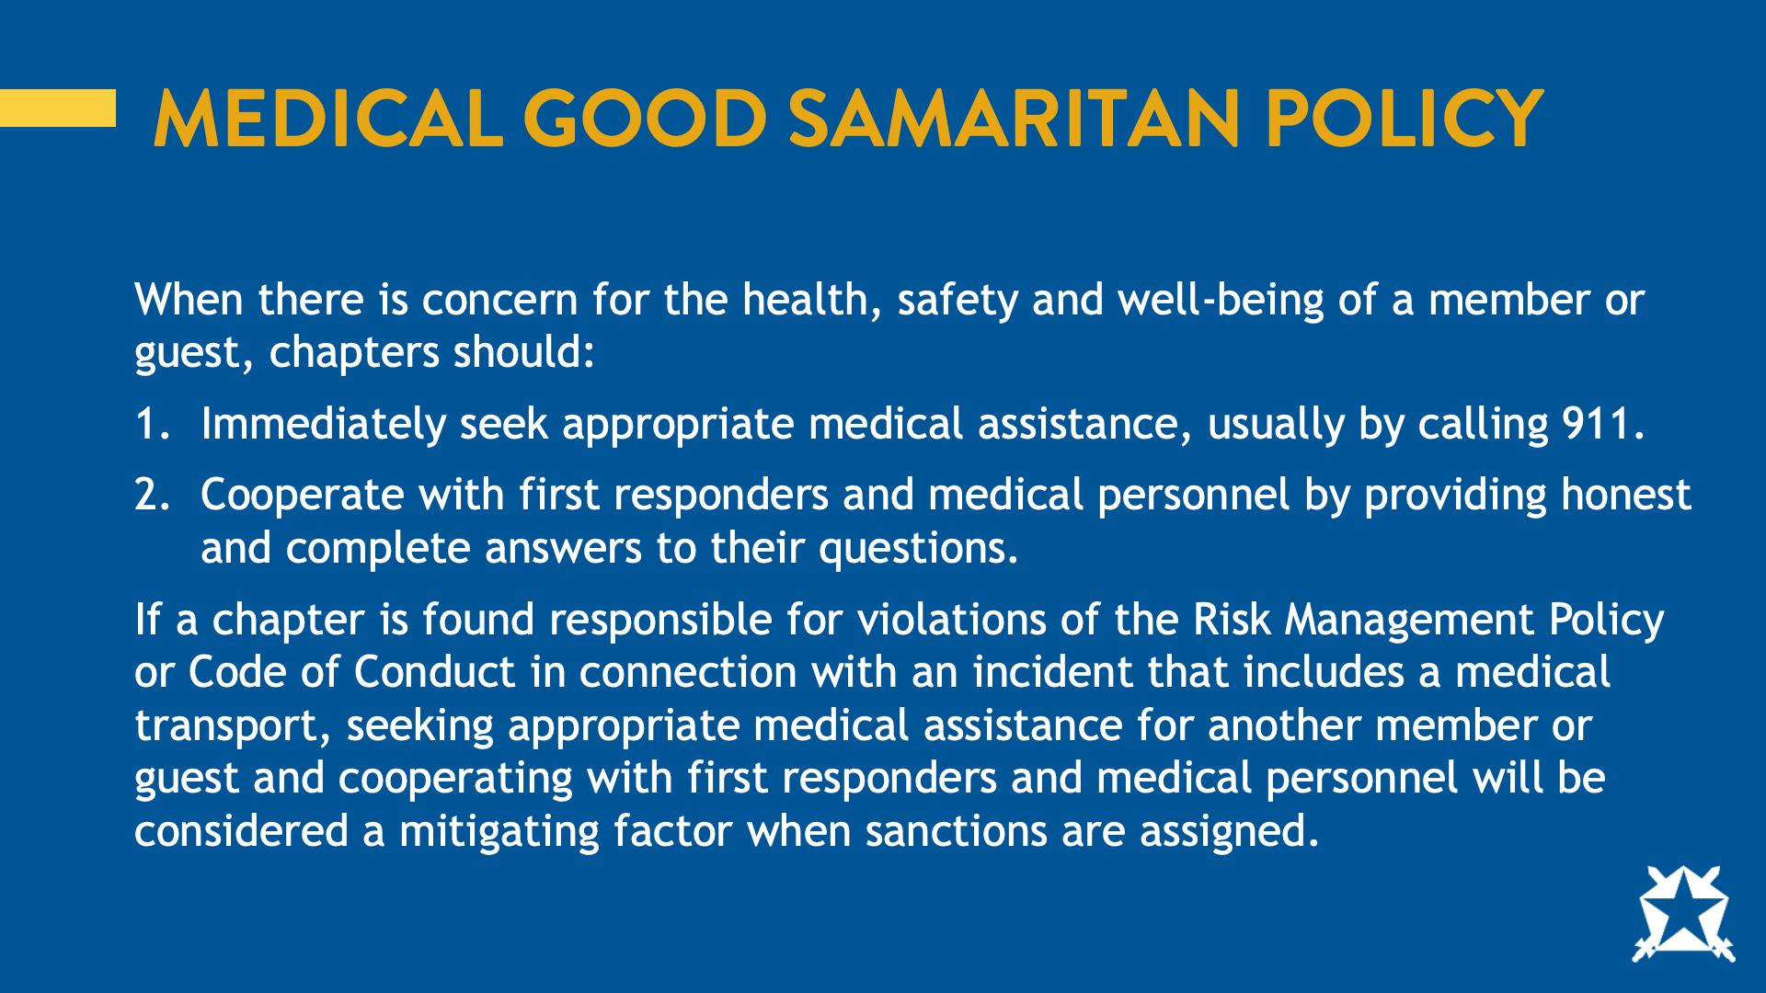
Notes:
When there is concern for health, safety and well-being of a member or guest, chapters should:
Immediately seek appropriate medical assistance, usually by calling 911.
Cooperate with first responders and medical personnel by providing honest and complete answers to their questions.
If a chapter is found responsible for violations of the Risk Management Policy or Code of Conduct in connection with an incident that includes a medical transport, seeking appropriate medical assistance for another member or guest and cooperating with first responders and medical personnel will be considered mitigating factors when sanctions are assigned.
Ask:
What is the importance of a Good Samaritan policy?
Does your campus have one?

Slide 56
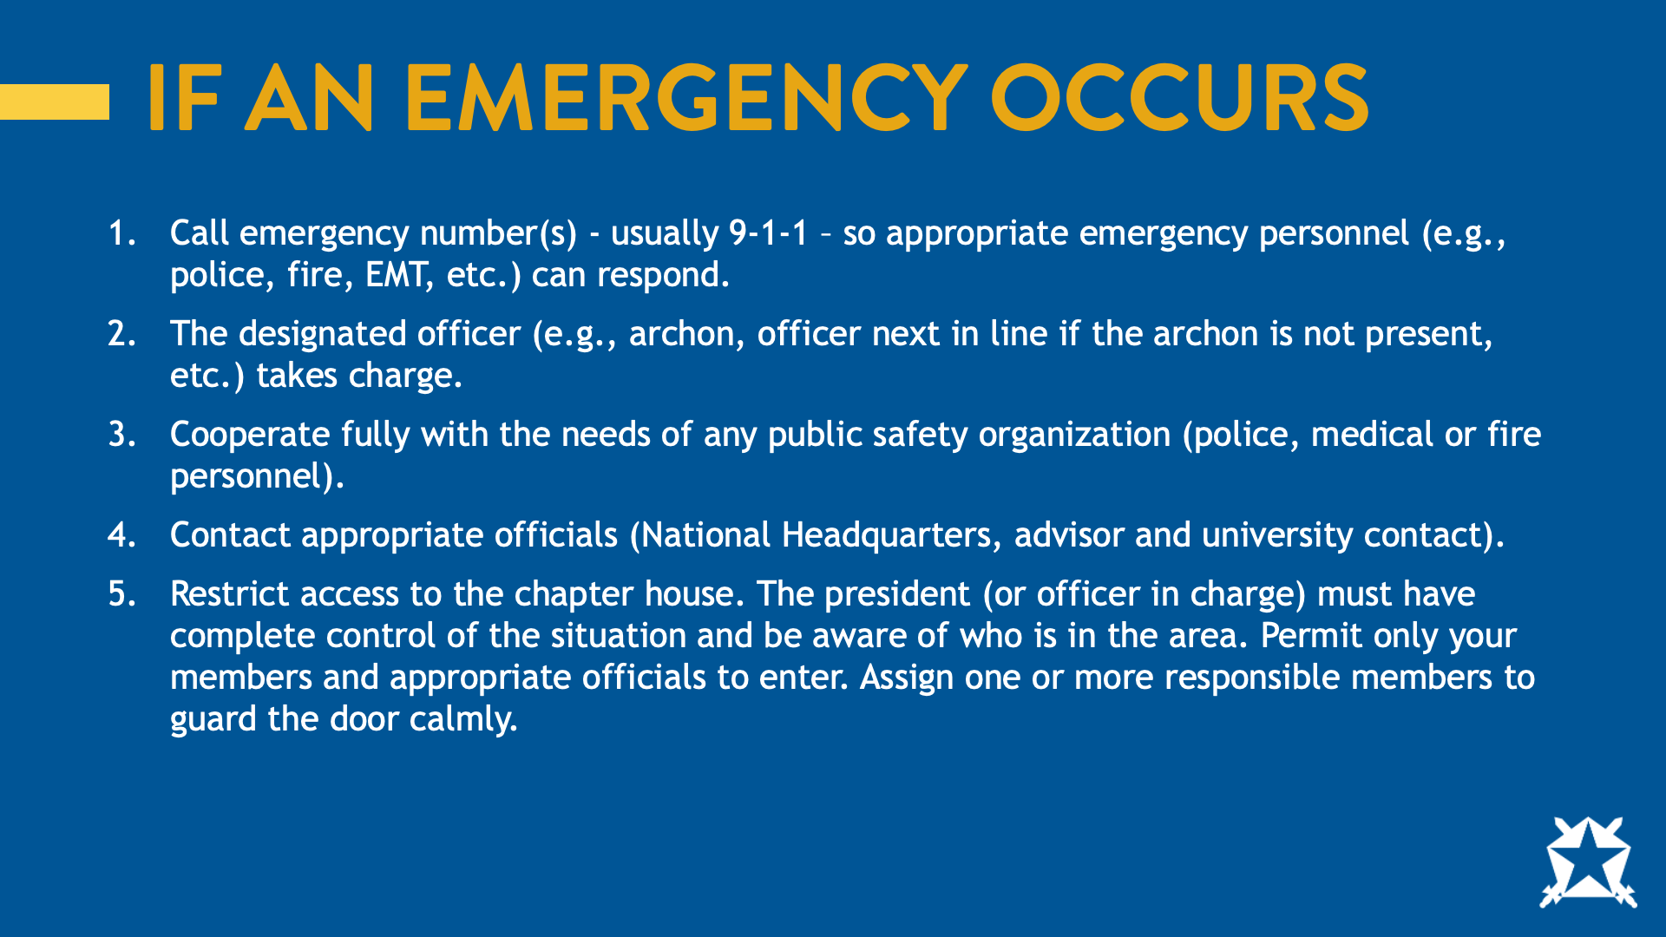
Notes:
Emergencies happen but it’s important to know that you are not alone. Over the next few slides, we’ll discuss the fraternity’s crisis management plan. You can find the full Crisis Management Plan by scanning the QR code.
Call emergency number(s) - usually 9-1-1 – so appropriate emergency personal (e.g. police, fire, EMT, etc.) can respond.
The designated officer (e.g. Archon, officer next in line if the Archon is not present, etc.) takes charge.
Cooperate fully with the needs of any public safety organization (police, medical or fire personnel).
Contact appropriate officials (Headquarters Contact, Advisor, & University Contact).
Restrict access to the chapter house. The President (or officer in charge) must have complete control of the situation and be aware of who is in the area. Permit only your members and appropriate officials to enter. Assign one or more responsible members to calmly guard the door.

Slide 57

Notes:
Do not tamper with any part of the area involved in the incident, specifically things that might be construed as evidence or areas involved with the incident.
Assemble your members in a group (in case of fire, assemble outside, in front near the street). All should remain calm. Remind members that only the President or Chapter Advisor can speak for the Fraternity — members are not to speak to anyone (including friends, girlfriends, parents, the university) about the emergency.
Do not discuss details, speculate on events or otherwise elaborate on the situation.

Slide 58

Notes:
The fraternity’s on call contact information is on the screen. If an emergency occurs, you should call this number at any time, day or night. You can save this number to your phone or download a digital contact card that includes the crisis management plan using the QR code on the screen.

Slide 59

Notes:
So, bringing it back to our Jane Doe scenario. Knowing what you do now from our time together, how could we prevent Jane Doe’s death?

Slide 60

Notes:
What questions do you have?

Slide 61

Notes:
Thank you all for your engagement in the program! On the screen you’ll see the contact information for the Senior Director of Harm Reduction. If you have any questions that you feel I haven’t answered or feedback about today’s program, you can contact him.

Slide 62


