Slide 1

Notes:
http://www.nytimes.com/2016/04/10/education/edlife/teaching-men-to-be-emotionally-honest.html?smid=fb-share&_r=1

Slide 2
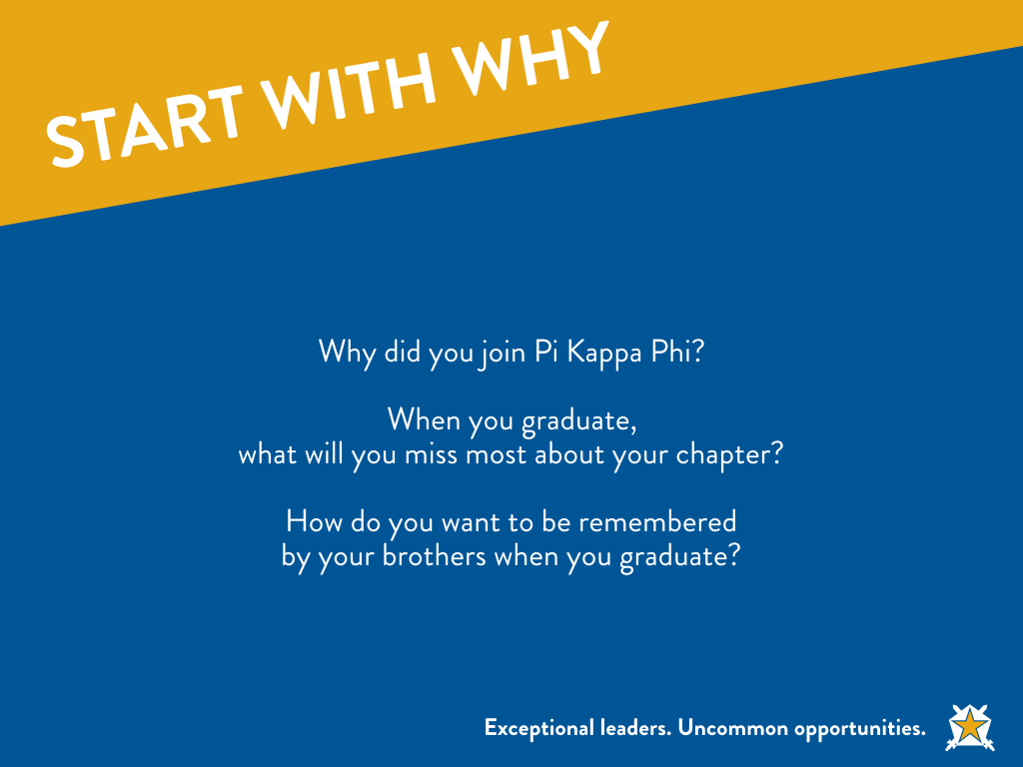
Notes:
I joined Pi Kappa Phi b/c..
When I graduated, what I will miss most about the chapter…
When I leave the chapter, what I hope my brothers remembers about me…

Slide 3
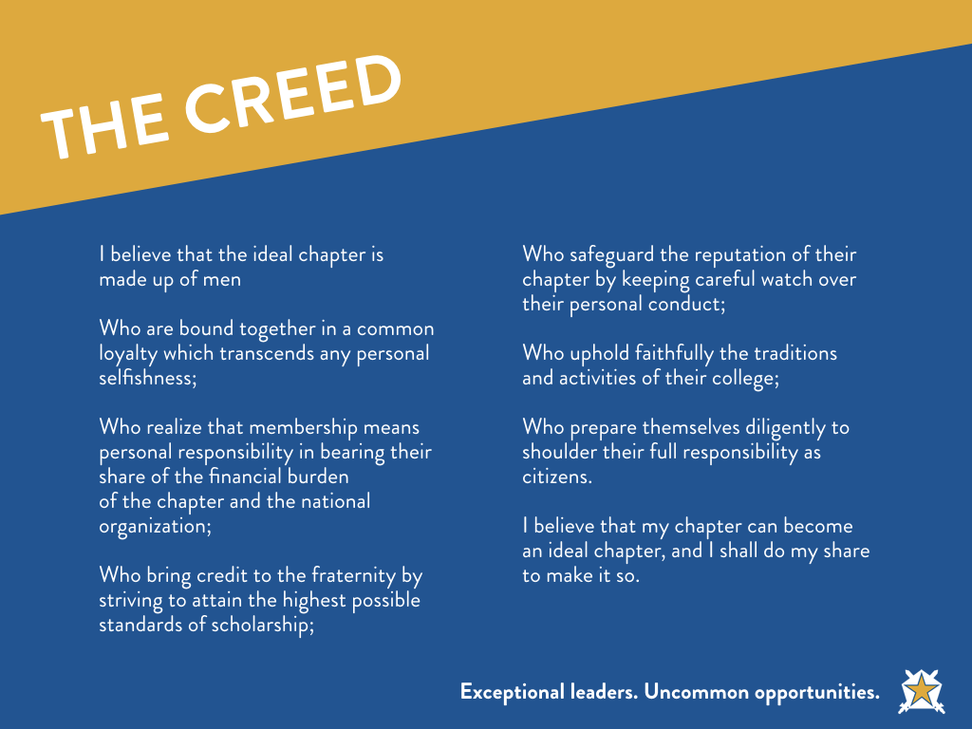

Slide 4
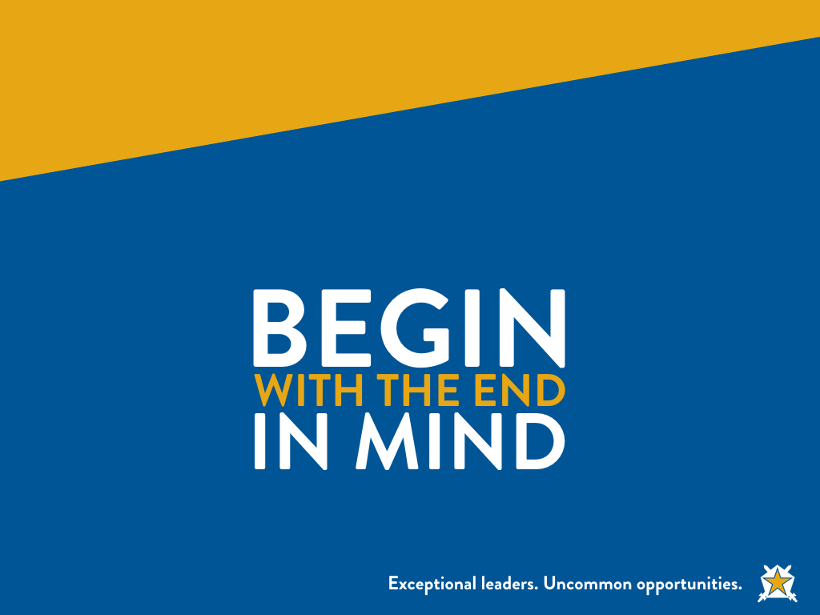
Notes:
Begin With the End in Mind – Stephen Covey
So, what do you want to be when you grow up? That question may appear a little trite, but think about it for a moment. Are you--right now--who you want to be, what you dreamed you'd be, doing what you always wanted to do? Be honest. Sometimes people find themselves achieving victories that are empty--successes that have come at the expense of things that were far more valuable to them. If your ladder is not leaning against the right wall, every step you take gets you to the wrong place faster.
Habit 2 is based on imagination--the ability to envision in your mind what you cannot at present see with your eyes. It is based on the principle that all things are created twice. There is a mental (first) creation, and a physical (second) creation. The physical creation follows the mental, just as a building follows a blueprint. If you don't make a conscious effort to visualize who you are and what you want in life, then you empower other people and circumstances to shape you and your life by default. It's about connecting again with your own uniqueness and then defining the personal, moral, and ethical guidelines within which you can most happily express and fulfill yourself. Begin with the End in Mind means to begin each day, task, or project with a clear vision of your desired direction and destination, and then continue by flexing your proactive muscles to make things happen.
How can we take this practice and apply to our chapter? If you had to think five or ten years out, where would you like to see your chapter?

Slide 5


Slide 6
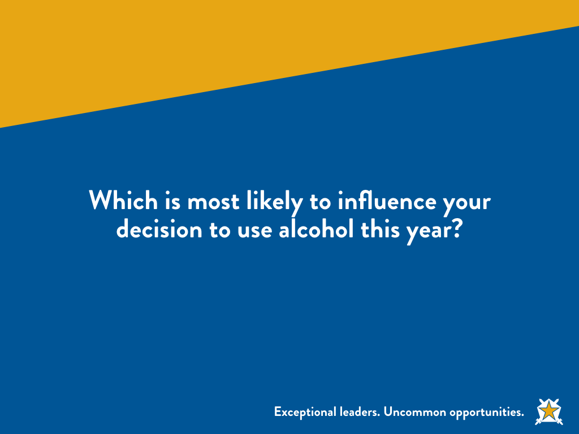

Slide 7
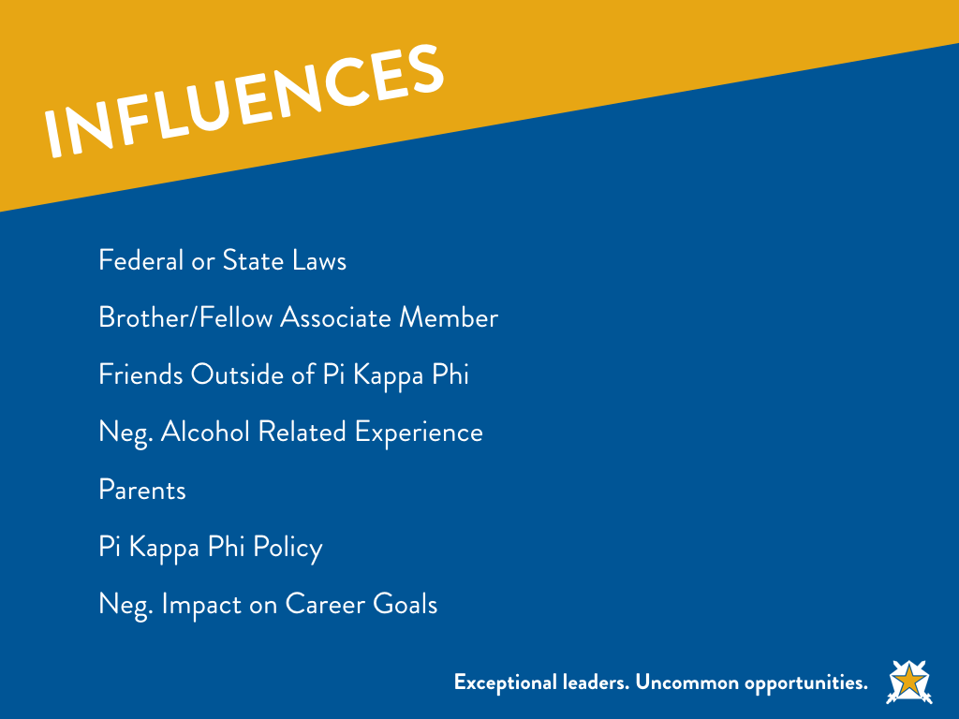

Slide 8
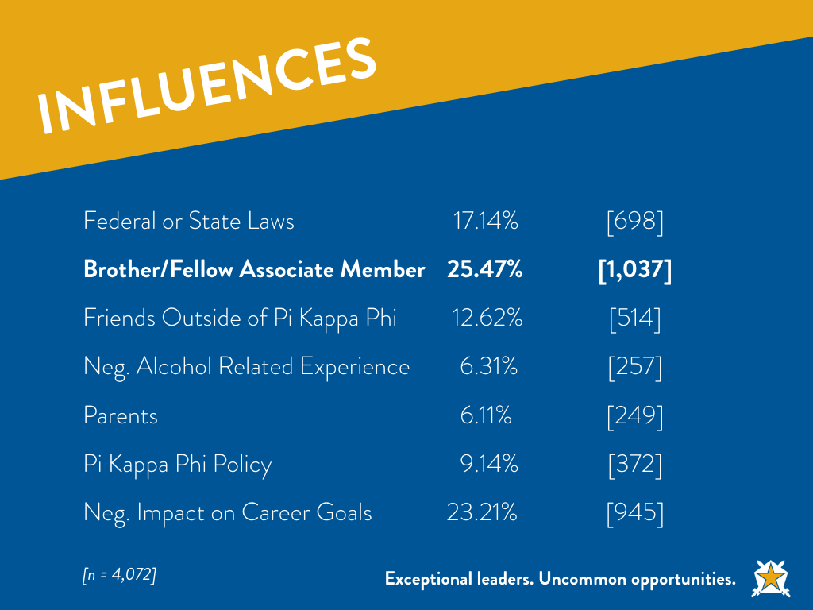

Slide 9
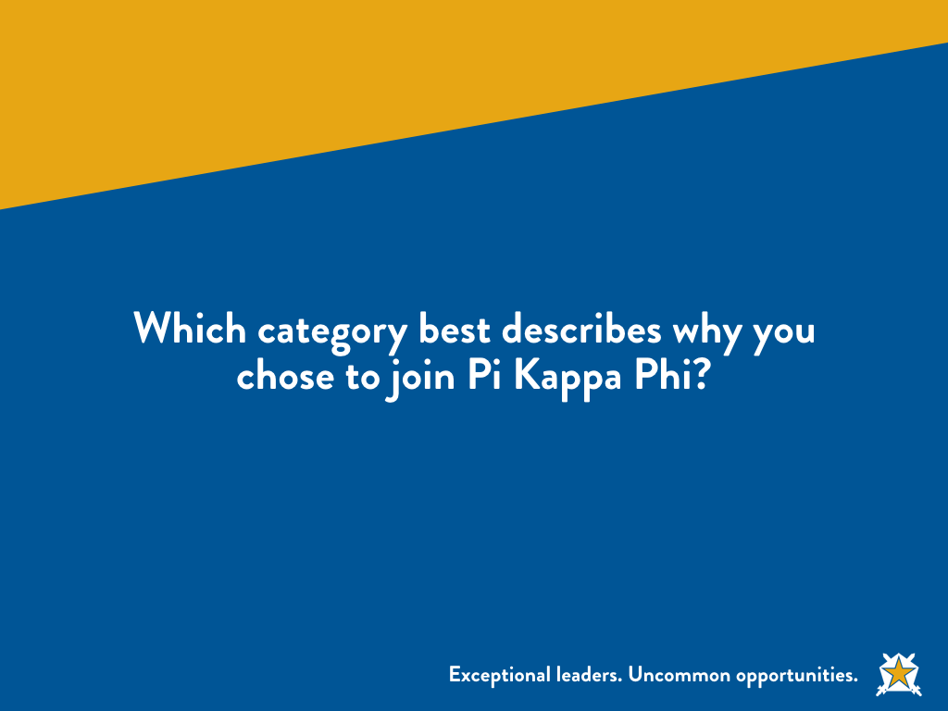

Slide 10
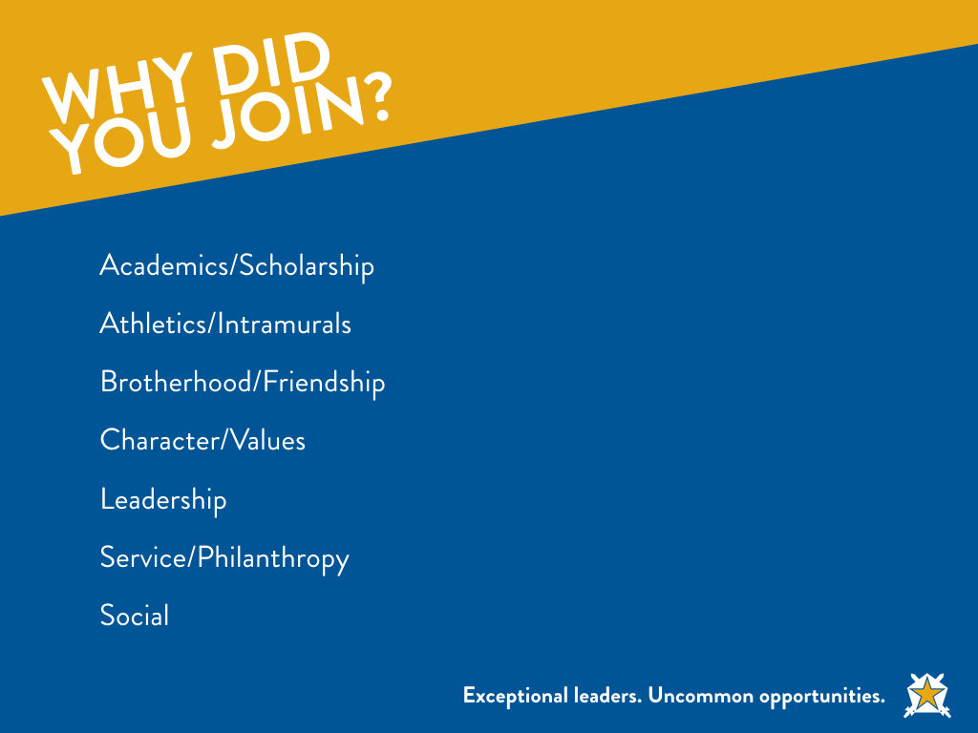

Slide 11
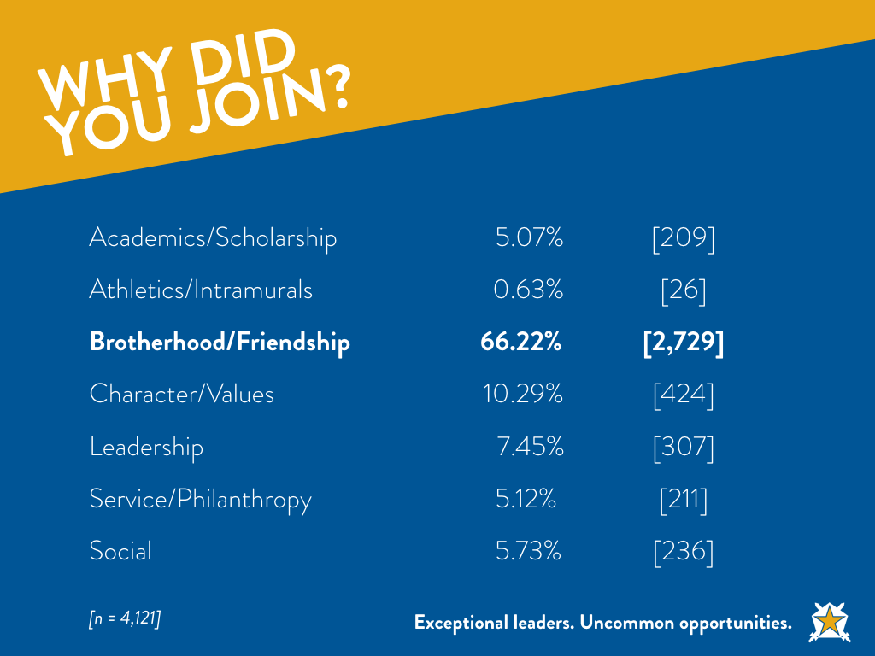

Slide 12
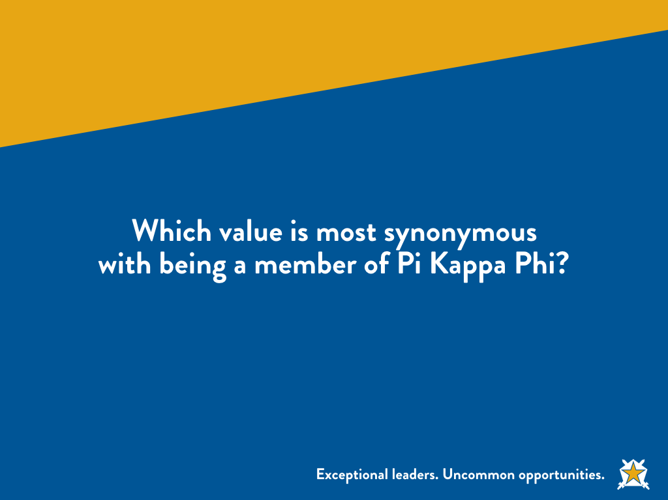

Slide 13
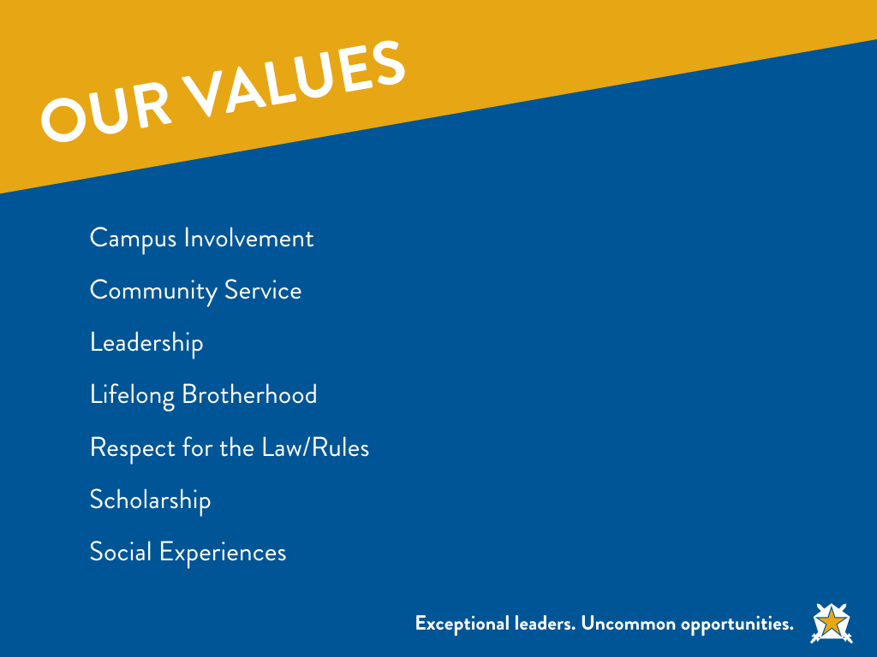

Slide 14
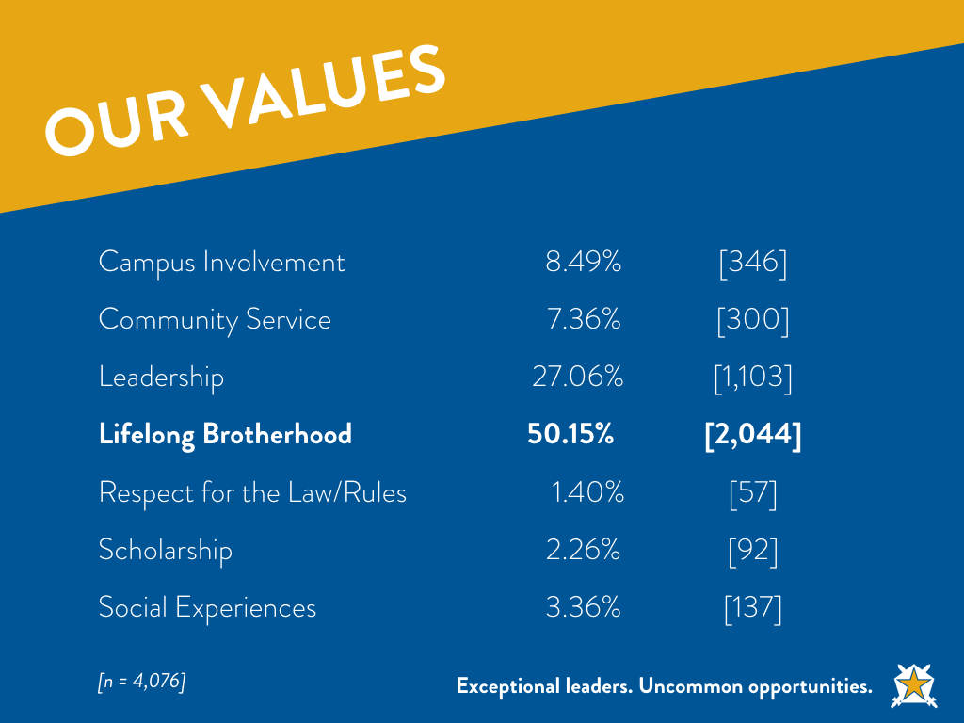

Slide 15
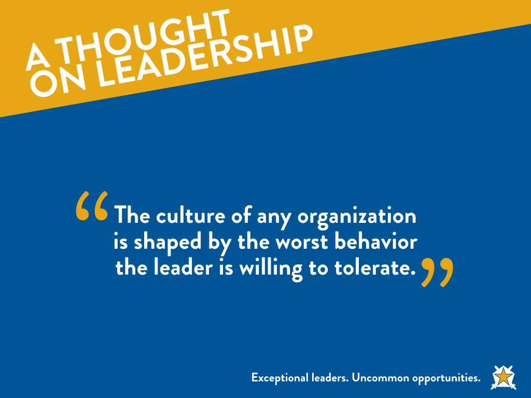
Notes:
http://ricklochner.com/the-culture-of-any-organization-is-shaped/

Slide 16
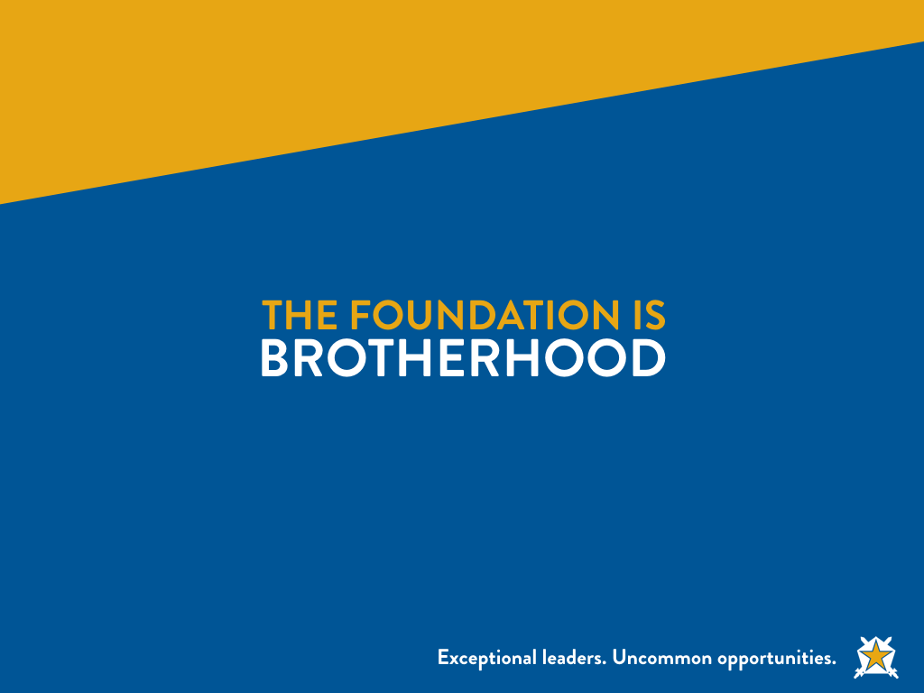
Notes:
Take GLE answers and build the foundation of BROTHERHOOD.
How do you define brotherhood?
What is the foundation of brotherhood?

Slide 17
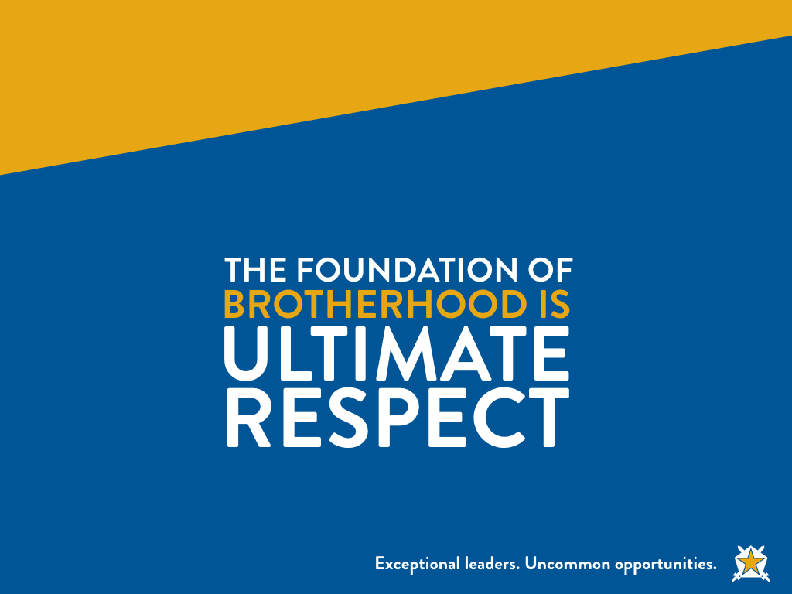

Slide 18
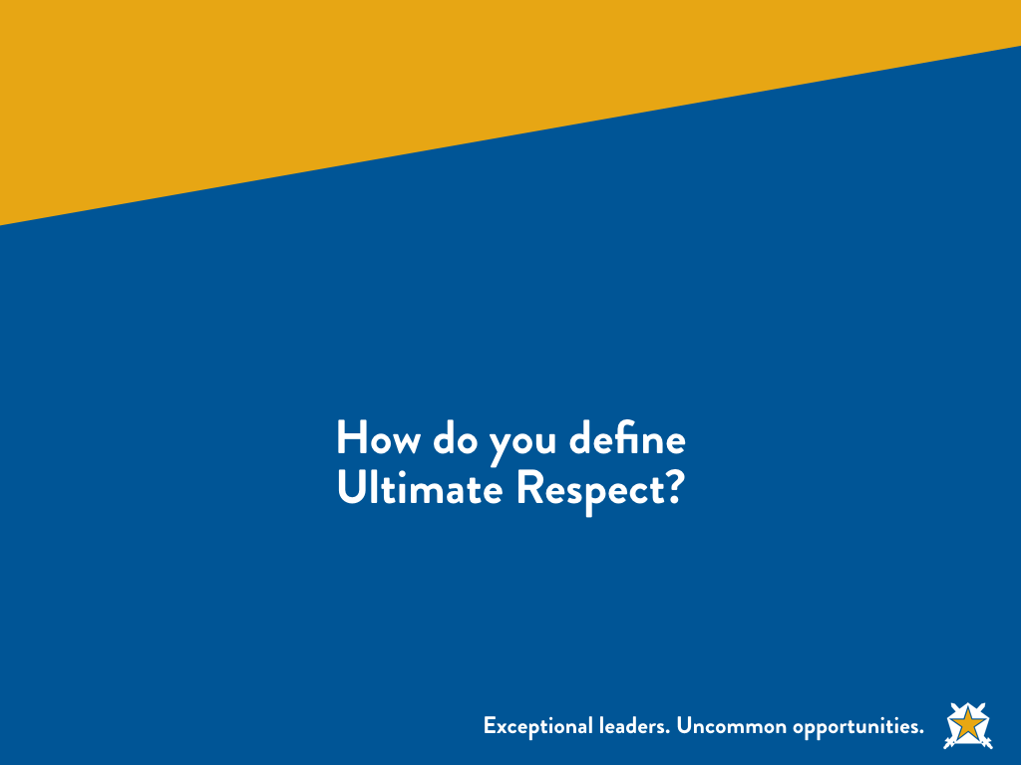
Notes:
Let them talk

Slide 19
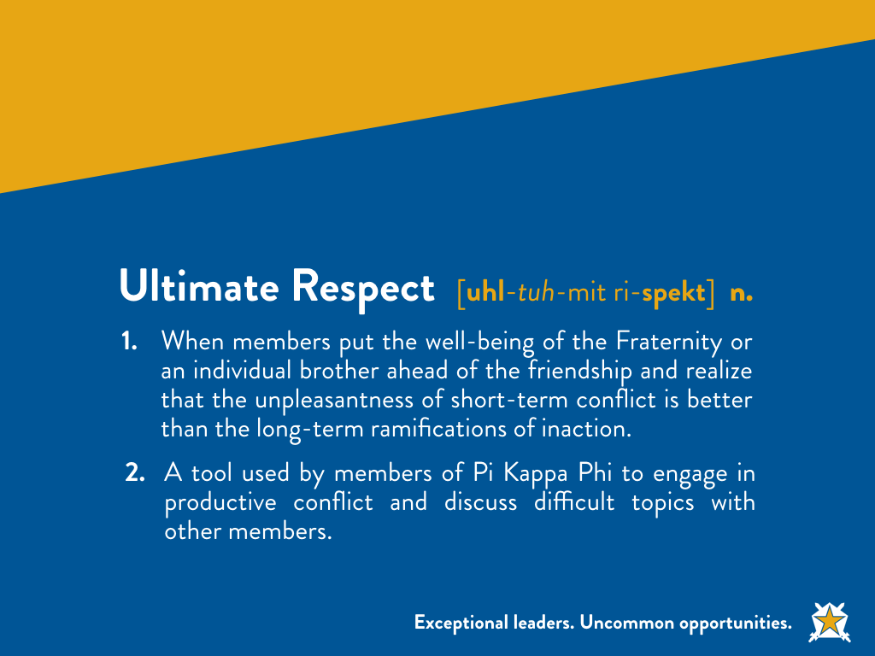

Slide 20
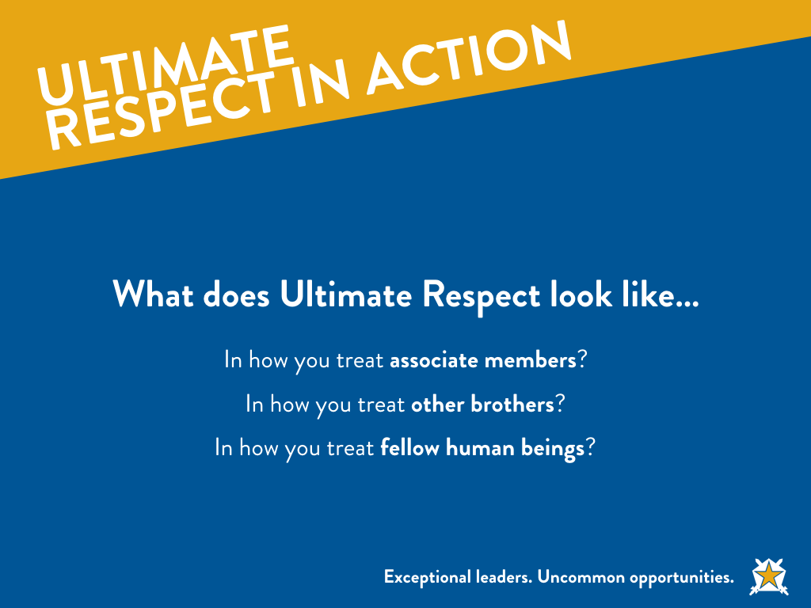

Slide 21
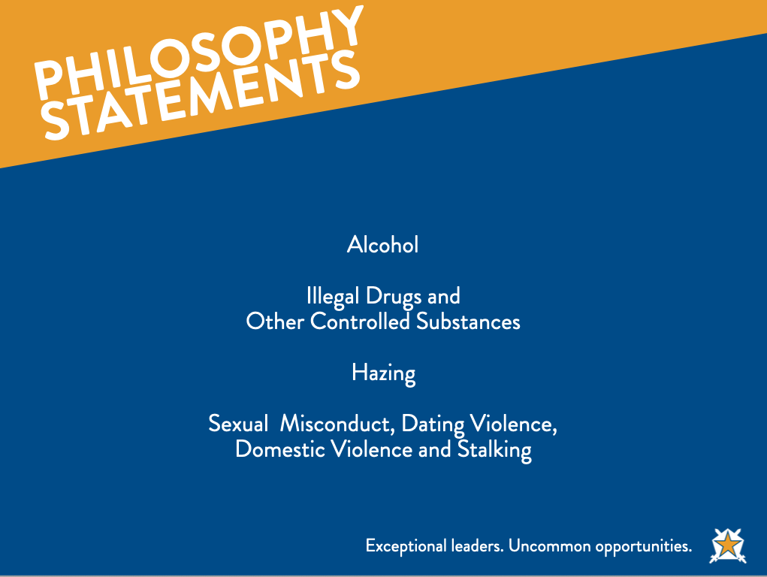
Notes:
We show ultimate respect by understanding and living out our philosophy statements.
Pi Kappa Phi has four Philosophy Statements…what do they have in common (next slide)?

Slide 22
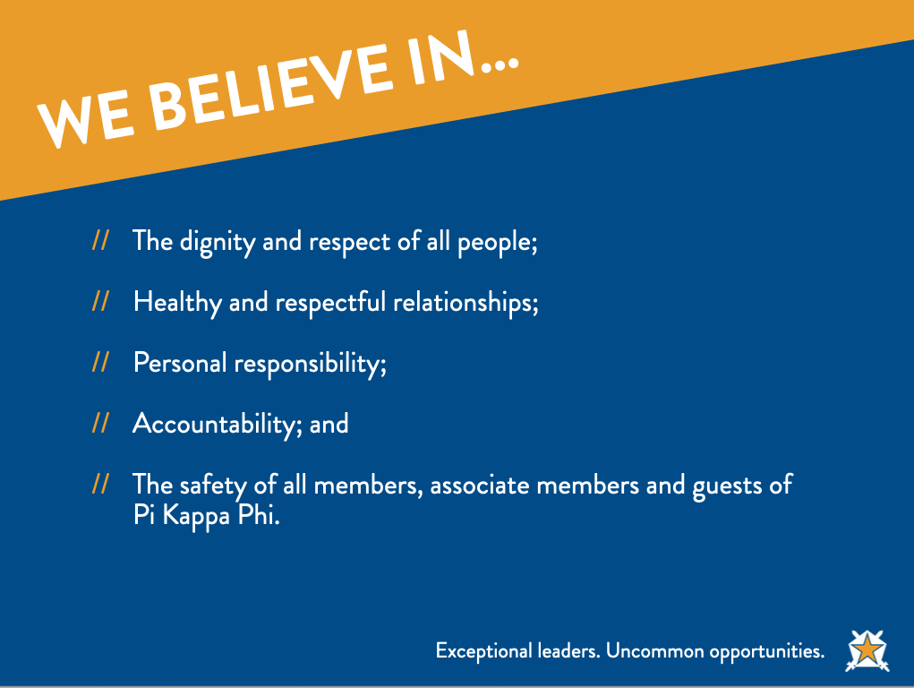

Slide 23
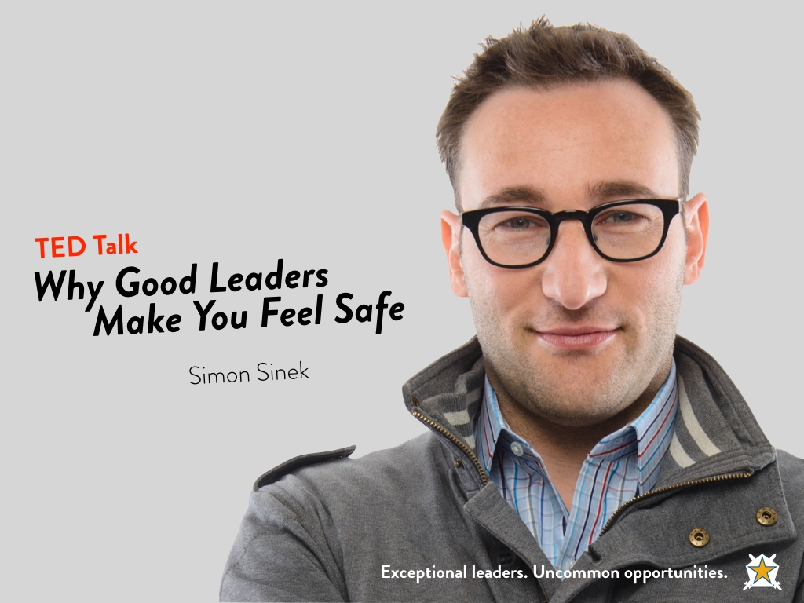
Notes:
Comment from Zach: The students do seem to really like the TED talks. I think it would be good to provide some discussions questions about the video; More than just the relationship status questions. Questions about if they've ever worked/been in bad organizations, how they felt, etc. I think it'll open the discussion up before they start talking about the chapter specifically. Diving right into "tell me about your relationships in the chapter" I found you get a lot of the answers you're "supposed" to get.
Discussion Questions AFTER Video:
Reaction to the talk? What stuck out to you?
To what extent is your chapter environment based on trust and cooperation?
What does it look like for yours leadership to put the safety of others first?
When do you fear the leaders?
When do you feel safe inside the organization?
How does this talk apply to your chapter?
http://www.ted.com/talks/simon_sinek_why_good_leaders_make_you_feel_safe
(the video is linked to the slide, so if you click the slide during the presentation, the video should open)
00:11 There's a man by the name of Captain William Swenson who recently was awarded the congressional Medal of Honor for his actions on September 8, 2009.
00:24 On that day, a column of American and Afghan troops were making their way through a part of Afghanistan to help protect a group of government officials, a group of Afghan government officials, who would be meeting with some local village elders. The column came under ambush, and was surrounded on three sides, and amongst many other things, Captain Swenson was recognized for running into live fire to rescue the wounded and pull out the dead. One of the people he rescued was a sergeant, and he and a comrade were making their way to a medevac helicopter.
01:07 And what was remarkable about this day is, by sheer coincidence, one of the medevac medics happened to have a GoPro camera on his helmet and captured the whole scene on camera. It shows Captain Swenson and his comrade bringing this wounded soldier who had received a gunshot to the neck. They put him in the helicopter, and then you see Captain Swenson bend over and give him a kiss before he turns around to rescue more.
01:43 I saw this, and I thought to myself, where do people like that come from? What is that? That is some deep, deep emotion, when you would want to do that. There's a love there, and I wanted to know why is it that I don't have people that I work with like that? You know, in the military, they give medals to people who are willing to sacrifice themselves so that others may gain. In business, we give bonuses to people who are willing to sacrifice others so that we may gain. We have it backwards. Right? So I asked myself, where do people like this come from? And my initial conclusion was that they're just better people. That's why they're attracted to the military. These better people are attracted to this concept of service. But that's completely wrong. What I learned was that it's the environment, and if you get the environment right, every single one of us has the capacity to do these remarkable things, and more importantly, others have that capacity too. I've had the great honor of getting to meet some of these, who we would call heroes, who have put themselves and put their lives at risk to save others, and I asked them, "Why would you do it? Why did you do it?" And they all say the same thing: "Because they would have done it for me." It's this deep sense of trust and cooperation. So trust and cooperation are really important here. The problem with concepts of trust and cooperation is that they are feelings, they are not instructions. I can't simply say to you, "Trust me," and you will. I can't simply instruct two people to cooperate, and they will. It's not how it works. It's a feeling.
03:17 So where does that feeling come from? If you go back 50,000 years to the Paleolithic era, to the early days of Homo sapiens, what we find is that the world was filled with danger, all of these forces working very, very hard to kill us. Nothing personal. Whether it was the weather, lack of resources, maybe a saber-toothed tiger, all of these things working to reduce our lifespan. And so we evolved into social animals, where we lived together and worked together in what I call a circle of safety, inside the tribe, where we felt like we belonged. And when we felt safe amongst our own, the natural reaction was trust and cooperation. There are inherent benefits to this. It means I can fall asleep at night and trust that someone from within my tribe will watch for danger. If we don't trust each other, if I don't trust you, that means you won't watch for danger. Bad system of survival.
04:12 The modern day is exactly the same thing. The world is filled with danger, things that are trying to frustrate our lives or reduce our success, reduce our opportunity for success. It could be the ups and downs in the economy, the uncertainty of the stock market. It could be a new technology that renders your business model obsolete overnight. Or it could be your competition that is sometimes trying to kill you. It's sometimes trying to put you out of business, but at the very minimum is working hard to frustrate your growth and steal your business from you. We have no control over these forces. These are a constant, and they're not going away.
04:46 The only variable are the conditions inside the organization, and that's where leadership matters, because it's the leader that sets the tone. When a leader makes the choice to put the safety and lives of the people inside the organization first, to sacrifice their comforts and sacrifice the tangible results, so that the people remain and feel safe and feel like they belong, remarkable things happen.
05:12 I was flying on a trip, and I was witness to an incident where a passenger attempted to board before their number was called, and I watched the gate agent treat this man like he had broken the law, like a criminal. He was yelled at for attempting to board one group too soon. So I said something. I said, "Why do you have treat us like cattle? Why can't you treat us like human beings?" And this is exactly what she said to me. She said, "Sir, if I don't follow the rules, I could get in trouble or lose my job." All she was telling me is that she doesn't feel safe. All she was telling me is that she doesn't trust her leaders. The reason we like flying Southwest Airlines is not because they necessarily hire better people. It's because they don't fear their leaders.
06:06 You see, if the conditions are wrong, we are forced to expend our own time and energy to protect ourselves from each other, and that inherently weakens the organization. When we feel safe inside the organization, we will naturally combine our talents and our strengths and work tirelessly to face the dangers outside and seize the opportunities.
06:27 The closest analogy I can give to what a great leader is, is like being a parent. If you think about what being a great parent is, what do you want? What makes a great parent? We want to give our child opportunities, education, discipline them when necessary, all so that they can grow up and achieve more than we could for ourselves. Great leaders want exactly the same thing. They want to provide their people opportunity, education, discipline when necessary, build their self-confidence, give them the opportunity to try and fail, all so that they could achieve more than we could ever imagine for ourselves.
06:58 Charlie Kim, who's the CEO of a company called Next Jump in New York City, a tech company, he makes the point that if you had hard times in your family, would you ever consider laying off one of your children? We would never do it. Then why do we consider laying off people inside our organization? Charlie implemented a policy of lifetime employment. If you get a job at Next Jump, you cannot get fired for performance issues. In fact, if you have issues, they will coach you and they will give you support, just like we would with one of our children who happens to come home with a C from school. It's the complete opposite.
07:36 This is the reason so many people have such a visceral hatred, anger, at some of these banking CEOs with their disproportionate salaries and bonus structures. It's not the numbers. It's that they have violated the very definition of leadership. They have violated this deep-seated social contract. We know that they allowed their people to be sacrificed so they could protect their own interests, or worse, they sacrificed their people to protect their own interests. This is what so offends us, not the numbers. Would anybody be offended if we gave a $150 million bonus to Gandhi? How about a $250 million bonus to Mother Teresa? Do we have an issue with that? None at all. None at all. Great leaders would never sacrifice the people to save the numbers. They would sooner sacrifice the numbers to save the people.
08:25 Bob Chapman, who runs a large manufacturing company in the Midwest called Barry-Wehmiller, in 2008 was hit very hard by the recession, and they lost 30 percent of their orders overnight. Now in a large manufacturing company, this is a big deal, and they could no longer afford their labor pool. They needed to save 10 million dollars, so, like so many companies today, the board got together and discussed layoffs. And Bob refused. You see, Bob doesn't believe in head counts. Bob believes in heart counts, and it's much more difficult to simply reduce the heart count. And so they came up with a furlough program. Every employee, from secretary to CEO, was required to take four weeks of unpaid vacation. They could take it any time they wanted, and they did not have to take it consecutively. But it was how Bob announced the program that mattered so much. He said, it's better that we should all suffer a little than any of us should have to suffer a lot, and morale went up. They saved 20 million dollars, and most importantly, as would be expected, when the people feel safe and protected by the leadership in the organization, the natural reaction is to trust and cooperate. And quite spontaneously, nobody expected, people started trading with each other. Those who could afford it more would trade with those who could afford it less. People would take five weeks so that somebody else only had to take three.
09:58 Leadership is a choice. It is not a rank. I know many people at the seniormost levels of organizations who are absolutely not leaders. They are authorities, and we do what they say because they have authority over us, but we would not follow them. And I know many people who are at the bottoms of organizations who have no authority and they are absolutely leaders, and this is because they have chosen to look after the person to the left of them, and they have chosen to look after the person to the right of them. This is what a leader is.
10:30 I heard a story of some Marines who were out in theater, and as is the Marine custom, the officer ate last, and he let his men eat first, and when they were done, there was no food left for him. And when they went back out in the field, his men brought him some of their food so that he may eat, because that's what happens. We call them leaders because they go first. We call them leaders because they take the risk before anybody else does. We call them leaders because they will choose to sacrifice so that their people may be safe and protected and so their people may gain, and when we do, the natural response is that our people will sacrifice for us. They will give us their blood and sweat and tears to see that their leader's vision comes to life, and when we ask them, "Why would you do that? Why would you give your blood and sweat and tears for that person?" they all say the same thing: "Because they would have done it for me." And isn't that the organization we would all like to work in?

Slide 24
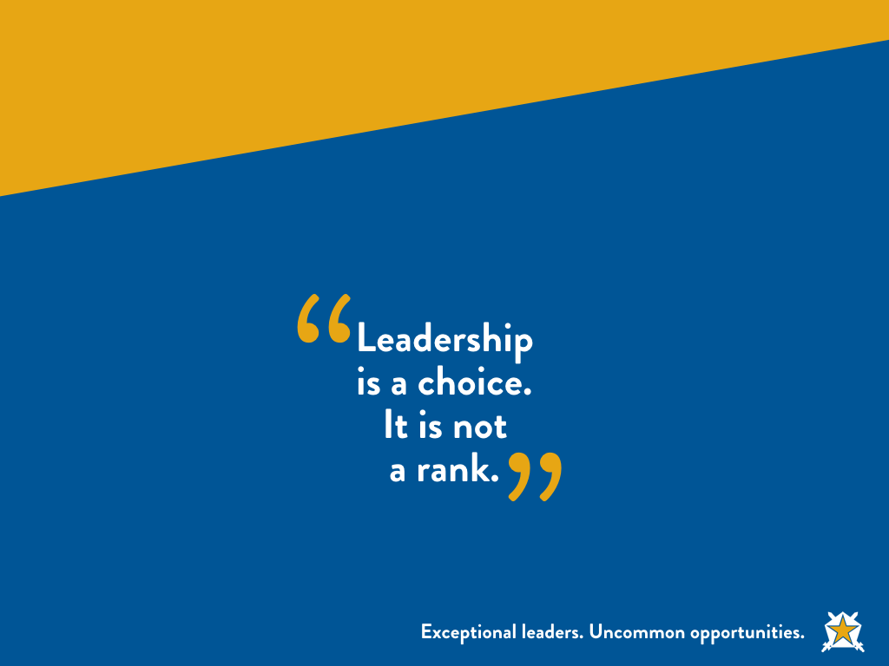

Slide 25
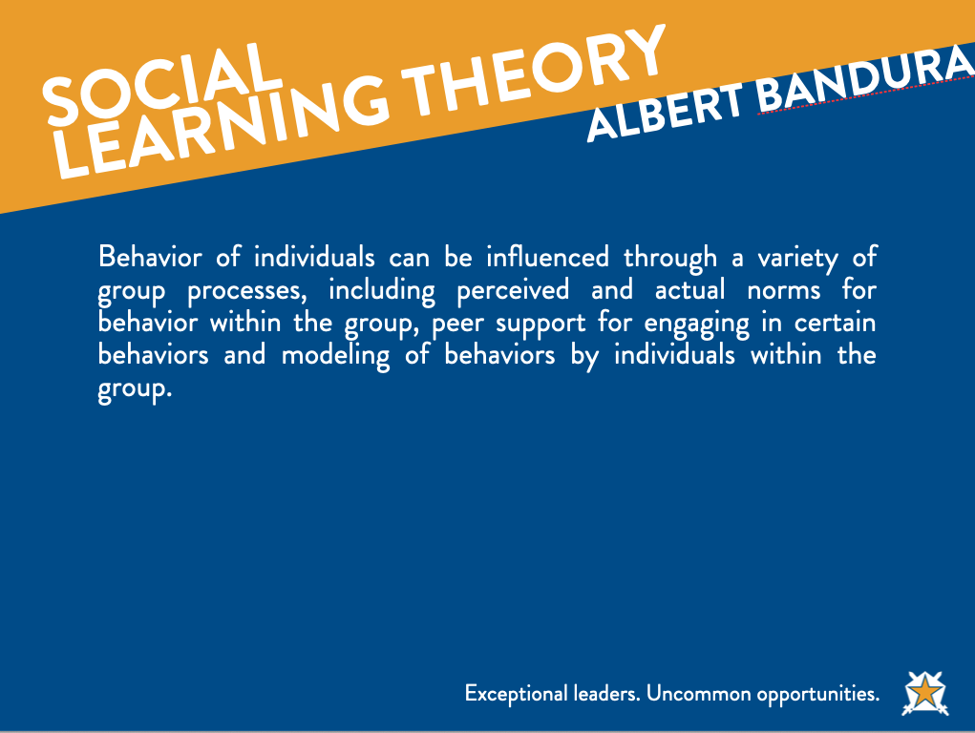
Notes:
FACILITATOR NOTE – THERE ARE THREE THEORIES…PICK ONE THAT WORKS FOR YOU.
From Zach: I used both of the Lewin and Bandura social learning slides. I like that they integrate the environment with personal factors. I've asked the men to think about what kind of environment they are creating and if it's working to make them all better or working to make them all worse. They may each feel they have a strong moral compass or are doing the right thing but they're swimming upstream if the chapter as a whole doesn't perform that way. I've given them some examples for silent thought too....do you often disagree with chapter decisions....do you find you're a different person with the fraternity than you are outside of it; is that better or worse..etc. At HPU I also lead this into a change discussion; about how the environment is made up of individuals so the only way to change it is through individuals. If you lament that there is "no environment of accountability in the chapter...the chapter needs to change" it will never happen unless you personally make a change. Be more accountable yourself, actively hold others accountable, etc.
SLIDE Social Learning Theory
The social learning theory proposed by Albert Bandura has become perhaps the most influential theory of learning and development. While rooted in many of the basic concepts of traditional learning theory, Bandura believed that direct reinforcement could not account for all types of learning.
While the behavioral theories of learning suggested that all learning was the result of associations formed by conditioning, reinforcement, and punishment, Bandura's social learning theory proposed that learning can also occur simply by observing the actions of others.
His theory added a social element, arguing that people can learn new information and behaviors by watching other people. Known as observational learning (or modeling), this type of learning can be used to explain a wide variety of behaviors.
"Learning would be exceedingly laborious, not to mention hazardous, if people had to rely solely on the effects of their own actions to inform them what to do. Fortunately, most human behavior is learned observationally through modeling: from observing others one forms an idea of how new behaviors are performed, and on later occasions this coded information serves as a guide for action."
-Albert Bandura, Social Learning Theory, 1977

Slide 26
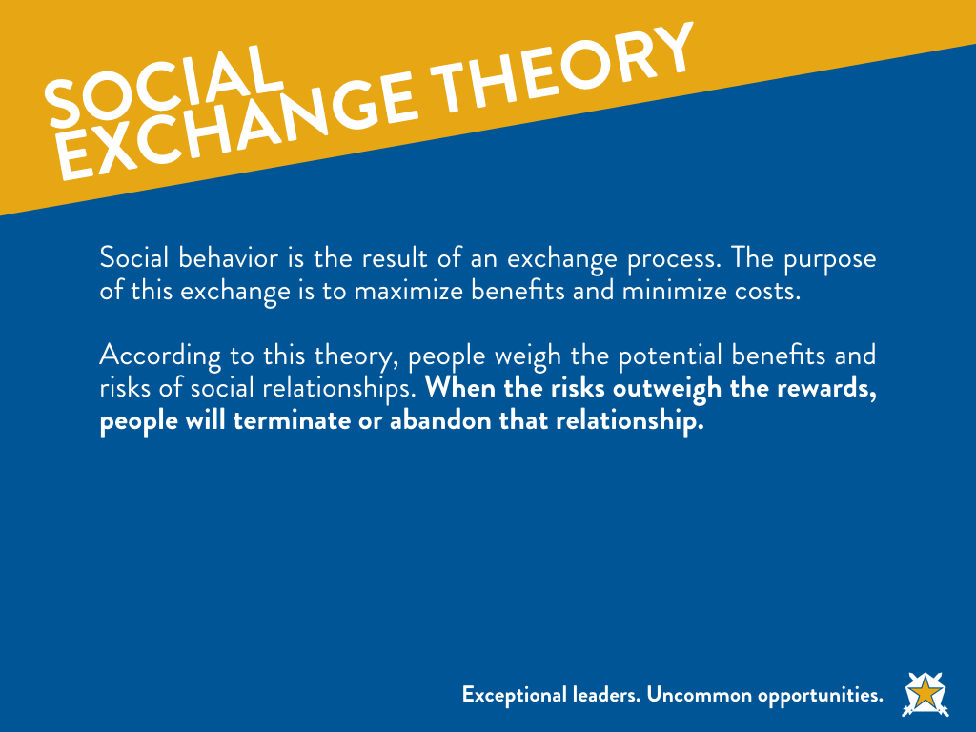
Notes:
SLIDE Social Exchange Theory – 1959
Social exchange theory proposes that social behavior is the result of an exchange process. The purpose of this exchange is to maximize benefits and minimize costs. According to this theory, people weigh the potential benefits and risks of social relationships. When the risks outweigh the rewards, people will terminate or abandon that relationship.
Costs involves things that are seen as negatives to the individual such as having to put money, time and effort into a relationship.
The benefits are thing things that the individual gets out the relationship such as fun, friendship, companionship and social support.
Social exchange theory suggests that we essentially take the benefits and minus the costs in order to determine how much a relationship is worth. Positive relationships are those in which the benefits outweigh the costs, while negative relationships occur when the costs are greater than the benefits.
All relationships have give and take, although the balance of this exchange is not always equal. Social Exchange theory explains how we feel about a relationship with another person as depending on our perceptions of:
The balance between what we put into the relationship and what we get out of it.
The kind of relationship we deserve.
The chances of having a better relationship with someone else.
In deciding what is fair, we develop a comparison level against which we compare the give/take ratio. This level will vary between relationships, with some being more giving and others where we get more from the relationship. They will also vary greatly in what is given and received. Thus, for example, exchanges at home may be very different, both in balance and content.
We also have a comparison level for the alternative relationships. With a high such comparison level, we might believe the world is full of lovely people just waiting to meet us. When this level is low, we may stay in a high-cost relationship simply because we believe we could not find any better elsewhere.

Slide 27

Notes:
Zach: The values exercise is good and always elicits discussion. It's interesting how viscerally some of the men have reacted to how "grey" some of these are. That may be a thought to work in here, or some other training; the vast grey area that is morality, but I digress. I do find that the setup is challenging for this exercise. The two rooms I've done this in were lecture-hall style rooms and they don't lend themselves to moving around. We either need to provide some direction on the room setup or modify the exercise. I've done it with a hand raise...which isn't ideal. There's a similar challenge with the ice-breaker which I also like.
The Task: Introduce the activity by informing the participants that they will be doing a values clarification exercise which will challenge their ethical decision making (or their personal scales of right and wrong) and will force them to justify their decisions. Define values: “Priorities or rankings that an individual establishes for his norms and beliefs.” (For example a personal value may be “It is important to get a good education.” Or “It is important to treat others with kindness and respect.”)
Write the following statements on separate sheets of flip chart paper:
(1) Strongly agree
(2) Agree
(3) Disagree
(4) Strongly disagree
Tape these sheets on the wall around the room. They should remain in the order of strongly agree, agree, disagree, strongly disagree.
Inform the group that you, as the activity leader, will read a statement. Each individual will need to make a personal decision and then move to the statement (agree-disagree) that best describes his feelings. After each member chooses his feeling of agreement call on one person in each category to tell why he disagrees, agrees, etc.
SLIDE: Dignity and Respect in Action
It’s OK to call a woman a “slut.”
It’s OK to call someone a “retard.”
It’s OK to hook up with someone after drinking.
It’s OK to require associates to be designated drivers.
It’s OK to talk shit about a brother to other brothers.
It’s OK to disregard the direction given by the officers.
It’s OK to lie to a brother.
It’s OK to make a fun of a brother who has hooked up with someone you think is unattractive.
It’s OK to make fun of someone’s race if it’s all intended as a joke.
It’s OK to call someone a “pussy.”
It’s OK to make the associates do physical exercise.
It’s OK to require associate members to do things brothers don’t have to do.
It’s OK to have required activities for members.
It’s OK to post pictures of people passed out.
It’s OK to encourage brothers to drink until they black out.
It’s OK to give your little brother the family drink if he is not required to drink it.
It’s OK to treat associate members like pledges.
It’s OK to make associate members earn their right to initiation.
It’s OK to threaten to blackball associates.
It’s OK to give a guy a bid that you know you are going to black ball.
It’s OK to intentionally not invite brothers to certain events.
It’s OK to physically fight a brother.
It’s OK to host an ABC Party (Anything by Clothes).
It’s OK to host a CEO and Office Hoes Party.
It’s OK to ask a brother to leave a party because he is being creepy to a guest.
It’s OK to be a cock block if you think a brother or the other person is too drunk to have sex.
It’s OK to stick up for an associate member if you think a brother is out of line.

Slide 28
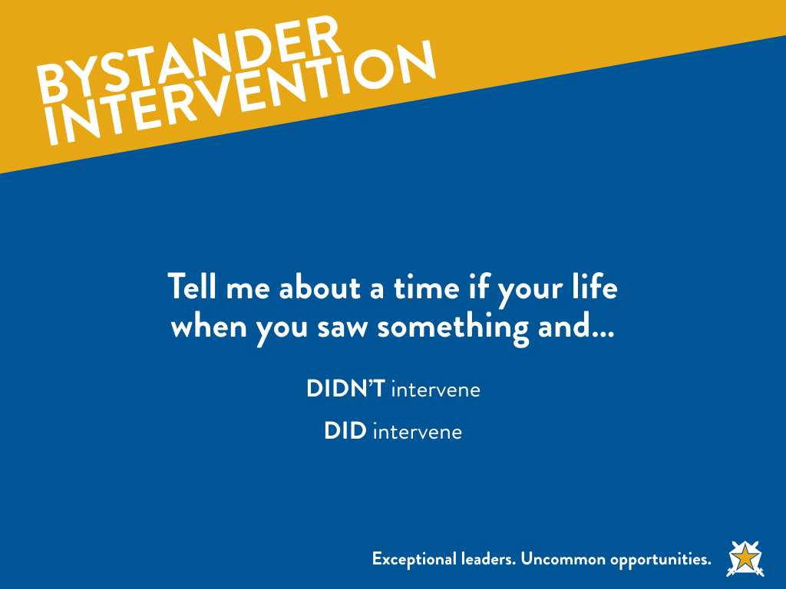
Notes:
Tell me about a time in your life where you saw something and you DIDN’T intervene.
Tell me about a time in your life when you saw something and you DID intervene.

Slide 29
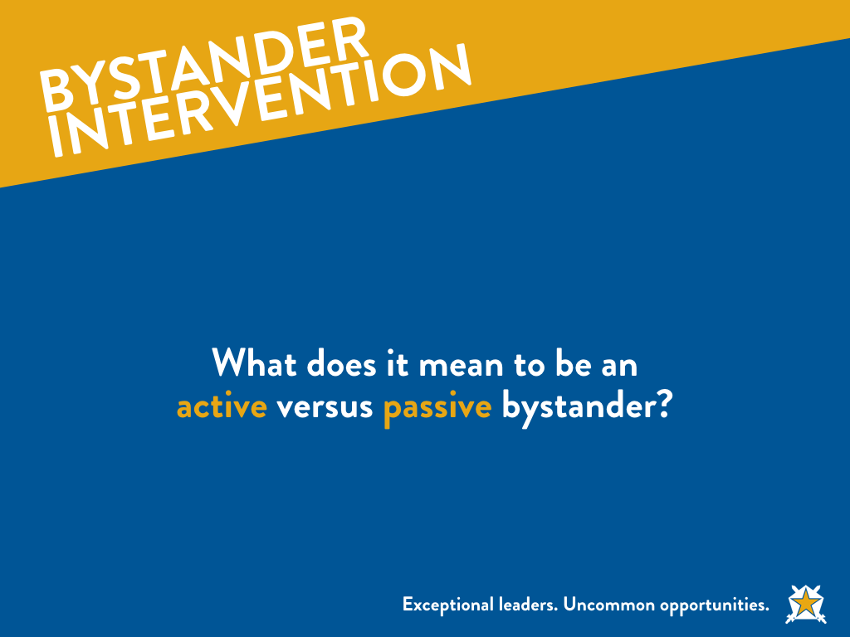
Notes:
Brief discussion as to what it means to the audience members to be an active vs. passive bystander. Also could pose questions asking when does it become our responsibility to intervene? What might that look like? How do we know our boundaries as to appropriate invention vs. not appropriate? Etc.

Slide 30
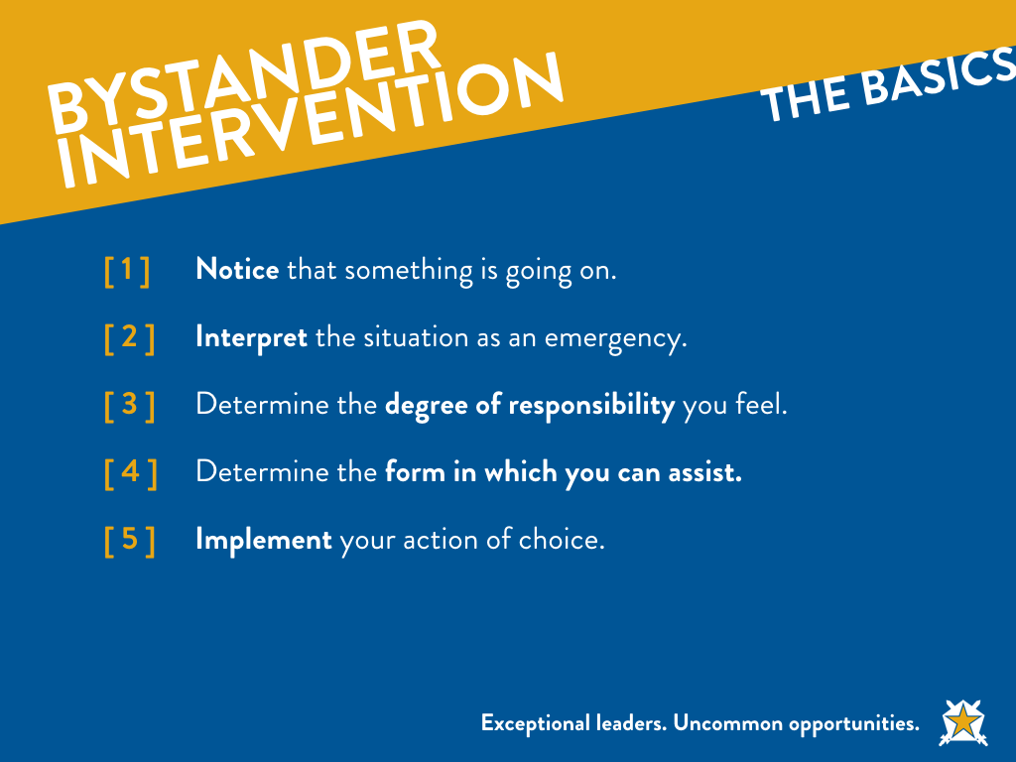
Notes:
The Bystander Effect
As you know, the Bystander Effect essentially boils down to the fact that the more individuals who see someone in need, the less likely each person is to intervene, and the less likely that individual is to receive help.
An example that can be used to explain this is the idea behind the story of "The Good Samaritan." It was first studied and "discovered" through a study done by two social psychologists named John Darley and Bibb Latane in 1968. They discovered that when it came to everyday situations when there was only one person witnessing the situation where assistance was needed that they helped 85% of the time. That dropped to 65% when there were two witnesses present. And when there were 4 or more witnesses present, that statistic dropped to 31% and continued to decrease as the number of witnesses increased in and inverse manner (I have a graph we used to depict this).
They also discovered that an individual goes through a multi step decision making process when decided whether or not to intervene. Each step follows with a cognitive decision made by the individual to proceed or pass on intervening. The steps published in their study are the following...
1. Notice that something is going on
2. Interpret that situation as being an emergency
3. Determine the degree of responsibility felt
4. Determine the form in which they can assist
5. Implement their action of choice
We chose to simplify these steps into an easy-to-remember phrase for the audience to take away. We came up the acronym See, Think, Act. We couldn't find anywhere this has been used before other than in England and pertaining to a study about relational security at a mental hospital facility, but nothing to my knowledge has been created using this as a bystander intervention program.

Slide 31
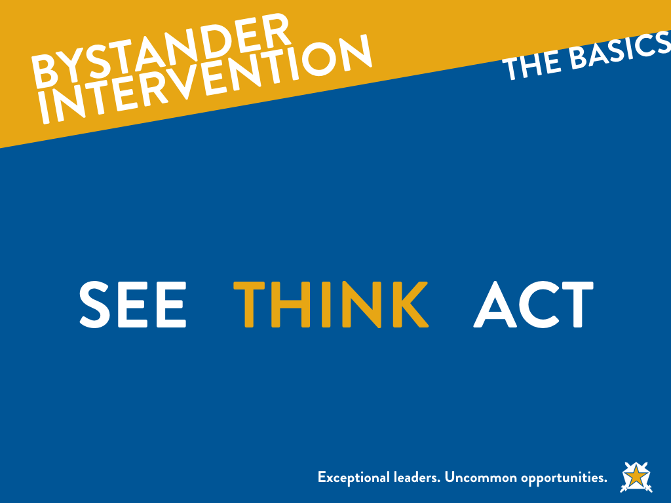
Notes:
See --> Think --> Act
This was one of the two main take aways we tried to get our audiences to walk away with. Understanding this acronym would be the bulk of the conversation. I would use this to engage the audience (which we did all-male, all-female, and co-ed) in a discussion around what each of these looks like in their world.
SEE
This boils down to a discussion about what might we see as an indicator of an individual in need of help. This would center around the idea that you have to notice the event before you can help and also reasons why we may overlook that event (Being intoxicated, under the influence of marijuana, not wanting to be bothered, lack of caring/awareness, etc.). This stage is important because it determines whether someone will get the help they need.
THINK
This is the stage where the individual must decide if the situation they have noticed actually warrants any attention. This is also a place for a discussion as to why individuals may fail to think they should intervene (personal safety, unsure if they are reading the situation correctly, they don't know how to help, bystander effect and thinking someone else will help, etc.). Another consideration to discuss is the urgency of the situation. Ending with a wrap up explanation that at this stage, it is critical to use your best objective judgement. If you are unsure, you can start by asking yourself, "What would I want if I were in the other individual's shoes?"
ACT
This is where we would ideally spend the bulk of our time, discussion how to act specifically. At this point, the active bystander must take personal responsibility for the situation. If they think that "someone" should do something, then they must recognize they are that someone.
During the THINK stage, we determined the urgency of the situation. Generally if the situation is urgent, it will require a direct approach. We also may need to enlist the help of others if necessary. If the situation is not urgent, we can take a reasonable amount of time to think through a plan of intervention. This type of situation can use both an indirect or direct method. There are four main ways to intervene, which we often used the phrase distract, delegate, and direct. The first two being indirect methods of intervention. The key take-a-way that we left them with was that regardless of how the bystander chooses to intervene, they need to think quickly and act decisively. Reminding them that you may not always have the luxury of time to strategize, so they must be confident in the decisions they make in order to be successful.

Slide 32
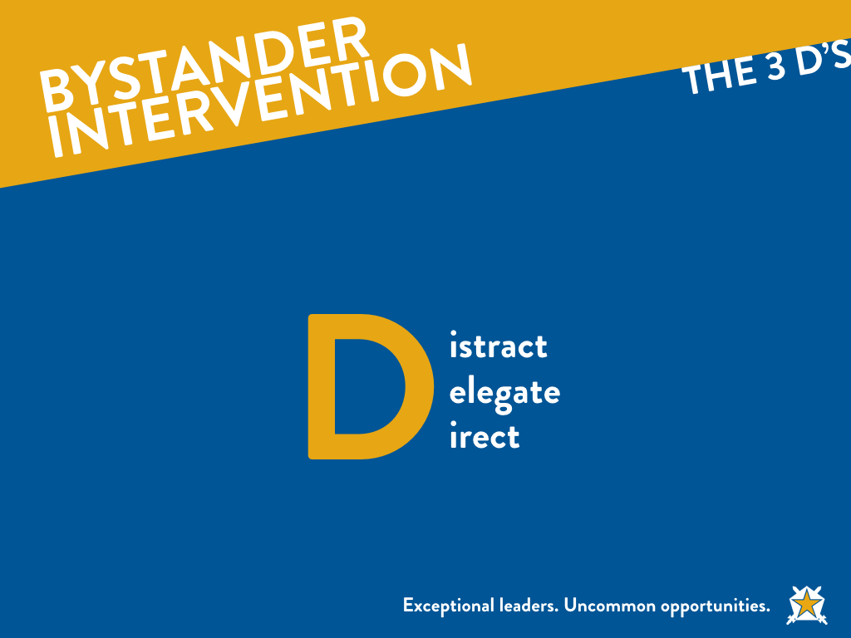
Notes:
Distract, Delegate, and Direct
The 3 D's of bystander intervention method is used in many different programs across the country. It boils down to the following.
Distract: This method is an indirect method that is often used when individuals want to avoid a confrontation and often found more comfortable for more introverted individuals to use. This method can be used with the victim or perpetrator as the target. Any act that would take the focus of the situation away from the victim can work.
Delegate: This method is a good choice to use when personal safety is a worry. An active bystander may choose to intervene indirectly for a number of reasons. Using this method, the bystander may choose to go to another individual to get help (such as security, an RA, the chapter president or risk manager, another friend near by, or anyone else who can help).
Direct: This method is obviously the direct method of intervention. This, like the distract method, can be used with the victim or perpetrator as the target. This would be where the bystander purposely inserts him/her self into the situation often with an honest and vocal assessment of what is happening and that it needs to stop immediately for said reasoning.
Take-A-Way
Remind the audience that most everyone will SEE a person in need, and a majority of those will also THINK that something should be done. However, when it comes time to ACT, many individuals will freeze up or leave the responsibility to someone else, when in all actuality, they must make a personal choice to act, and realize that they can and will determine whether or not that person in need gets the necessary help.

Slide 33
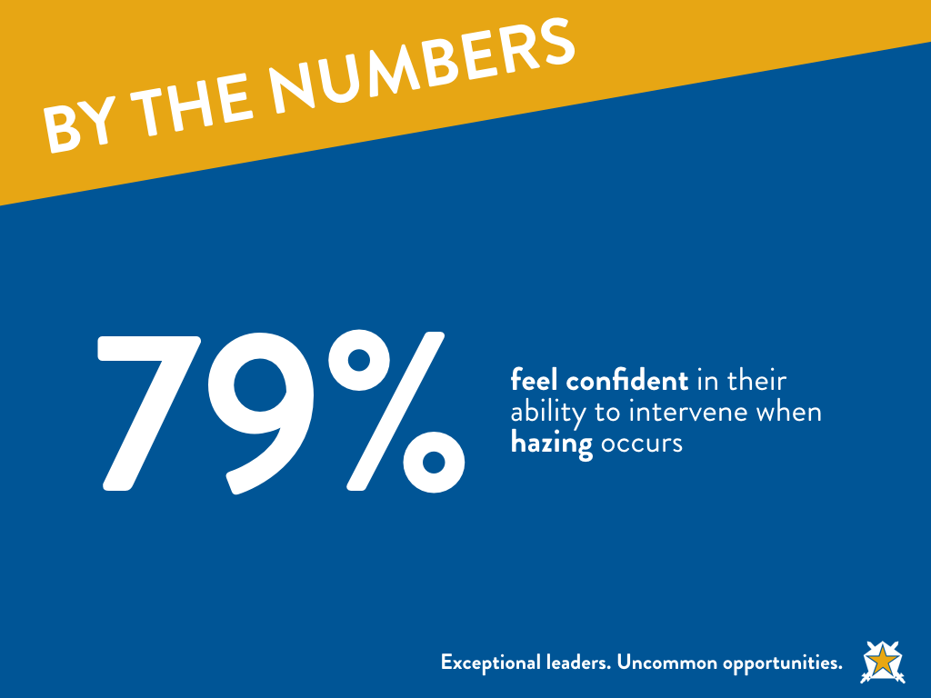
Notes:
This info is from GreekLifeEdu. Optional slides.
From Zach: I really like the survey slides; I've started framing it in reverse...that if we are really intervening 78 and 86 percent of the time and all the bad things you hear about are still happening we're way riskier than we thought. I've parlayed that into a discussion of why we don't intervene given some of the examples they provided earlier. This sets up the instruction period well I think.

Slide 34
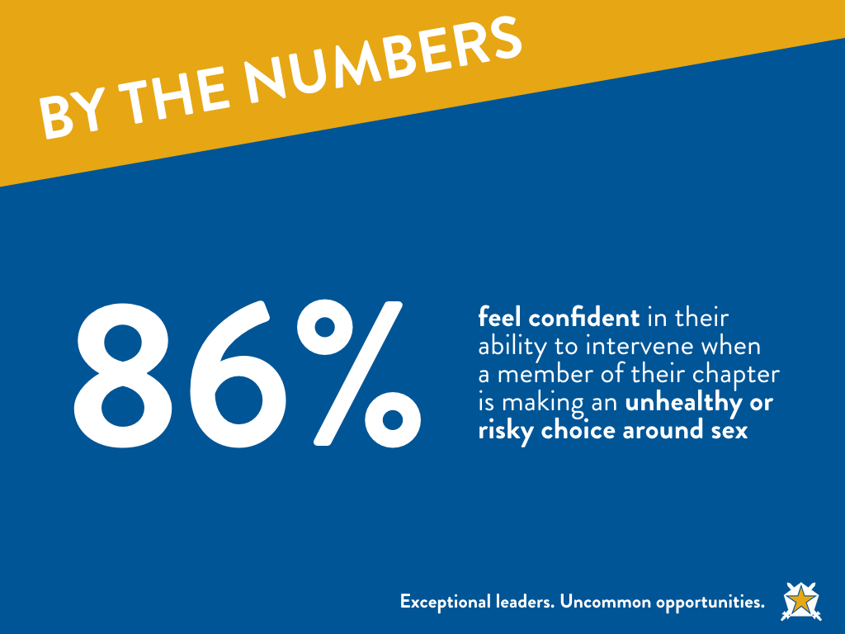
Notes:
Optional

Slide 35
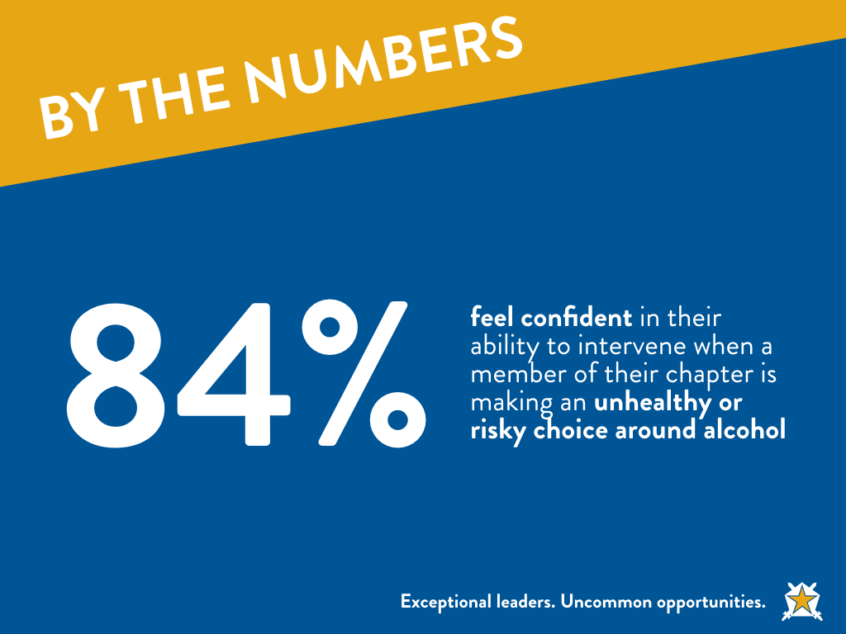

Slide 36
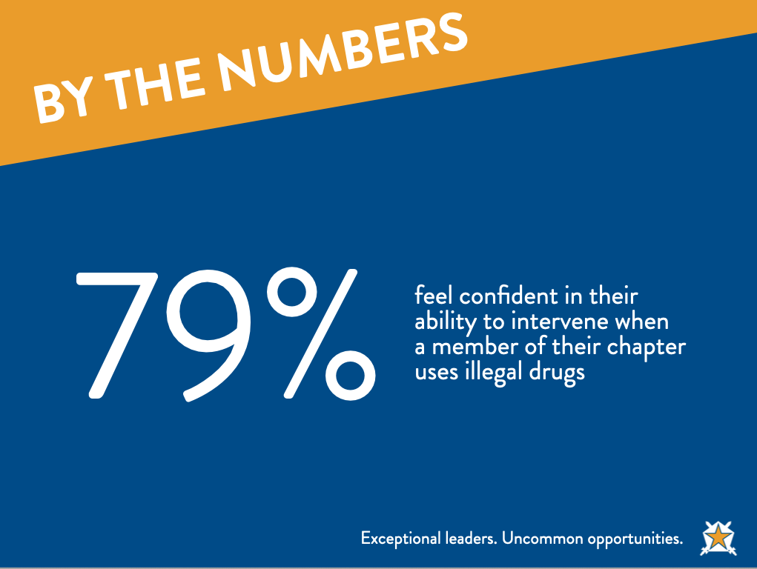

Slide 37
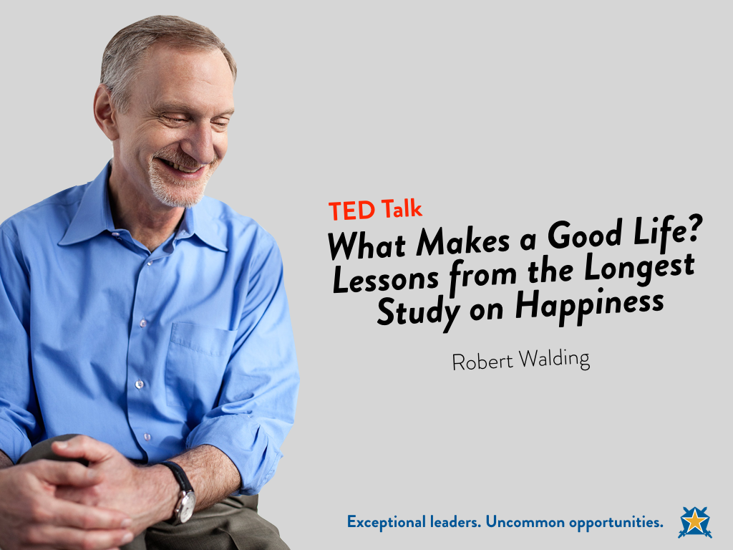
Notes:
From Zach: I didn't get to use the last Ted Talk at HPU, but I did at UVA. I think this needs to be a required part of this curriculum. We go through ultimate respect, and then all this nuance about values, social learning and how our actions effect each other, then how to intervene in risky situations, etc. When I showed this at UVA I recapped the program for a couple minutes afterward and then told them that all the things we talked about previously are just guidelines to good relationships. Having strong shared values, looking out for our brothers, being a positive influence and that all comes down to really just being a good person. If you forget everything I said just remember the golden rule; and do unto others. We have the ability to create the relationships in fraternity that will make us healthier for life; or we can create doubt, fear, insecurity, and all the worst things that will make us demonstrably less healthy. It's up to you individually to decide the type of chapter you want to have, visualize what it takes to get there, and then work together to make it happen.
Ted Talk: Harvard Research
http://www.ted.com/talks/robert_waldinger_what_makes_a_good_life_lessons_from_the_longest_study_on_happiness/
Script from Ted Talk:
What keeps us healthy and happy as we go through life? If you were going to invest now in your future best self, where would you put your time and your energy? There was a recent survey of millennials asking them what their most important life goals were, and over 80 percent said that a major life goal for them was to get rich. And another 50 percent of those same young adults said that another major life goal was to become famous.
00:49 (Laughter)
00:51 And we're constantly told to lean in to work, to push harder and achieve more. We're given the impression that these are the things that we need to go after in order to have a good life. Pictures of entire lives, of the choices that people make and how those choices work out for them, those pictures are almost impossible to get. Most of what we know about human life we know from asking people to remember the past, and as we know, hindsight is anything but 20/20. We forget vast amounts of what happens to us in life, and sometimes memory is downright creative.
01:35 But what if we could watch entire lives as they unfold through time? What if we could study people from the time that they were teenagers all the way into old age to see what really keeps people happy and healthy?
01:54 We did that. The Harvard Study of Adult Development may be the longest study of adult life that's ever been done. For 75 years, we've tracked the lives of 724 men, year after year, asking about their work, their home lives, their health, and of course asking all along the way without knowing how their life stories were going to turn out.
02:24 Studies like this are exceedingly rare. Almost all projects of this kind fall apart within a decade because too many people drop out of the study, or funding for the research dries up, or the researchers get distracted, or they die, and nobody moves the ball further down the field. But through a combination of luck and the persistence of several generations of researchers, this study has survived. About 60 of our original 724 men are still alive, still participating in the study, most of them in their 90s. And we are now beginning to study the more than 2,000 children of these men. And I'm the fourth director of the study.
03:14 Since 1938, we've tracked the lives of two groups of men. The first group started in the study when they were sophomores at Harvard College. They all finished college during World War II, and then most went off to serve in the war. And the second group that we've followed was a group of boys from Boston's poorest neighborhoods, boys who were chosen for the study specifically because they were from some of the most troubled and disadvantaged families in the Boston of the 1930s. Most lived in tenements, many without hot and cold running water.
03:53 When they entered the study, all of these teenagers were interviewed. They were given medical exams. We went to their homes and we interviewed their parents. And then these teenagers grew up into adults who entered all walks of life. They became factory workers and lawyers and bricklayers and doctors, one President of the United States. Some developed alcoholism. A few developed schizophrenia. Some climbed the social ladder from the bottom all the way to the very top, and some made that journey in the opposite direction.
04:34 The founders of this study would never in their wildest dreams have imagined that I would be standing here today, 75 years later, telling you that the study still continues. Every two years, our patient and dedicated research staff calls up our men and asks them if we can send them yet one more set of questions about their lives.
04:59 Many of the inner city Boston men ask us, "Why do you keep wanting to study me? My life just isn't that interesting." The Harvard men never ask that question.
05:10 (Laughter)
05:19 To get the clearest picture of these lives, we don't just send them questionnaires. We interview them in their living rooms. We get their medical records from their doctors. We draw their blood, we scan their brains, we talk to their children. We videotape them talking with their wives about their deepest concerns. And when, about a decade ago, we finally asked the wives if they would join us as members of the study, many of the women said, "You know, it's about time."
05:49 (Laughter)
05:50 So what have we learned? What are the lessons that come from the tens of thousands of pages of information that we've generated on these lives? Well, the lessons aren't about wealth or fame or working harder and harder. The clearest message that we get from this 75-year study is this: Good relationships keep us happier and healthier. Period.
06:22 We've learned three big lessons about relationships. The first is that social connections are really good for us, and that loneliness kills. It turns out that people who are more socially connected to family, to friends, to community, are happier, they're physically healthier, and they live longer than people who are less well connected. And the experience of loneliness turns out to be toxic. People who are more isolated than they want to be from others find that they are less happy, their health declines earlier in midlife, their brain functioning declines sooner and they live shorter lives than people who are not lonely. And the sad fact is that at any given time, more than one in five Americans will report that they're lonely.
07:18 And we know that you can be lonely in a crowd and you can be lonely in a marriage, so the second big lesson that we learned is that it's not just the number of friends you have, and it's not whether or not you're in a committed relationship, but it's the quality of your close relationships that matters. It turns out that living in the midst of conflict is really bad for our health. High-conflict marriages, for example, without much affection, turn out to be very bad for our health, perhaps worse than getting divorced. And living in the midst of good, warm relationships is protective.
07:56 Once we had followed our men all the way into their 80s, we wanted to look back at them at midlife and to see if we could predict who was going to grow into a happy, healthy octogenarian and who wasn't. And when we gathered together everything we knew about them at age 50, it wasn't their middle age cholesterol levels that predicted how they were going to grow old. It was how satisfied they were in their relationships. The people who were the most satisfied in their relationships at age 50 were the healthiest at age 80. And good, close relationships seem to buffer us from some of the slings and arrows of getting old. Our most happily partnered men and women reported, in their 80s, that on the days when they had more physical pain, their mood stayed just as happy. But the people who were in unhappy relationships, on the days when they reported more physical pain, it was magnified by more emotional pain.
09:03 And the third big lesson that we learned about relationships and our health is that good relationships don't just protect our bodies, they protect our brains. It turns out that being in a securely attached relationship to another person in your 80s is protective, that the people who are in relationships where they really feel they can count on the other person in times of need, those people's memories stay sharper longer. And the people in relationships where they feel they really can't count on the other one, those are the people who experience earlier memory decline. And those good relationships, they don't have to be smooth all the time. Some of our octogenarian couples could bicker with each other day in and day out, but as long as they felt that they could really count on the other when the going got tough, those arguments didn't take a toll on their memories.
10:00 So this message, that good, close relationships are good for our health and well-being, this is wisdom that's as old as the hills. Why is this so hard to get and so easy to ignore? Well, we're human. What we'd really like is a quick fix, something we can get that'll make our lives good and keep them that way. Relationships are messy and they're complicated and the hard work of tending to family and friends, it's not sexy or glamorous. It's also lifelong. It never ends. The people in our 75-year study who were the happiest in retirement were the people who had actively worked to replace workmates with new playmates. Just like the millennials in that recent survey, many of our men when they were starting out as young adults really believed that fame and wealth and high achievement were what they needed to go after to have a good life. But over and over, over these 75 years, our study has shown that the people who fared the best were the people who leaned in to relationships, with family, with friends, with community.
11:20 So what about you? Let's say you're 25, or you're 40, or you're 60. What might leaning in to relationships even look like?
11:30 Well, the possibilities are practically endless. It might be something as simple as replacing screen time with people time or livening up a stale relationship by doing something new together, long walks or date nights, or reaching out to that family member who you haven't spoken to in years, because those all-too-common family feuds take a terrible toll on the people who hold the grudges.
12:03 I'd like to close with a quote from Mark Twain. More than a century ago, he was looking back on his life, and he wrote this: "There isn't time, so brief is life, for bickerings, apologies, heartburnings, callings to account. There is only time for loving, and but an instant, so to speak, for that."
12:33 The good life is built with good relationships.

Slide 38
Notes:
You need an ending…this is a good place to come back to.

Slide 39
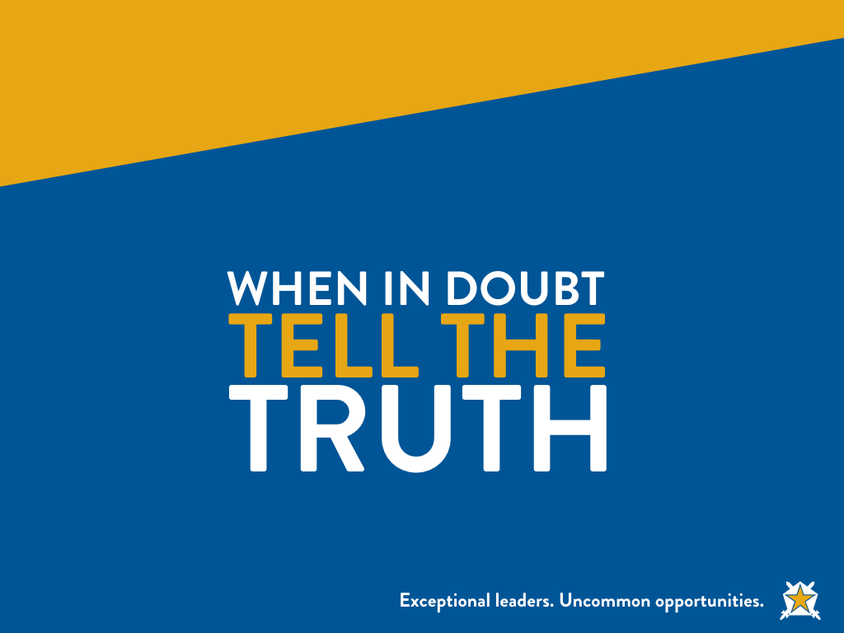
Notes:
Very much an optional slide…but you need to have a final point to pull it all together. Brotherhood, love, safety…etc.

