Slide 1
Notes:
FACILITATOR NOTES:
Italicized text like this will contain notes & instructions for you.
Directions are bolded.
Polls are BOLD AND UNDERLINED
Briefly introduce yourself: Name, current job, chapter you are from, volunteer experience with the Fraternity.

Slide 2
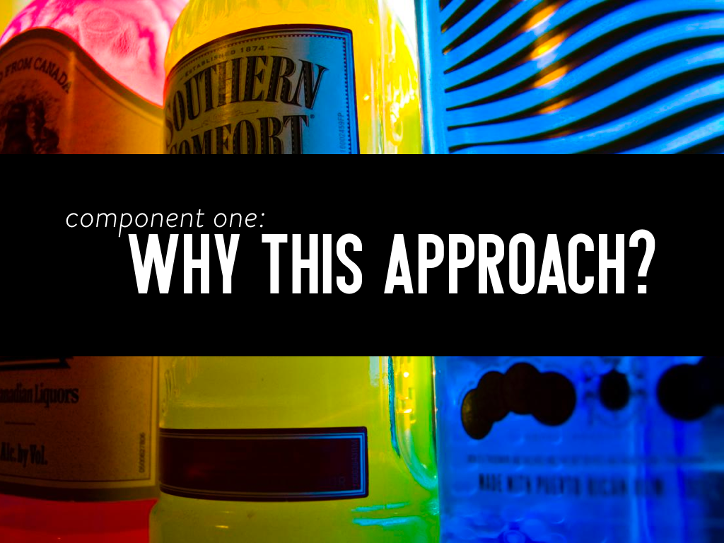
Notes:
Introduction of the first (of seven) components

Slide 3
Notes:
Share:
The purpose of this program is to help students who choose to drink make informed decisions about their alcohol consumption and to help them do so in a less dangerous and less risky way.
I will treat you as a responsible adult.
I am here to support each individual student’s decision regarding alcohol.
Remember: Ask open-ended questions through your time with the program. Avoid using “right,” “correct,” and “is it.” You never want to say, “here’s how you drink safely,” or “we know you’re going to drink…”
Allow the data to be confrontational, not you.
If you’ve kept the audience resistance down, you’ve set up the likelihood for change.

Slide 4
Notes:
Share:
The purpose of this program for individuals who choose to drink is to help them do so in a less dangerous and less risky way.
The best way to avoid the unwanted effects from alcohol is to not drink at all.
If you are under 21, it is illegal to drink.
This presentation is for everyone, including non-drinkers.
The information and skills you gain today might be helpful for a friend or in the future if you make the choice to drink.

Slide 5
Notes:
Ask:
What do we need to do to make our time together successful?
For example, no cell phones, participate, 1 person speaks at a time, use appropriate language and tone, etc.
Share:
During this presentation, your role is to participate. ASTP is meant to be a discussion, not a lecture.

Slide 7
Notes:
Discuss:
Why do you think people drink alcohol?
What are some ways alcohol affects people positively in social situations?
What are some ways alcohol affects people in “not so good” ways during social situations?
Share:
Expectancies refers to what you are thinking or expecting will happen when you drink alcohol.

Slide 8
Notes:
Share:
BAR Lab = Behavioral Alcohol Research Lab. The University of Washington created the BAR Lab to evaluate how alcohol and the environment can influence the behavior of a person.
The study utilized college students 21 and over who already drank. The participants were asked the same three questions we just discussed and were then told that at some point during the study they may be provided with alcohol. The participants were then asked to sign a consent form.

Slide 9
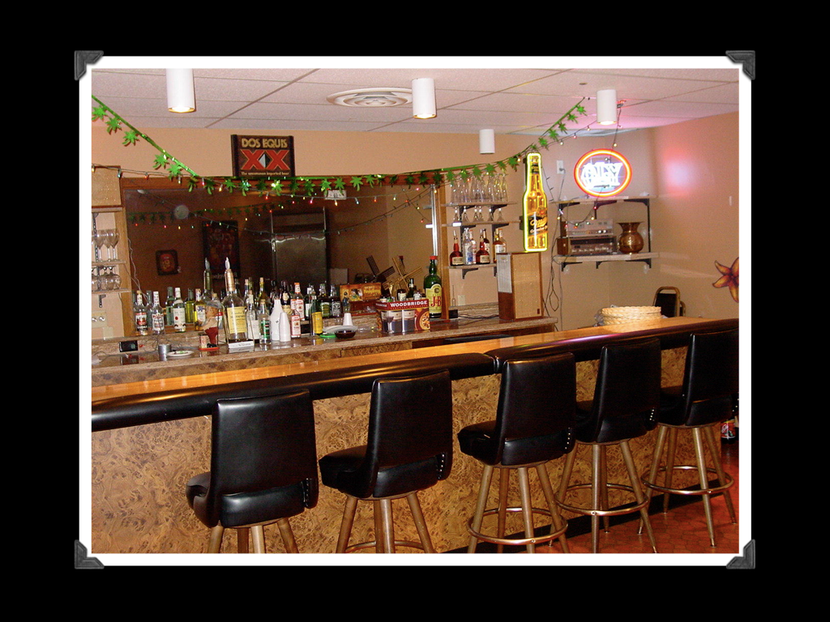
Notes:
Share:
This is a picture of the BAR Lab at the University of Washington. It was designed to look and feel like a bar as much as possible. However, if you look closer you can tell the mirror is a two-way mirror and there are microphones in the ceiling.

Slide 10
Notes:
Share:
This sign was hung in the bar (above the mirror) and used to record what was happening during the experiment. The sign was cut between the Xs to make room for a camera, which was removed in order to take this picture.

Slide 11
Notes:
Share:
The study utilized a balanced placebo design with the intent of separating the chemical effects of alcohol from the psychological effects of drinking. A placebo is a substance having no medication that is administered for its psychological effect (e.g. sugar pill in a clinical trial).
The balanced placebo design involves two conditions in which participants (in this case college students who were age 21 and over and had signed a consent release) received a beverage that was not what it seemed. Some expected to receive alcohol and others expected non-alcoholic drinks.
The placebo beer was a blend of several different “Near Beers.” It tasted like beer, but it didn’t actually contain a significant amount of alcohol. The drinks participants were given that appeared to be liquor were really just tonic water with lime. This study has been replicated numerous times with the same results.

Slide 12
Notes:
Ask:
How do you think participants who expected to receive alcohol and did receive alcohol acted?
Share:
Pretty much the way you would think they might ask. The students became more talkative, louder, and more flirtatious.

Slide 13
Notes:
Ask:
How do you think the students who expected to receive no alcohol and actually received no alcohol behaved?
Share:
Pretty much the way you expect. They primarily kept to themselves, were fairly quit, and did not exhibit much socialization.

Slide 14
Notes:
Ask:
How do you think the students who expected to not receive alcohol but who actually received alcohol behaved?
Share:
In this group, students were told they were only being served tonic water. Based on each participant’s height and weight, the researchers concocted one drink to get each student to a 0.06% BAL (enough to keep you intoxicated for 4 hours after the study ends). The participants were then given tonic water for the second drink.
At the 20 minute mark, the participants indicated that they wanted study to be over.
By the 40 minute mark, the physical effects (e.g. fatigue, flushing, lack of coordination) had set in, and people attributed it to not getting enough sleep, having a long day of class, etc.
At the end of the experiment (one hour), everyone was required to blow a breathalyzer at to verify that they received alcohol.

Slide 15
Notes:
Ask:
How do you think the participants who expected to receive alcohol but actually received no alcohol acted?
Share:
This was the first introduction to the powerful impact of expectancies. By the 20 minute mark, you couldn’t tell the difference between the Alcohol/Alcohol group and this group. The students began showing many of alcohol’s social effects — they became louder, more talkative, and more flirtatious. By the 40 minute mark, students began reporting physical side effects consistent with alcohol consumption.
You could mention the story of the student who acted as though the drinks were really strong

Slide 16
Notes:
Share:
The effects of substances are due to the drug itself, the setting a person is in, and his/her mindset.
The expectancy effect is more powerful than the chemical or physiological effects of alcohol.
The social and interpersonal things that happen with alcohol are a result of expectancies.
So, perhaps if you’re funny when you drink at a party, you’re actually just a funny person in general.
Share:
Possibly, the main “take away” message might be that if someone chooses to cut down, they won’t be “missing out” on the positives typically attributed to alcohol.
Review influences of set and setting
Be sure to ask what questions they have, what they make of these findings, and what they would do with this information.
Share:
So now that we’ve just talked about what alcohol doesn’t do, let’s talk about what we know alcohol does do.

Slide 17
Notes:
In this component, I’d like you to participants to consider your own drinking habits (type of alcohol, usual standards drinks they usually have in a night of drinking). If you’re a non-drinker consider the habits of a drinker you’re close with.

Slide 18
Notes:
Share:
Let’s talk about what a standard drink is of each type of alcohol.
Discuss:
What is a standard drink of beer?
What is a standard drink of wine?
What is a standard drink of 80 proof liquor?

Slide 19
Notes:
Examples:
12 oz. beer – Bud Light
10 oz. wine cooler or microbrew – Sam Adams
8 oz. malt liquor, Canadian beer, or ice beer – Olde English “800,” Mike’s Hard Lemonade, Smirnoff Ice, Natty Ice
6 oz. ice malt liquor – Mickey’s Ice
2.5 oz. fortified wine – wine in which a distilled beverage (usually brandy) has been added (e.g. port, sherry)
1.25 oz. 80-proof hard alcohol – Smirnoff vodka
1 oz. 100-proof hard alcohol – Captain Morgan
What is ice beer?
One step in creating beer is allowing parts to evaporate, turn into water droplets, and then slowly fall back into the container. In ice beer, the water droplets are flash frozen and removed, thus increasing the alcohol content of the beer.
Quick Conversions:
1 pint = 16 oz.
a “40” of Olde English “800” = 40 oz. = 5 standard drinks
Most people think drinks are counted by containers, rather than by standard drink. Knowing what a standard drink is can help you determine how much alcohol you are actually consuming.
CALCULATING A STANDARD DRINK SIZE BASED ON PROOF:
0.5 oz. of ethyl alcohol goes in the numerator; alcohol percentage by volume goes in the denominator
Example: 80-proof alcohol (40% ABV) → 0.5 / 0.4 = 1.25 oz. is a standard drink
wine (12.5% ABV) → 0.5 / 0.125 = 4.00 oz. is a standard drink
something with 6.2% ABV → 0.5 / 0.062 = 8.06 oz. is a standard drink

Slide 20
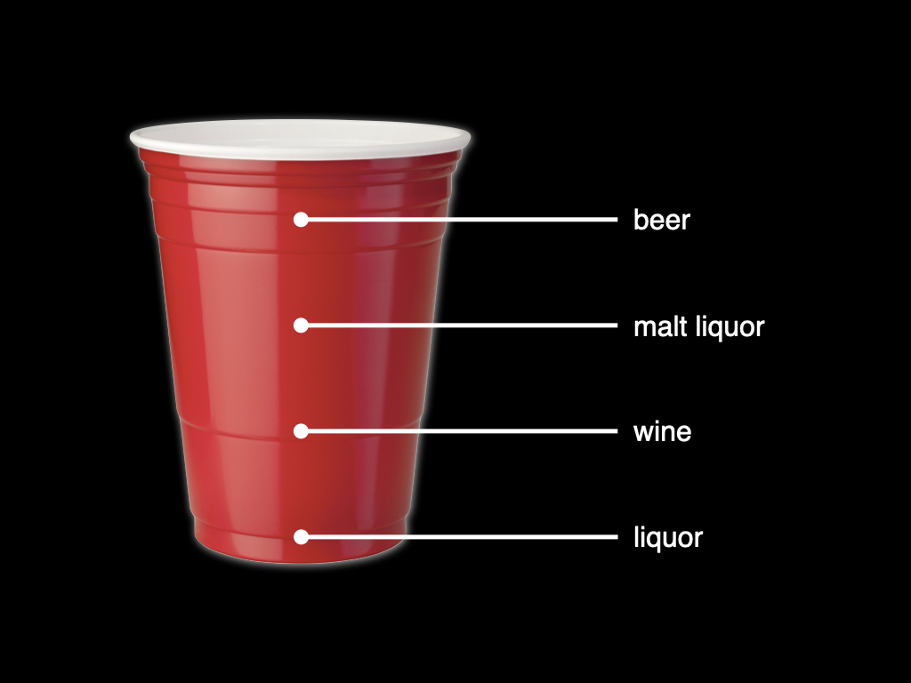
Notes:
A red Solo cup actually holds 16 oz.

Slide 21
Notes:
Have participants pause to consider what they normally drink (beer, liquor, wine, hard seltzer, etc.) and how it fits into the standard drink formula
After people answer share the following:
It's important to think critically about the amount of alcohol in any drink you have.
"Two drinks" could mean very different things to different people. Thus, we need to measure our drinks in standard drinks. When you set a drink limit, that limit should be based on standard drinks, not glasses of alcohol.

Slide 22
Notes:
Ask:
Think of an occasion in the past month when you drank the most. If you did not drink in the past month, you can think of the past 6 months or the past year. If you abstain, you can think of the amount you observed someone else drink. Think about how much time it took them to consume this amount. Write this down that it will matter latter in the program.

Slide 23
Notes:
Ask:
How do you think the average college student would answer this question?

Slide 24
Notes:
Share:
According to a study conducted at the University of Washington, on average, 90% of college students drink; and of those who drink, the average number of drinks per week is 10.
*There is reason to suspect that “generic” normative data isn’t particularly helpful. The inclusion of a discussion of norms presumes that normative data for the campus you’re visiting is available. If the data is available, great. If not, talk about norms misperceptions and the idea that we notice the extremes*
Social Norms – Perceptions vs. Reality
People are influenced by their subjective interpretation of a situation, rather than by the actual situation (Lewin, 1943). We are influenced by our perception of others’ attitudes, behaviors, and expectations rather than by their actual attitudes, behaviors, or expectations. Our perceptions and interpretations are also often inaccurate.
Share:
So what is the take away?
Not everyone drinks, not everyone drinks heavily, and even heavy drinks have not-so-heavy nights.
Some people are surrounded by a group of friends who drink heavily, and thus heavy drinking may seem more “normal” to them than it really is.
Everyone has heard tales of heavy partying, but rarely do people brag about the time when they only drank one or two drinks.
Ask:
How are people’s perceptions of what is “average” or “typical” drinking may be distorted?
Share:
It’s important to think critically about the amount of alcohol in any drink handed to you during a party.
“Two drinks” could mean very different things to different people. Thus, we need to measure drinks in standard drinks.
If someone sets a drink limit, that limit should be based on standard drinks, not glasses of alcohol.
Perceptions of what goes on around us really could be impacted by a handful of (extreme) examples.

Slide 26
Notes:
Ask:
What is alcohol?
Share:
Alcohol is a central nervous system depressant.
The term “depressant” is often misused. In short, alcohol depresses (or slows) the central nervous system.
As one’s blood alcohol level goes up, the depressant effect becomes more pronounced.
Because the brain is a part of the central nervous system, we see the deficits in cognitive processing and motor coordination increase as individuals get more intoxicated.
It is important to remember that reaction time decreases with the first sip of alcohol.

Slide 27
Notes:
Ask:
How does alcohol get into your system? Allow for some responses,
Share:
When you swallow a drink the alcohol first travels to your stomach.
Some of the alcohol begins going through the stomach wall and into your bloodstream through a process called absorption.
The rest of the alcohol then travels to the small intestine, where it enters the bloodstream rapidly and completely, regardless of the food content in the small intestine at the time.
Therefore, once alcohol reaches the intestine, the rate of absorption is fairly standard.

Slide 28
Notes:
Ask:
What influences the rate of absorption?
Share:
Strength: The higher the concentration of alcohol in your beverage, the faster it is absorbed into your bloodstream.
Amount and Time: The faster you drink, the faster the alcohol will get into your bloodstream. for example, playing drinking games increases your rate of absorption.
Food in the Stomach: When you have eaten recently and there is still food in your stomach, the movement of alcohol from the stomach into the small intestine is delayed. Thus, the absorption of alcohol will be slower than if you are drinking on an empty stomach.
Effervescence also increases the rate of absorption. A bubbly drink, such as champagne, will absorb faster. The same holds true for drinks mixed with soda or tonic water.
It can take as little as 10 seconds for alcohol to go from the stomach to the brain.

Slide 29
Notes:
Ask:
How does alcohol leave our system?
Share:
Approximately 90% of alcohol is broken down — or metabolized — in the body primarily by the liver and to a lesser extent in the stomach lining.
When alcohol is metabolized, it is first changed into a toxic chemical called acetaldehyde; but it is quickly changed into a less toxic chemical called acetate.
Eventually, acetate is changed into carbon dioxide and water, which were returned to the bloodstream to be filtered out by the kidneys and eventually excreted as urine.
The 10% of the alcohol that is not oxidized in the livers leaves the body through sweat, breath, or directly through urine.

Slide 30
Notes:
Ask:
What are some ways people try to sober up? Allow for some responses, then share:
Share:
Compared with how quickly your body can absorb alcohol, the rate of metabolism is very constant.
The liver can only metabolize alcohol at a rate of 0.016% per hour. The rate of metabolism can be thought of as the speed at which a person “sobers up.”
There is no way to speed up the “sobering up” process.
Coffee, water, exercise, etc. might cause a shock to the system, but it won’t impact your blood alcohol level.
Ask:
What about throwing up?
Alcohol is in your blood. Throwing up will not impact your BAL. Instead, you feel better when you throw up because the nausea is gone, and you feel relief.
Ask:
When you drink, how long does it take for the alcohol to be detected in your brain?
10 seconds

Slide 31
Notes:
Review the slides 26-31.
Getting back to 0.00% from 0.08%
5 hours, if you are legally intoxicated at midnight (i.e. 0.08%), you won’t sober up until 5:00am.
Getting back to 0.00% from 0.16%
10 hours, if you are double the legal limit at midnight (i.e. 0.16%), you won’t sober up until 10:00am.
Getting back to 0.00% from 0.24%
15 hours, if you are three times the legal limit (i.e. 0.24%) at midnight, you won’t sober up until 3:00pm. Now we are going to see an illustration of exactly what this would look like for you the following day.
On slide 31 ask:
What are the takeaways here?
Share:
There is no way to sober up quickly.
If you make the choice to drink and want to stay in more control of your night, you could eat prior to drinking, or consider the mixer you’re using.
Someone who starts tailgating and drinking Saturday afternoon may not have sobered up from Friday night. The same holds true if s/he attempts to drive home in the morning after crashing at a friend’s house.

Slide 32
Notes:
Review the slides 26-31.
Getting back to 0.00% from 0.08%
5 hours, if you are legally intoxicated at midnight (i.e. 0.08%), you won’t sober up until 5:00am.
Getting back to 0.00% from 0.16%
10 hours, if you are double the legal limit at midnight (i.e. 0.16%), you won’t sober up until 10:00am.
Getting back to 0.00% from 0.24%
15 hours, if you are three times the legal limit (i.e. 0.24%) at midnight, you won’t sober up until 3:00pm. Now we are going to see an illustration of exactly what this would look like for you the following day.
On slide 31 ask:
What are the takeaways here?
Share:
There is no way to sober up quickly.
If you make the choice to drink and want to stay in more control of your night, you could eat prior to drinking, or consider the mixer you’re using.
Someone who starts tailgating and drinking Saturday afternoon may not have sobered up from Friday night. The same holds true if s/he attempts to drive home in the morning after crashing at a friend’s house.

Slide 33
Notes:
Review the slides 26-31.
Getting back to 0.00% from 0.08%
5 hours, if you are legally intoxicated at midnight (i.e. 0.08%), you won’t sober up until 5:00am.
Getting back to 0.00% from 0.16%
10 hours, if you are double the legal limit at midnight (i.e. 0.16%), you won’t sober up until 10:00am.
Getting back to 0.00% from 0.24%
15 hours, if you are three times the legal limit (i.e. 0.24%) at midnight, you won’t sober up until 3:00pm. Now we are going to see an illustration of exactly what this would look like for you the following day.
On slide 31 ask:
What are the takeaways here?
Share:
There is no way to sober up quickly.
If you make the choice to drink and want to stay in more control of your night, you could eat prior to drinking, or consider the mixer you’re using.
Someone who starts tailgating and drinking Saturday afternoon may not have sobered up from Friday night. The same holds true if s/he attempts to drive home in the morning after crashing at a friend’s house.

Slide 34
Notes:
Review the slides 26-31.
Getting back to 0.00% from 0.08%
5 hours, if you are legally intoxicated at midnight (i.e. 0.08%), you won’t sober up until 5:00am.
Getting back to 0.00% from 0.16%
10 hours, if you are double the legal limit at midnight (i.e. 0.16%), you won’t sober up until 10:00am.
Getting back to 0.00% from 0.24%
15 hours, if you are three times the legal limit (i.e. 0.24%) at midnight, you won’t sober up until 3:00pm. Now we are going to see an illustration of exactly what this would look like for you the following day.
On slide 31 ask:
What are the takeaways here?
Share:
There is no way to sober up quickly.
If you make the choice to drink and want to stay in more control of your night, you could eat prior to drinking, or consider the mixer you’re using.
Someone who starts tailgating and drinking Saturday afternoon may not have sobered up from Friday night. The same holds true if s/he attempts to drive home in the morning after crashing at a friend’s house.
.

Slide 35
Notes:
Review the slides 26-31.
Getting back to 0.00% from 0.08%
5 hours, if you are legally intoxicated at midnight (i.e. 0.08%), you won’t sober up until 5:00am.
Getting back to 0.00% from 0.16%
10 hours, if you are double the legal limit at midnight (i.e. 0.16%), you won’t sober up until 10:00am.
Getting back to 0.00% from 0.24%
15 hours, if you are three times the legal limit (i.e. 0.24%) at midnight, you won’t sober up until 3:00pm. Now we are going to see an illustration of exactly what this would look like for you the following day.
On slide 31 ask:
What are the takeaways here?
Share:
There is no way to sober up quickly.
If you make the choice to drink and want to stay in more control of your night, you could eat prior to drinking, or consider the mixer you’re using.
Someone who starts tailgating and drinking Saturday afternoon may not have sobered up from Friday night. The same holds true if s/he attempts to drive home in the morning after crashing at a friend’s house.

Slide 36
Notes:
Review the slides 26-31.
Getting back to 0.00% from 0.08%
5 hours, if you are legally intoxicated at midnight (i.e. 0.08%), you won’t sober up until 5:00am.
Getting back to 0.00% from 0.16%
10 hours, if you are double the legal limit at midnight (i.e. 0.16%), you won’t sober up until 10:00am.
Getting back to 0.00% from 0.24%
15 hours, if you are three times the legal limit (i.e. 0.24%) at midnight, you won’t sober up until 3:00pm. Now we are going to see an illustration of exactly what this would look like for you the following day.
On slide 31 ask:
What are the takeaways here?
Share:
There is no way to sober up quickly.
If you make the choice to drink and want to stay in more control of your night, you could eat prior to drinking, or consider the mixer you’re using.
Someone who starts tailgating and drinking Saturday afternoon may not have sobered up from Friday night. The same holds true if s/he attempts to drive home in the morning after crashing at a friend’s house.

Slide 37
Notes:
What do BAL and BAC stand for?

Slide 38
Notes:
Share:
First, BAL or Blood Alcohol Level Is another term for BAC or Blood Alcohol Content.
BAL is the ratio of alcohol to blood in the bloodstream and is calculated as a percentage.
What BAL/BAC is not: the number of drinks a person consumes.

Slide 39
Notes:
Share:
QUANTITY – The more alcohol you drink, the higher your blood alcohol level will be.
RATE – The faster you consume alcohol, the higher your blood alcohol level will be.
WEIGHT – The less you weigh, the higher your blood alcohol level will be. Your weight reflects the volume of fluid in your body. Because
BAL represents the ratio of alcohol to overall fluid volume, a person who weighs 200 lbs. and drinks one beer will have a lower concentration of alcohol in the bloodstream than a person who weighs 100 lbs. and also drinks one beer.
TIME – Over the course of one drinking occasion, the amount of alcohol you consume per hour to maintain a constant BAL will decrease. Your BAL drops by a steady rate of 0.016% per hour, but your BAL may rise faster than your liver can metabolize. Thus, some of the effects of each drink can actually accumulate.
SEX – A women will get more intoxicated than a man of the same weight who is drinking at the same rate. We will be covered more in depth later.
Share:
Now we know what affects BAL, let's talk about how BAL effects a person at different levels.

Slide 40
Notes:
Share:
0.02% Relaxed
0.04% Relaxation continues, buzz develops
0.06% Cognitive judgement is impaired

Slide 41
Notes:
Share:
Sober, an individual can consider the full range of values, thoughts, concerns, and rules.
As the person’s BAL continues to rise, however…S/he begins focusing more and more…
On the “here and now.” Thus the term, MYOPIA mean nearsightedness. Alcohol myopia refers to the phenomenon that affects cognitive processing as a person’s BAL increases, resulting in a narrow focus on the “here and now.”
At higher BALs, the usual concerns, values, thoughts, and rules may be out of “focus.”
Alcohol myopia begins at a 0.06% BAL.
As the person drinks more, their range of consideration narrows.
Example: Beer goggles – the focus shifts to the immediate feeling of wanting to hook up with someone (but not always the someone immediately in front of the student). Because of alcohol myopia, the person does not consider the other factors surrounding the situation.
Alcohol myopia is also why suicidal feelings and/or manifestations of depression can be more pronounced at higher BALs. The person focuses on immediate feelings and nothing else.

Slide 42
Notes:
Ask:
What is a black out?
Share:
During a black out, a person’s short-term memory remains intact. That’s why the person can continue doing things, such as carrying on a conversation. The alcohol, however, primarily interferes with the transfer of information from short-term to long-term memory. Thus, a person who was experiencing a black out is later unable to retrieve memories of the evening from their long-term memory.
0.08% Nausea may occur, motor coordination is impaired
0.10% clear deterioration in cognitive judgement and motor coordination
0.15-0.25% you have the potential to black out

Slide 43
Notes:
Share:
0.25%-0.35% Increases your chances of passing out, loss of consciousness, and risk of death
0.40-0.45% Is a lethal dose of alcohol
For 1% of the population, the central nervous system will shut down at a 0.30%.
Remember to always call for help if a brother or friend gets to a point of concern (i.e. slow and shallow breathing, non-responsiveness, etc.).

Slide 44
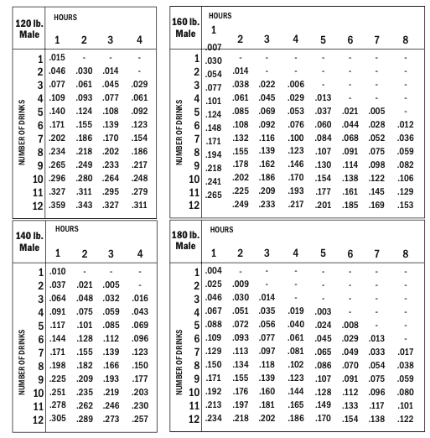
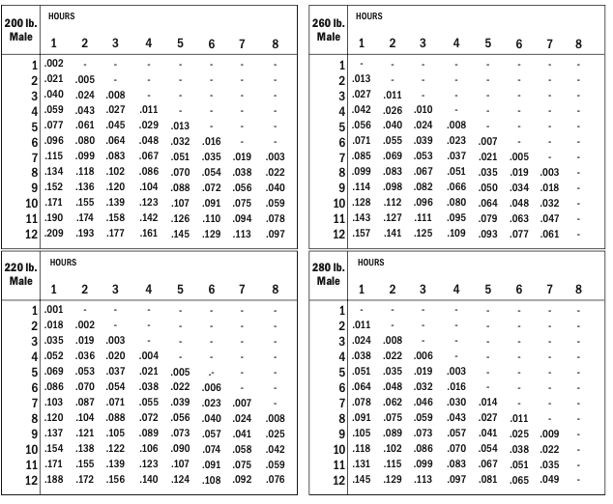
Notes:
Show slides BAL charts for men and explain how to read them.
Share:
It should be noted that the effects of each drink on BAL are cumulative. Most people require more than one hour to metabolize one drink. The reason for this is that the liver can metabolize only a small amount of alcohol each hour, and it typically falls slowly behind. Likewise, the number of drinks one needs to consume to maintain a constant BAL decreases with each hour.
BAL is specific to weight and sex (as indicated on the charts).
BAL tables are ESTIMATES only. The exact level of intoxication depends on everything from sex to food intake to muscle-to-fat ratio to amount of alcohol, etc. Therefore, the charts should not be used to determine whether or not someone should be permitted to drive.
Share:
Now that we know how BAC works, use this BAC chart to calculate what your possible BAC was the night you consumed the most.
Ask:
Was anyone surprised or concerned about their BAC that night?

Slide 45
Notes:
Distribute the BAL charts and explain how to read them.
It should be noted that the effects of each drink on BAL are cumulative. Most people require more than one hour to metabolize one drink. The reason for this is that the liver can metabolize only a small amount of alcohol each hour, and it typically falls slowly behind. Likewise, the number of drinks one needs to consume to maintain a constant BAL decreases with each hour.
BAL is specific to weight and sex (as indicated on the charts).
BAL tables are ESTIMATES only. The exact level of intoxication depends on everything from sex to food intake to muscle-to-fat ratio to amount of alcohol, etc. Therefore, the charts should not be used to determine whether or not someone should be permitted to drive.

Slide 46
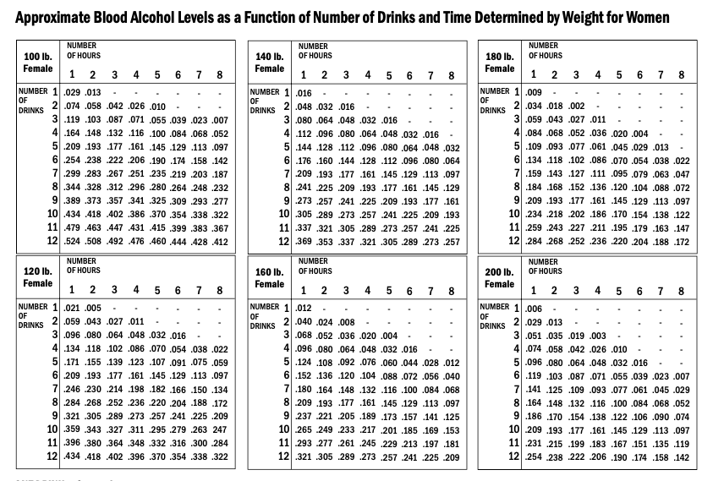
Notes:
Share:
This is a BAC chart for women.
Now using this information, we will compare the two.

Slide 47
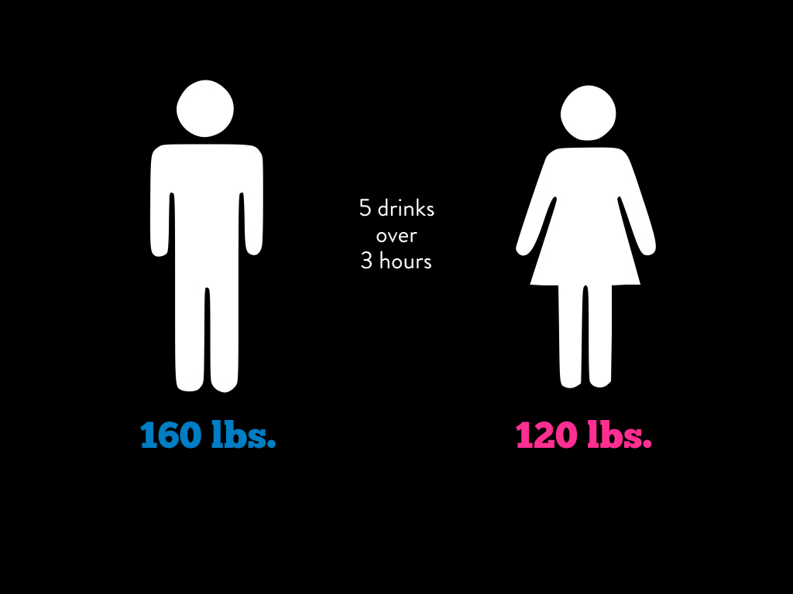
Notes:
Ask:
If a 160 lb. man and a 120 lb. woman…
Have five drinks over three hours, what will their BAL be?
Why does the woman attain a BAL twice that of the man?
Share:
Different fluid volume – It is estimated that, whereas an average male body is composed of approximately 60% water, an average female body is only 50% water (because women have a higher body fat content than men). Lower fluid volumes in women result in a higher concentration of alcohol in the bloodstream.
Different enzyme levels – Levels of gastric alcohol dehydrogenase — an enzyme that aids in the decomposition of alcohol — are significantly lower in women than in men.
Different hormone levels – A woman’s hormone level change during the luteal phase of her menstrual cycle (typically days 23-28), such that she will get more intoxicated and stay intoxicated longer during this phase. This is also true for women taking oral contraceptives.
Please note that BAL is affected by birth sex rather than gender identity

Slide 48
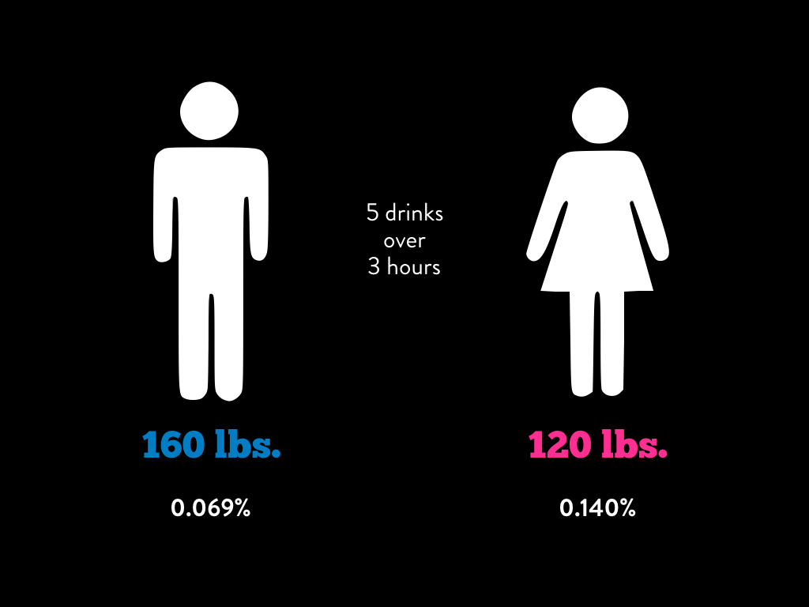
Notes:
Ask:
If a 160 lb. man and a 120 lb. woman…
Have five drinks over three hours, what will their BAL be?
Why does the woman attain a BAL twice that of the man?
Share:
Different fluid volume – It is estimated that, whereas an average male body is composed of approximately 60% water, an average female body is only 50% water (because women have a higher body fat content than men). Lower fluid volumes in women result in a higher concentration of alcohol in the bloodstream.
Different enzyme levels – Levels of gastric alcohol dehydrogenase — an enzyme that aids in the decomposition of alcohol — are significantly lower in women than in men.
Different hormone levels – A woman’s hormone level change during the luteal phase of her menstrual cycle (typically days 23-28), such that she will get more intoxicated and stay intoxicated longer during this phase. This is also true for women taking oral contraceptives.
Please note that BAL is affected by birth sex rather than gender identity

Slide 49
Notes:
Share:
There is frequently a lot of “drink matching” at parties between men and women. Thus, it is important to recognize that women are not on the same level as men when it comes to the effects of alcohol on their bodies.

Slide 50
Notes:
Ask:
How would you define tolerance?
Share:
When someone develops tolerance, it means that over time, they have to drink more alcohol to get the effects they would normally expect at a lower BAL. Or, consequently, the same amount of alcohol does not produce the effect it did in the past.
It is important to note that tolerance is not the same as BAL. Someone who is not experiencing the expected effects at her current BAL is not any less drunk.
For example, two people or the same weight and sex who have been drinking at the same rate will reach the same BAL, even if one has developed tolerance and the other hasn’t.

Slide 51
Notes:
Ask:
Who is familiar with Pavlov’s study? What do you know about it?
Share:
Pavlov studied the impact of environmental cues on his dog’s behavior. In his experiment, the ringing of a bell made the dog’s mouth water, even in the absence of food.
What connection can we make between Pavlovian conditioning and tolerance?
The bell used in Pavlov’s experiment could be some environmental cue for us. This experiment illustrates the adage, “Know what you bring to the table and what the table brings to you.”
One study showed that participants failed to exhibit the same level of tolerance when drinking a smurf blue liquid as they did when drinking a liquid perceived as “beer-like.”
Another study showed that smokers who re-arranged their houses when they quit smoking experienced fewer cravings and had increased success with quitting.
Siegel, S. & Ramos, B.M.C. (2002). Applying laboratory research: Drug anticipation and the treatment of drug addiction. Experimental and Clinical Psychopharmacology, 10, 162-183. (http://alcoholism.about.com/cs/alerts/l/blnaa28.htm)

Slide 52
Notes:
Share:
Current research on tolerance shows that while tolerance is part physiological, it is largely influenced by the environment. Studies show that in a novel or new setting, people failed to exhibit the same amount of tolerance they did in their usual or familiar settings.
Ask:
How does this concept of tolerance impact events hosted in unfamiliar settings (i.e. semi-formals, Rose Balls, spring break trips)?

Slide 53
Notes:
Ask:
What are the Perceived Advantages of a higher tolerance? – Remember that there are no scientific advantages to an increased tolerance. Thus, the advantages a student will share will be perceived advantages.
What are the Disadvantages of a higher tolerance? – When people with a low-to-average tolerance have too much alcohol, their bodies let them know (they get dizzy, nauseated, etc.). In essence, they receive cues that suggest they should slow down or stop drinking. Because people who have developed tolerance don’t experience these negative reactions, they drink without the cues that would alert many to stop.
Tolerance can give people a false sense of security. People with tolerance may be unaware of how impaired they really are (i.e. how high their BAL actually is) and may drink to a near-lethal dose without getting the cues that would normally prompt them to stop.
It’s also more expensive to drink five drinks in order to feel a buzz, compared to only have to drink two drinks.
Thus, tolerance results in an increase in negative health risks.
A person can gain or lose tolerance. How do you lose it? Take time away form consuming alcohol.
Take Aways:
Decision making worsens the more you drink, including decisions about when you should call it a night.
Numerous factors contribute to alcohol affecting men and women differently.
Tolerance does not mean that a person can “handle their alcohol better.”
Tolerance in one setting may not follow the person to another setting.

Slide 54
Notes:
Discuss:
If you have consumed alcohol before, think about what it feels like to have a buzz. When people lose their buzz, what do they do? (Let them answer first) Usually drink more, right? Or take more shots?
Do they ever get that same buzz back? (Let them answer first) The answer is no, it doesn’t ever feel the same. Let me explain.

Slide 55
Notes:
Share:
When consuming alcohol, the body experiences a stimulating, energizing effect, which you might consider to be a positive effect of alcohol. The energizing feeling is followed by the depressant effects of alcohol, which you might consider this to be the negative effect of alcohol.
Every time alcohol is introduced into the system, the biphasic effect or biphasic curve follows. So, imagine each curve as consuming some alcohol. First, it stimulates and then a depressant effect occurs. This would be your standard buzz feeling.
The cultural myth about alcohol is that the more we drink, the better we feel. The biphasic effect, however, demonstrates that this isn’t the case. Instead, we should remember that feeling good is about not feeling bad.
In fact, there is a point at which the "positives" have been maximized and the "negatives" have been minimized. Continued consumption of alcohol beyond this point results In greater and greater "negative" effects and fewer and fewer "positive" effects.
Thus, there is a point of diminishing returns
The point of diminishing returns occurs between 0.05% and 0.06% BAL.
Share:
What does all of this mean?
If you currently drink at or below the point of diminishing returns, you should stay at this point if you haven’t experienced problems associated with drinking.
Most importantly, everyone must find his/her own limit based on what he wants to get out of drinking.
One more drink will not do you any good, it will in fact make the "negatives" worse.
Ask:
What is a hangover?
There are three hypotheses: (1) The blow to the system that gets more pronounced after 0.06%; (2) Dehydration – alcohol is a diuretic; and (3) Congeners (imperfections in the alcohol – more in dark liquors than light liquors)

Slide 56
Notes:
Share:
We have spent the majority of our time together learning about alcohol and its effects, but I want you to be aware of how dangerous mixing alcohol and drugs can be and the consequences that come with combining the two.

Slide 57
Notes:
Share:
Potentiation- This is the interaction that results from the combination of two drugs that act in the same direction, such as two stimulants or two depressants.
Examples would be alcohol + marijuana, alcohol + vicodin, alcohol + xanax
The effects of two drugs on the central nervous system can lead to an overdose, even if the dose is typical of previous doses consumed.
Effects on the brain:
Hippocampus – attention, concentration, memory
Research with college students shows impact on these cognitive abilities even 24 hours after last use (Harrison Pope research)
After daily use, takes 28 days of abstinence for cognitive performance to match that of non-users
Additional Information on Marijuana and Cognitive Abilities:
MTF (Johnston, et al., 2011) past year use of:
Marijuana: 33%
Tobacco cigarette: 28%

Slide 58
Notes:
Share:
Antagonistic- This is the interaction that results from the combination of two drugs that act In opposite directions. This would be a stimulant and depressant used at the same time. (
Examples of this would be alcohol + cocaine, alcohol + adderall/ritalin, alcohol + energy drinks
Energy Drinks: If they are mixing energy drinks with alcohol, energy drinks are usually loaded with caffeine, so the diuretic properties are worsened (i.e., you're mixing caffeine, which dehydrates people, with alcohol, which dehydrates people). This can actually worsen day aftereffects. Additionally, the cues that would let someone know how much of a depressant they've ingested (e.g., alcohol), are being masked by the presence of a stimulant (in this case, caffeine). So, it could lead to drinking more. More alcohol can lead to obtaining a higher BAL which, in and of itself, can lead to feeling worse the next day.
Alcohol and cocaine when used together is the most lethal two drug combination.
Consuming drugs with an antagonistic interaction put the nervous system in a physiological "tug of war."
Additionally, if one drug leaves the system more quickly than the other, a person may be left with a lethal dose of one of those drugs in their system.
The use of multiple drugs can lead to dangerous interactions.
Things like caffeine can mask how impaired someone actually is.

Slide 59
Notes:
What are the consequences that could be experienced as a result of alcohol use?
Academic failure
Black outs
Hangovers
Weight gain
Tolerance
Poor decision-making
Impaired sleep
Passing out is different from falling asleep
There are five stages of sleep (REM, Stage 1, Stage 2, Stage 3, and Stage 4)
Good sleep involves a balance across all five stages where the individual is gradually phased out of the deeper (Stage 4, 3, 2) levels of sleep
If you fall asleep intoxicated and remain intoxicated until you wake up, your body never reaches REM sleep and thus you don’t experience dreaming
If you sober up while sleeping, your body attempts to catch up on REM sleep. Thus, you remember very vivid dream just before waking up.
The next day, you likely experience an increase in daytime sleepiness, anxiety, irritability, and jumpiness. You also feel fatigue.
That night (the night after dreaming), your body attempts to catch up on REM sleep, again resulting in the wrong balance of each stage.
It’s not until your third night after a drinking occasion where you went to sleep intoxicated when you finally get “good” sleep.
Sexual assault
Finances
Alcohol-related accidents
Time wasted/spent intoxicated
Strain on relationships
Legal problems
Work-related programs

Slide 60
Notes:
Share:
We know most incidents of sexual misconduct involve alcohol in some form or fashion. Here are some ways to reduce your risk around sex.

Slide 61
Notes:
Share:
Here are some strategies on reducing the risk of drinking and driving.

Slide 62
Notes:
So, now that we’ve discuss potential consequences? Here are are few things we can do to reduce our risk of experiencing them

Slide 63
Notes:
These are some strategies to reduce the amount of alcohol you consume.
Ask: Which of these strategies would work for you?

Slide 64
Notes:
`

