Slide 1
Jeopardy! Tutorial
This template is ready to us. Add 5 questions & answers related to Chapter History on slides 57-66. Simply click in the text box to add your questions and answers. To begin, enter full screen on Slide 3.
Once a question has been answered, click the amount the question was worth to return to the home screen.
Please do not delete whole slides, otherwise we can not guarantee a smooth game experience and problems may occur.
Have a lot of fun with our JEOPARDY! game!

Slide 2
Rules of Jeopardy!
To start the game, click on the first Jeopardy! Slide and start the presentation by clicking on the menu Slide Show > From Current Slide.
Now the intro with music starts playing and you only must click one more time to run the begin animation. When the second money board appears, the first player can choose the category and money- value by clicking on the field. (With the increasing amount of money, the difficulty of the questions also increases!)
As soon the question appears, the players have 30 seconds to think about it. (until music ends) When one person raises his arm (or shouts) he/ she can answer. Answers must be phrased as questions, unless it’s said differently.
Right answer? Then the player gets the amount of money, the question is worth. Take a sheet and write down the value to the persons' name. If he guessed it wrong, the other players could try their luck. If time runs out, or no one got it, no one will get any points. The person with the highest amount of money, wins.
Advanced version: guessing it wrong will subtract the amount of money from the players account; negative values are also accurate.

Slide 4
PLEASE CLICK TO START THE GAME!

Slide 5
$ 200
$ 200
$ 200
$ 200
$ 200
$ 400
$ 400
$ 400
$ 400
$ 400
$ 600
$ 600
$ 600
$ 600
$ 600
$ 800
$ 800
$ 800
$ 800
$ 800
$ 1000
$ 1000
$ 1000
$ 1000
$ 1000

Slide 7
FRATERNAL HISTORY

Slide 9
THE FOUNDING OF PI KAPPA PHI

Slide 11
THE 20th CENTURY

Slide 13
THE 21st CENTURY

Slide 15
CHAPTER HISTORY

Slide 16
Fraternal History
Founding of Pi KappaPhi
The 20th Century
The 21st Century
Chapter History
YOU FINISHED THIS GAME
TIME TO COUNT THE MONEY!

Slide 17
True or False: The idea of “the college fraternity” originated in Europe before becoming popular in the United States.
Click here for the answer

Slide 18
Solution:
FALSE
$ 200

Slide 19
Name the organization that regularly met in the Raleigh Tavern to escape the academic rigors of The College of William & Mary.
Click here for the answer

Slide 20
Solution:
WHO IS THE THE FLAT HAT CLUB ?
$ 400

Slide 21
Founded by John Heath in December 1776.
I created many characteristics that mark the modern fraternity.
My second chapter was opened at Yale University in 1780.
I was forced to divulge my secrets in the 1830s.
Click here for the answer

Slide 22
Solution:
WHO IS PHI BETA KAPPA?
$ 600

Slide 23
Three fraternities that formed “The Union Triad.”
Click here for the answer

Slide 24
Solution:
WHO ARE KAPPA ALPHA SOCIETY, SIGMA PHI, AND DELTA PHI?
$ 800

Slide 25
Three fraternities that formed “The Miami Triad.”
Click here for the answer

Slide 26
Solution:
WHO ARE BETA THETA PI, PHI DELTA THETA, AND SIGMA CHI?
$ 1000

Slide 27
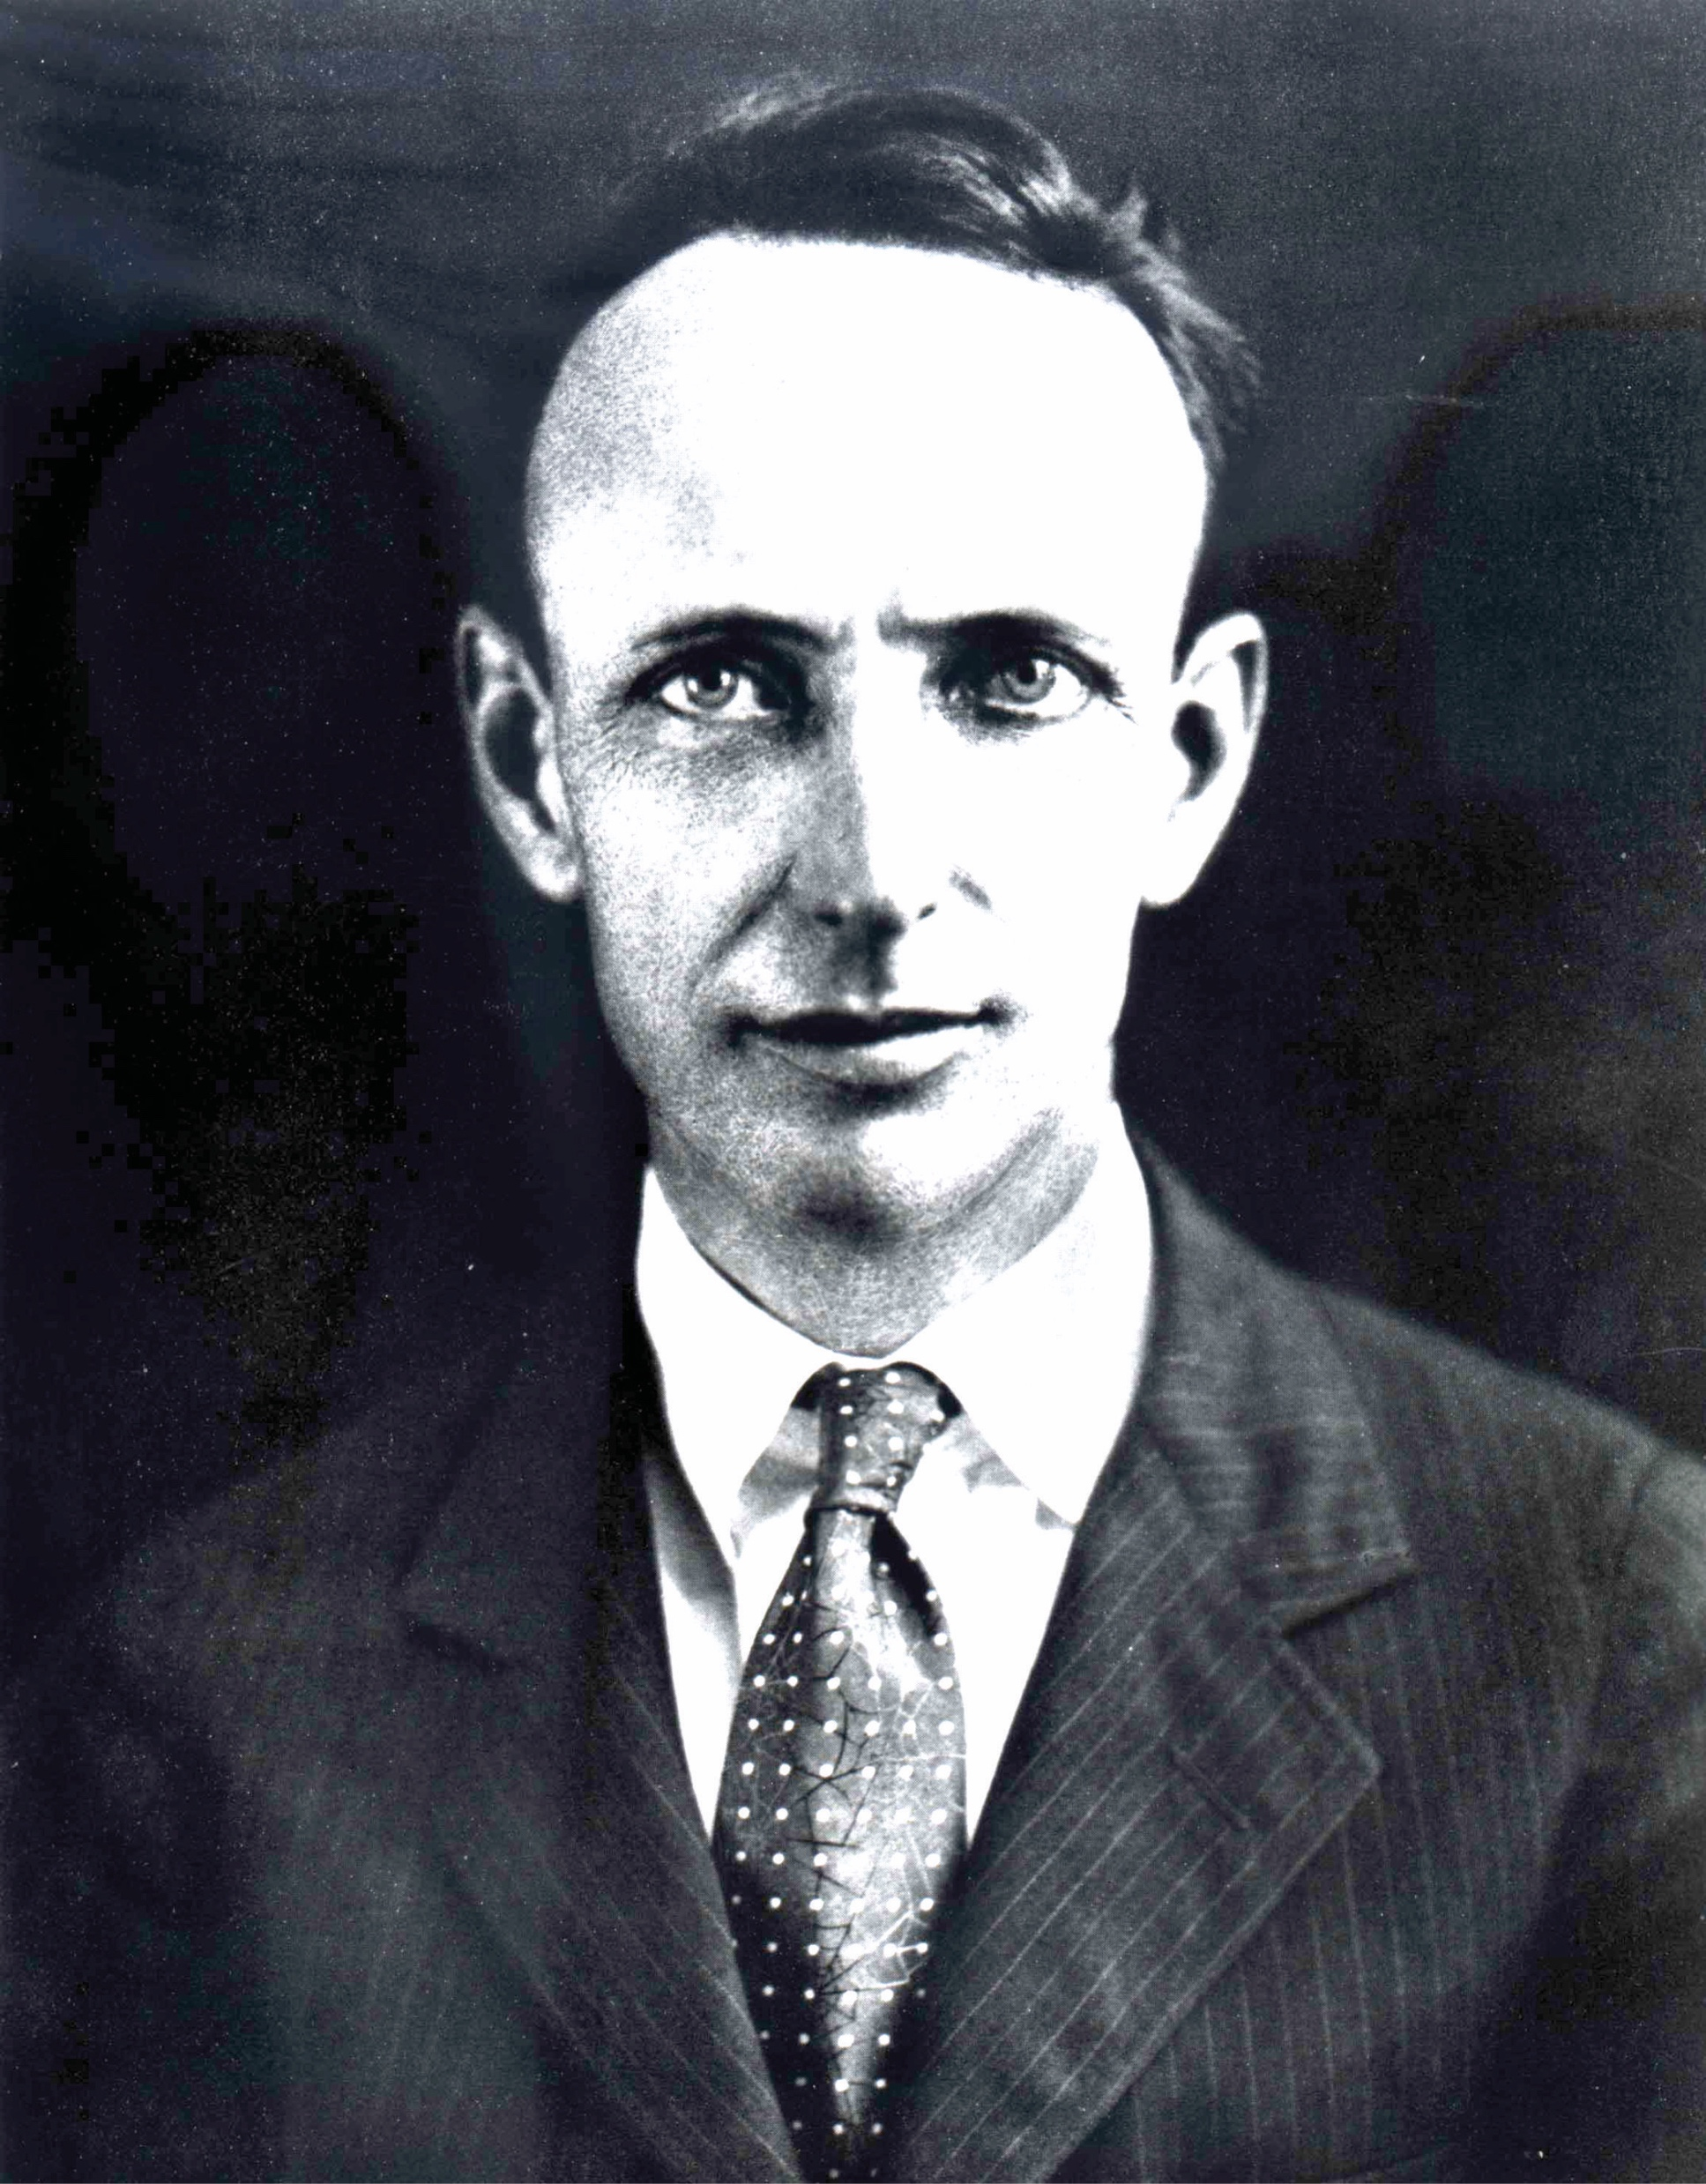
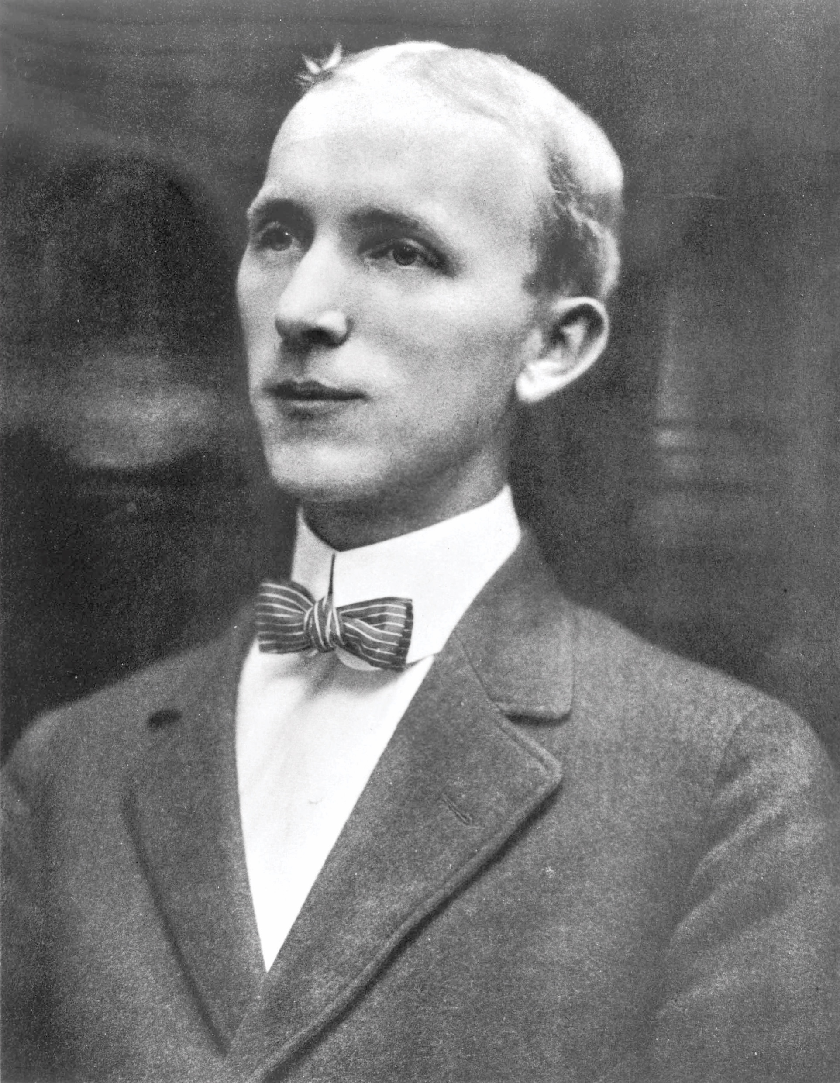
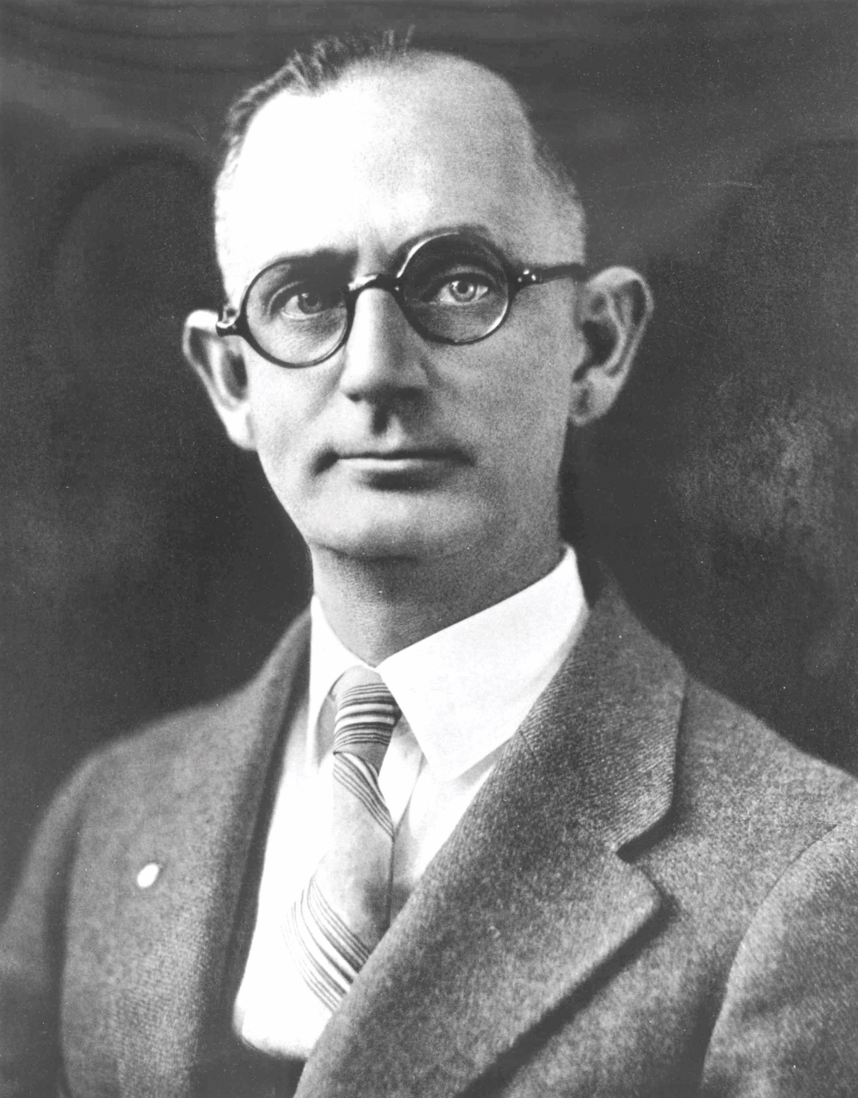
Click here for the answer

Slide 28
Solution:
WHIO IS SIMON FOGARTY, JR., ANDREW ALEXANDER GROEG, JR., & LAWRENCE HARRY MIXON?
$ 200

Slide 29
OPPOSE THE FRATERNITY SLATE, ELECT FOUNDERS KROEG, FOGARTY, AND MIXSON AS OFFICERS IN THE CRESTOMATHIC LITERARY SOCIETY
Click here for the answer

Slide 30
Solution:
WHAT WAS THE PURPOSE OF NU PHI?
$ 400

Slide 31
TRUE OR FALSE: PI KAPPA PHI WAS FOUNDED AT 90 BROAD STREET, THE FAMILY HOME OF FOUNDER MIXSON, ON DECEMBER 10, 1904.
Click here for the answer

Slide 32
Solution:
FALSE
90 Broad Street was the family home of founder Fogarty
$ 600

Slide 33
Pi Kappa Phi was founded by seven men. Andrew Alexander Kroeg Jr., Lawrence Harry Mixson, and Simon Fogarty Jr. were three. What were the names of the others?
Click here for the answer

Slide 34
Solution:
WHO IS THEODORE BARNWELL KELLY, A. PELZER WAGENER, THOMAS F. MOSIMANN, & JAMES FOGARTY?
$ 800

Slide 35
How many students were enrolled at the College of Charleston in 1904?
Click here for the answer

Slide 36
Solution:
What is 72 students?
$ 1000

Slide 37
WHICH THREE FOUNDERS ARE ATTRIBUTED WITH AUTHORING PI KAPPA PHI’S RITUAL OF INITIATION?
Click here for the answer

Slide 38
Solution:
WHO IS A. PELZER WAGENER, LAWRENCE HARRY MIXSON, AND SIMON FOGARTY JR.?
$ 200

Slide 39
PI KAPPA PHI WAS TRULY ESTABLISHED AS A NATIONAL FRATERNITY WHEN FOUNDER THEODORE BARNWELL KELLY CHARTERED THE GAMMA CHAPTER AT THIS UNIVERSITY ON THE WEST COAST.
Click here for the answer

Slide 40
Solution:
WHERE IS UC – BERKELEY?
$ 400

Slide 41
DURING EACH MILESTONE ANNIVERSARY, PI KAPPA PHI GAVE GIFTS TO THE COLLEGE OF CHARLESTON. NAME EACH GIFT IN THE ORDER IN WHICH IT WAS GIVEN.
Click here for the answer

Slide 42
Solution:
WHAT IS GATE (25), CLOCK (50), ROSE GARDEN (75), & BELLTOWER (CENTENNIAL)?
$ 600

Slide 43
INITIATED INTO THE XI CHAPTER AT ROANOKE COLLEGE.
HIRED AS PI KAPPA PHI’S EXECUTIVE SECRETARY IN 1959.
AT THE TIME OF MY RETIREMENT, 78 PERCENT OF ALL OF THE FRATERNITY’S MEMBERS WERE INITIATED WHILE I SERVED AS EXECUTIVE DIRECTOR.
I WAS NAMED HONORARY FOURTH FOUNDER BY THE 44TH SUPREME CHAPTER.
Click here for the answer

Slide 44
Solution:
WHO IS EXECUTIVE DIRECTOR EMERITUS
DURWARD W. OWEN?
$ 800

Slide 45
This organization, founded in partnership with artist and architect Thomas Sayre, is the only philanthropy founded and sustained by a fraternity or sorority.
Click here for the answer

Slide 46
Solution:
WHAT IS THE ABILITY EXPERIENCE?
$ 1000

Slide 47
Initiated into the Alpha Epsilon Chapter at the University of Florida.
I was installed as the Fraternity’s eighth Executive Director in 1994 and as Chief Executive Officer in 1995.
I continue to serve the Fraternity from the National Headquarters.
Click here for the answer

Slide 48
Solution:
WHO IS MARK E. TIMMES?
$ 200

Slide 49
TRUE OR FALSE: The Kelley A. Bergstrom Leadership Center of Pi Kappa Phi – our Fraternity’s National Headquarters – is located in Charleston, South Carolina.
Click here for the answer

Slide 50
Solution:
FALSE
$ 400

Slide 51
Redesigned in 2010, this national program empowers the Fraternity’s rising sophomores and juniors to make their chapter more like an ideal chapter.
Click here for the answer

Slide 52
Solution:
WHAT IS PI KAPP COLLEGE FOR EMERGING LEADERS?
$ 600

Slide 53
Adopted in 2014, this strategic plan charts Pi Kappa Phi’s path in seven areas of focus: student experience, alumni engagement, growth, chapter quality & support, branding & communication, funding, and governance.
Click here for the answer

Slide 54
Solution:
WHAT IS UNCOMMON LEADERSHIP?
$ 800

Slide 55
Under the leadership of this National President, Pi Kappa Phi adopted an updated risk management policy, a shared associate member education experience, and banned hard alcohol in chapter facilities and at chapter events.
Click here for the answer

Slide 56
Solution:
WHO IS JEREMY D. GALVIN, ALPHA OMICRON (IOWA STATE)?
$ 1000

Slide 57
Insert question about chapter history.
Click here for the answer

Slide 58
Solution:
Insert answer to previous slide’s question about chapter history.
$ 200

Slide 59
Insert question about chapter history.
Click here for the answer

Slide 60
Solution:
Insert answer to previous slide’s question about chapter history.
$ 400

Slide 61
Insert question about chapter history.
Click here for the answer

Slide 62
Solution:
Insert answer to previous slide’s question about chapter history.
$ 600

Slide 63
Insert question about chapter history.
Click here for the answer

Slide 64
Solution:
Insert answer to previous slide’s question about chapter history.
$ 800

Slide 65
Insert question about chapter history.
Click here for the answer

Slide 66
Solution:
Insert answer to previous slide’s question about chapter history.
$ 1000

